Slide 1


Welcome
Brig. Gen. J. Roy Robinson (Ret.)
NGAUS President

Slide 2
Legislative Update
Col. Mike Hadley (Ret.)
Vice President, Government Affairs

Slide 3









Agenda
Mission
Organizational Structure
Legislative Team
Strategic Overview
Resolutions
Notable FY21 Accomplishments
Priorities for a 21st Century National Guard
Congressional Cycle Overview

Slide 4


Mission
Serve as a strong advocate for National Guard service members, their families, and veterans in Washington, D.C.
Continuously improve National Guard readiness, modernization, and quality of life within the Total Force
Preserve and promote the National Guard’s rich militia heritage as the first military organization of the U.S.

Slide 5
Organizational Structure
Board of Directors
NGAUS President
Chief of Staff
Executive Staff
Legislation
Communications
Membership & Marketing
Industry Relations
Contracts/Finance/HR
Vice President
Director
Director
Director
Director
Legislative Staff
Communications Staff
Membership Staff
Industry Relations Staff
Finance Staff

Slide 6
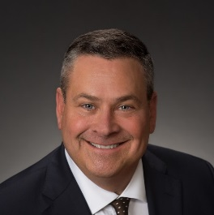


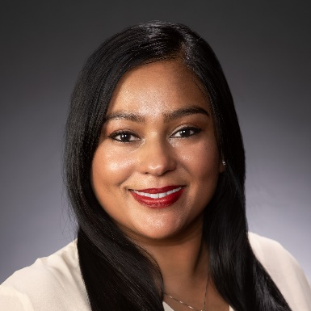

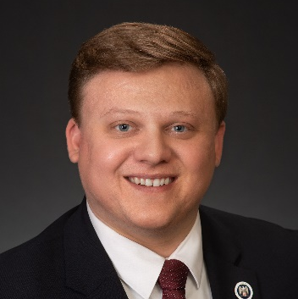
Legislative Team
BG (Ret) Roy Robinson
NGAUS President
COL (Ret) Mike Hadley
Vice President, Government Affairs
JC Cardinale
Legislative Affairs Manager
Joint & Personnel Programs
Priya Ghosh Ahola
Legislative Affairs Manager
Air National Guard Programs
Marcy Weldin
Legislative Affairs Manager
Army National Guard Programs
Blaise Lemke
Legislative Analyst

Slide 7





Strategic Overview
Advocacy
Apolitical & Non-Partisan
  Collaboration with:
  DoD, NGB, VA and DHS
  Military Service Organizations, Veteran Service Organizations
  Lobby for National Guard equipment parity and benefits equity
  Develop strong relationships with Congress and staff
  Grassroots engagement

Slide 8
Resolutions Process
Dec.
States Draft
Jun.-July
NGAUS Review
July*
NGAUS BoD Review
Aug./Sep.
NGAUS Conf. Consideration
Oct.-Nov.
Prioritization/ Leg. Action Plan
Jan.-May
States Approve
Aug.
NGAUS Preps Drafts
*All Drafts Due to NGAUS by June 30

Slide 9
Notable FY21 Accomplishments
Army
$100.0M for ARNG High Mobility Multi-purpose Wheeled Vehicle (HMMWV) modernization program
$884.4M for Joint Light Tactical Vehicles (JLTVs) for the Army
$862.0M for UH-60 Black Hawk M model helicopters for the Army
Air
$570.0M for 6 C-130J Super Hercules aircraft for ANG
$265.5M for C-130H modernization, includes:
  - $180.0M for NP2000 propeller upgrades
  - $79.0M for T-56 Series 3.5 engine modifications
$75.0M for F-16 Viper Active Electronically Scanned Array (AESA) radars for ANG
Joint/Personnel
Allows CNGB to provide annual unfunded priorities list to Congress
Three-month maternity leave including retirement credit and pay for traditional Soldiers and Airmen
Access to VA home loans for Guardsmen who have served on Title 32 orders
Expanded USERRA protections to Guardsmen serving on SAD orders, or responding to a National or Federal Natural Disaster Emergency
$950.0M for the National Guard and Reserve Equipment Account (NGREA), includes:
  - $285.0M for both ARNG and ANG
$7.0 M for the National Guard preventative mental health program

Slide 10



Priorities for a 21st Century National Guard
Ensuring Deployability, Sustainability, and Interoperability with the Active Component through…
The Same Organization
Future Multi-Domain Battlefield Interoperability, including:
  – Deployable & Interoperable Force Structure that is Validated & Doctrinally Consistent
  – Space National Guard as Primary Combat Reserve within Space Force
  – Continued National Guard Integration into Total Force Cyber Mission & Training
The Same Equipment
Deployable, Interoperable & Sustainable Equipment
Concurrent & Proportional Fielding of Equipment to the National Guard, including:
  – UH-60M, F-35A, KC-46A & C-130J Procurement
National Guard Equipment Modernization & Recapitalization, including:
– HMMWV, M1 & M2, C-130H, A-10, F-15 & F-16 Modernization
The Same Resources and Benefits
Zero Cost TRICARE to Ensure Reserve Component Medical Readiness
Post 9/11 GI Bill Parity
Robust National Guard & Reserve Equipment Account (NGREA) Funding
Tax Incentives for Guardsmen & Employers
Ready Access to Mental Health Care & Suicide Prevention
Increased National Guard Military Construction (MILCON) Funding

Slide 11
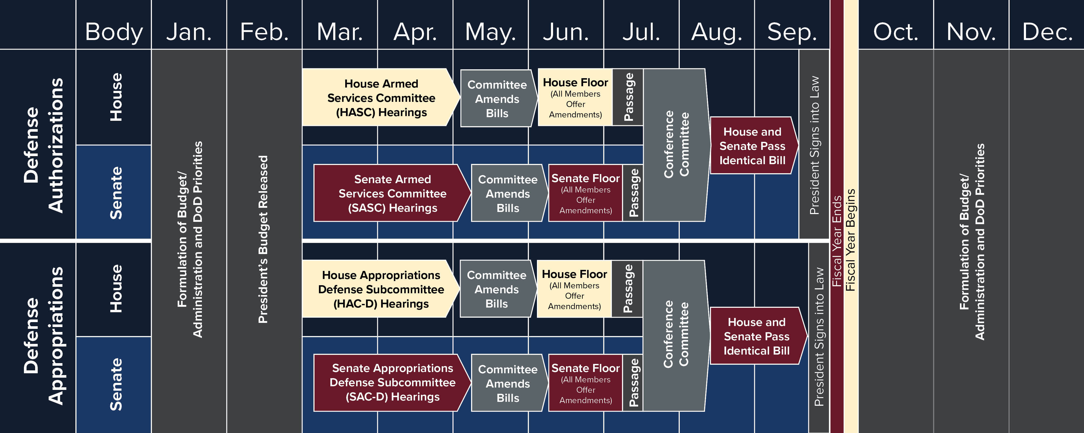
Defense Congressional Cycle
CURRENT ACTIVITY
CURRENT
ACTIVITY

Slide 12
Legislative Update
Authorizations
S.1605 – National Defense Authorization Act for Fiscal Year 2022
  President signed into law on 27 December 2021
  Authorizes $950.0M total NGREA
  Authorizes all unfunded priorities requested by the Chief, National Guard Bureau
Appropriations
H.R.4432 - Department of Defense Appropriations Bill, 2022
  $950M total NGREA; $285M for the ARNG, $285M for the ANG
  Introduced in the House on 15 July
  Next Step: Considered by the full House
H.R.4432 - Department of Defense Appropriations Bill, 2022
  $1.45B total NGREA; $435M for the ARNG, $435M for the ANG
  Introduced in the Senate on 20 October
  Next Step: Considered by the full Senate
H.R.6119 – Continuing Resolution
  Provides stopgap funding for the Federal Government until 18 February 2022

Slide 13
Legislative Update
H.R.3512 – Healthcare for our Troops Act
  Provides Zero-Cost TRICARE Reserve Select and dental coverage for all members of the RC
  Authorizes TRS eligibility for RC servicemembers who are federal employees in their civilian capacity
H.R.1836 – Guard and Reserve GI Bill Parity Act
  Provides GI Bill education benefits parity between the Active and Reserve Components
S.1297 – Record of Military Service for Members of the Armed Forces Act of 2021
  Provides definitive record of service (DD-214) for members of the RC for titles 14 and 32
  Standardizes proof of service across all compos making it easier for Guardsmen to receive benefits
S.1859/H.R.3626 – Reserve Component bonus and incentive pay
  Ensures bonus and incentive pay parity between AC and RC servicemembers
S.3215 – USACE Military Personnel Augmentation Act of 2021
  Expands USACE eligibility to all Warrant Officers and Enlisted members

Slide 14


Legislative Outreach Programs
Next Summit: July 17-20, 2022
Targeted towards Company Grade and Warrant Officers from the 54
Goals:
  Elevate CGOs view from the State to the National level highlighting challenges faced across the 54.
  Increase CGO involvement and advocacy at the grassroots level
Short Video:
https://www.youtube.com/watch?v=h8Xmn1nUvZE
Next Workshop: February 10th, 2022
Targeted towards CACOs, Executive Directors and Presidents of the 54 Associations
Goal:
  Inform audience of NGAUS Legislative Priorities and efforts syncing messaging across the 54.

Slide 15


What Can You Do?
Get Informed
Communicate & Socialize
State & District Congressional Staff Outreach

Slide 16
Questions?
Col. Mike Hadley (Ret.)
Mike.Hadley@ngaus.org

Slide 17
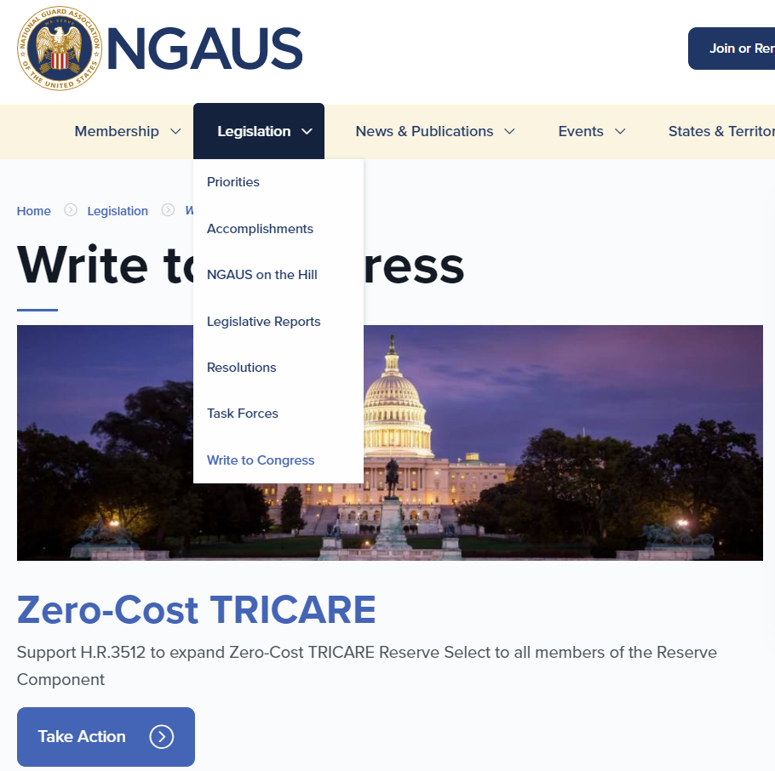
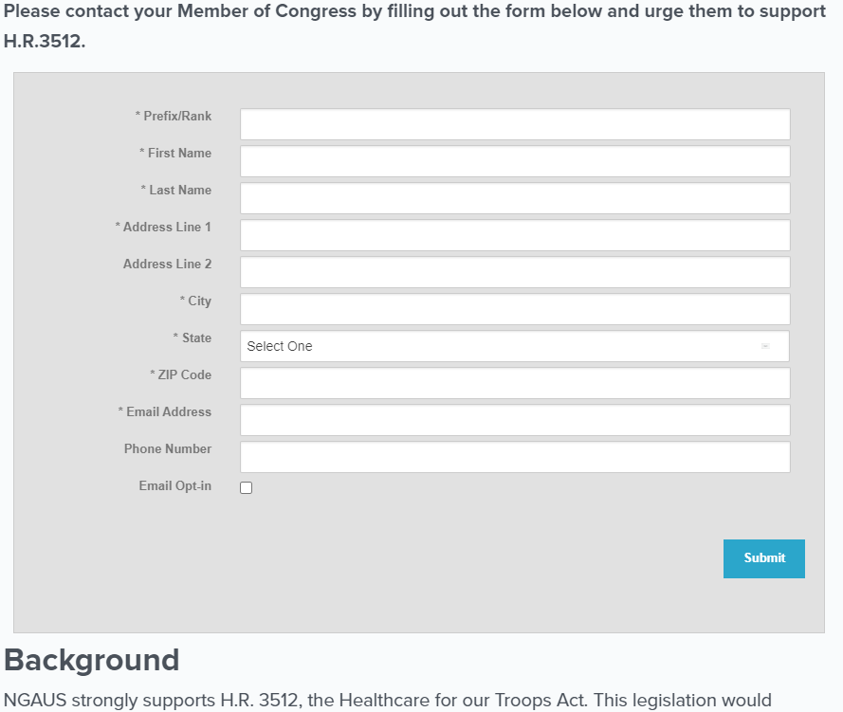
NGAUS Write to Congress
H.R.3512 – Health Care for our Troops Act

Slide 18
117th Congress, First Session Overview
House of Representatives - 221-211 Democratic Majority
Senate - 50-50 split, Democratic control under 2021 US Senate Power-Sharing Agreement
President’s Budget released May 28, 2021
New Chairs in SASC, HASC, SAC-D, HAC-D, SVAC, HVAC
Committee | Senate Chair | Senate Co-Chair/Ranking Member | House Chair | House Ranking Member
Armed Services | Jack Reed (D-RI) | Jim Inhofe (R-OK) | Adam Smith (D-WA) | Mike Rogers (R-AL)*
Appropriations | Patrick Leahy (D-VT) | Richard Shelby (R-AL) | Rosa DeLauro (D-CT)* | Kay Granger (R-TX)
Defense Subcommittee | Jon Tester (D-MT)* | Richard Shelby (R-AL) | Betty McCollum (D-MN)* | Ken Calvert (R-CA)
VA/MILCON Subcommittee | Martin Heinrich (D-NM)* | John Boozman (R-AR) | Debbie Wasserman Schultz (D-FL) | John Carter (R-TX)
Veterans’ Affairs | John Tester (D-MT) | Jerry Moran (R-KS)* | Mark Takano (D-CA) | Mike Bost (R-IL)*

Slide 19
NGAUS Insurance Trust
Luke Guthrie
Director, NGIT & NGEF

Slide 20

Overview
NGAUS Insurance Trust was created in 1963 to make insurance programs available to the technician community.
The NGAUS Insurance Trust offers Disability Insurance and only Technicians and Title 5 National Guard employees are eligible for this plan.
About 5,000 are currently are enrolled in the plan.
Coverage in 53 states and territories and the District of Columbia

Slide 21
Technician Disability Income Insurance
National Guard Technicians and Title 5 employees under the age of 65 are eligible for affordable group rates.
New hires that apply within their first 31 days of employment are guaranteed acceptance into the plan.
Basic and Supplemental plans – Technician can get up to $4,500 per month, depending on salary, should they become disabled

Slide 22
Common Causes of Disability
Accidental injury
Heart Disease
Cancer
Arthritis
Musculoskeletal Disorders
Stroke
Basic disability benefits kick in after 30 consecutive days of disability and continue for up to 10 years for an injury and up to 3 years for sickness.
Supplemental benefits begin after 60 days (under age 40) and or after 90 days (over age 40) and continue for up to 10 years for an injury and up to 3 years for sickness.
If over the age of 60, the maximum benefit period is 12 months.

Slide 23
Plan Enhancements
Expanded salary ranges and benefits for Technicians and Title 5’s
Increased the maximum age from 60 to 65
Created new and improved marketing materials
Increased the AD&D benefit from $1,000 to $2,500
Benefit Briefing Solutions, LLC provides marketing services

Slide 24
State Engagement
We revenue-share with State Associations & EANGUS
More than $100,000 each year – revenue back to the states, territories and DC
State Partner Program – 45 states (One-time $50 per new insured)

Slide 25
Insurance State Partners
Alaska | Arizona | Arkansas | California
Colorado | Connecticut | District of Columbia | Delaware
Florida | Georgia | Hawaii | Illinois
Indiana | Iowa | Kansas | Kentucky
Maryland | Massachusetts | Michigan | Minnesota
Missouri | Montana | Nebraska | Nevada
New Jersey | New Mexico | New York | North Carolina
North Dakota | Ohio | Oklahoma | Oregon
Pennsylvania | Puerto Rico | South Carolina | South Dakota
Tennessee | Utah | Virginia | Virgin Islands
Vermont | Washington | West Virginia | Wisconsin
Wyoming

Slide 26
Questions?
Luke Guthrie
Luke.guthrie@ngaus.org

Slide 27
Serving Your Association
Membership 101
BG (Ret) Maria Kelly, NGAUS
Director of Membership and Marketing

Slide 28
Agenda
NGAUS - State Relationship
Why Membership is Important
Engaging as Leader Responsibility

Slide 29
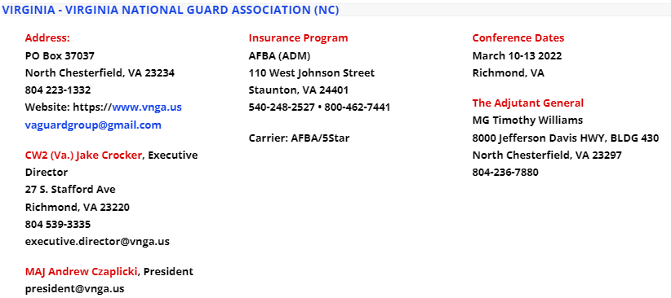
NGAUS –State Association Relationship
NGAUS – An “Association of Associations”

Slide 30
Why Membership is Important
Membership Counts - Literally
Membership strength and % make a statement of values
Demonstrates that as a leader, I am using every proper tool to improve organizational readiness and individual benefits
Gives leaders the opportunity to further develop ourselves by collaboration across services and States

Slide 31
How Can I Engage?
What Does Active Involvement
Look Like?
Active Membership in State and National Associations
Active Participation beginning with the State Association
Engagement in Processes such as Resolutions, Committee Work, Area/Regional Involvement

Slide 32
Membership & Marketing Department
Director
BG (Ret) Maria Kelly
Marketing Manager
Cheyenne Arnold
Database Manager
Melvin Bodmer, Jr.
Customer Service Representative
Vacant

Slide 33
Key Responsibilities
Membership Campaign
Marketing and Digital Communications Campaign
Database Management
Customer Service

Slide 34
Additional Responsibilities
Provide Support to the NGAUS Membership Committee
National Conference Registration Process
Liaison with NGEDA for training and national conference registration and hotel reservations
Host numerous small group training events and visiting groups
Conduct scholarship screening and selection of NGAUS/AFBA Scholars
Manage and link benefits to members

Slide 35

Membership 101

Slide 36
Types of Membership
State Membership
Individual Membership
Corporate Membership
Honorary Membership
Notes:
Newly commissioned, warrant officers and those newly assessed to the NG are eligible to receive a Complimentary membership for a period of one full year and any portion of the year in which they are appointed.

Slide 37
Membership Eligibility
NGAUS Membership is offered to:
All currently serving, separated and retired commissioned and warrant officers of the National Guard
  Complimentary Membership
  Active Annual
  Active Life
  Separated/Retired Life
Enlisted personnel, families and supporters of the National Guard
  Non-voting membership
    Associate Annual
    Associate Life
Notes:
Newly commissioned, warrant officers and those newly accessed to the NG are eligible to receive a Complimentary membership for a period of one full year and any portion of the year in which they are appointed.

Slide 38
Membership Dues
Company Grade | O1, O2, O3, WO1, CW2, CW3 | $40.00
Field Grade | O4, O5, O6, CW4, CW5 | $80.00
Flag Officer | O7, O8, O9, O10 | $130.00
Active Life Membership/Digital Version | $1,000/$500
Active Annual Membership: Dues are collected based on pay grade
Active Life Membership: Paid once or in installments for a lifetime membership
  Monthly Installments available (up to two years to pay off)
  Your Annual Membership can be applied to the Life Payment
Notes:
Annual membership counts for the full year, Jan-Dec. These dues are based on pay grade. Active life memberships can be paid once in full, $250 ever 6 months or $100 for 10 months. If someone is an Active Life Member, they stay an Active Life Member even after retirement or separation. This means the member counts toward their state’s percentage for the rest of their life.

Slide 39
Individual Member Benefits
Scholarships
Educational Events
Professional Development Opportunities
Publications
Insurance Supplements

Slide 40


Scholarships
AFBA/NGAUS Active Life Member Scholarship
  Award two $5,000 scholarships to a NGAUS Active Life Member or their dependent
Grantham University Scholarship
  Two $14,200 scholarships, one for an active Guardsman and NGAUS member and Guardsman ranked 0-5 and below. The second for a spouse of an active member
National Guard Educational Foundation Scholarships
  The Van Hipp Heroes Scholarship Fund
  Leonardo DRS Guardian Scholarship Fund
Notes:
- The NGAUS AFBA Active Life Member Scholarship awards two $5,000 scholarships every July to Active Life members of NGAUS or dependents of Active Life members seeking an undergraduate, graduate or post-graduate degrees. Applicant must be full-time students. The application period runs from March 1 through May 31 and will be available at www.ngaus.org
- NGAUS and Grantham University award two full tuition graduate scholarships annually. One scholarship is for an active NGAUS member and current Guardsman who is a commissioned or warrant officer ranked 0-5 and below. The second scholarship is for a spouse of an active member. Each scholarship is valued up to $14,200, and covers tuition costs, required textbooks, software and fees. Scholarship value depends on degree selected and credits transferred.

Slide 41


Educational Events
144th General Conference and Exhibition
August 26-29, 2022
Join us in Columbus to hear from national defense leaders and conduct important association business..
24th Annual Industry Day
December 2023
NGAUS invites industry leaders to come to the association’s headquarters. Learn how to work with the Guard and gain insight into Guard priorities.
Notes:
From thrilling adventures to moving artistic performances, family play dates and magnetic nightlife, Charlotte holds something for everyone. As we gather to conduct association business and make decisions on the efforts of NGAUS for FY23, we get the opportunity to learn from senior leaders and connect with old friends. Join us in Charlotte for the 143rd General Conference & Exhibition.
Industry Day is a networking event aimed at connecting defense industry representatives with leaders of the Army and Air National Guard. Attended by over 230 people ranging from representatives of some the nation’s leading defense organizations to the owners of emerging small businesses with the intention of building a stronger bond between Guard leaders and industry. The primary goal of the event is to provide attendees with requirements and strategic planning of the National Guard.

Slide 42


Educational Events
Capitol Summit
July 17-20, 2022; October 2022
NGAUS currently offers Army and Air National Guard company-grade officers from each state and territory to the nation’s capital for a close look at how the government works and the role NGAUS plays in the legislative process.
Legislative Workshop – February 10, 2022
An annual professional development event to educate Guardsmen, Congressional Action Contact Officers (CACOs), and National Guard State Association POCs on National Guard issues in Congress and the Department of Defense.
Notes:
The fly-ins to Washington, D.C., is one of three officer professional-development programs NGAUS currently offers Army and Air National Guard company-grade officers. The program brings Guardsmen from each state and territory to the nation’s capital for a close look at how the government works and the role NGAUS plays in the legislative process. Interested officers should contact their state or territory association executive director or president.
The NGAUS Legislative Workshop is an annual professional development event to educate Guardsmen, Congressional Action Contact Officers (CACOs), and National Guard State Association POCs on National Guard issues in Congress and the Department of Defense. Attendees hear from Members of Congress, senior Guard leaders, and Congressional staffers on National Guard issues in Washington, D.C., and how best to inform key stakeholders of the Guard’s most pressing requirements.

Slide 43

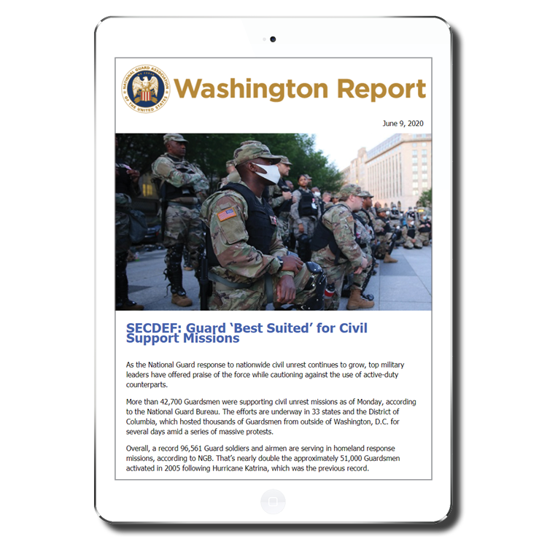
Publications
NATIONAL GUARD Magazine
Focuses on insight and analysis
Interviews with key leaders
Washington Report
Weekly e-newsletter with news from Washington affecting the Guard
NGAUS on the Hill
Monthly update on how the NGAUS Legislative team is working for you on the Hill
Legislative Analysis
Reviews provisions in defense and veterans legislation to determine impacts on National Guard servicemembers, funding, programs, and issues.
Notes:
We highly encourage members to provide us with a civilian email address to ensure they receive the Washington Report a weekly e-newsletter that provides the latest developments on NGAUS legislative efforts.

Slide 44
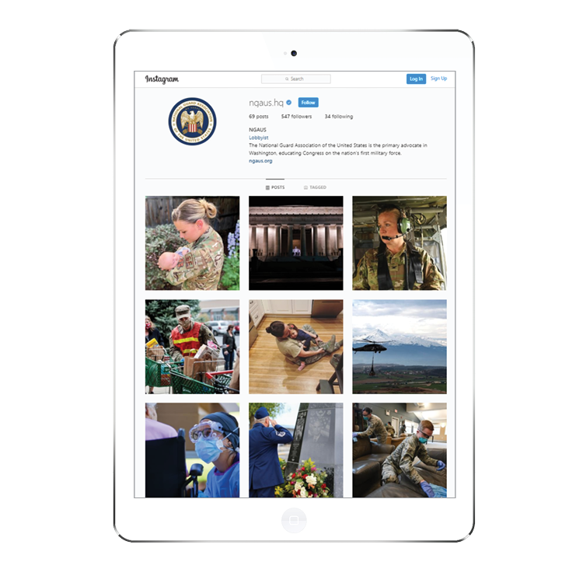






Social Media
@NGAUS.hq
@NGAUS1878
@NGAUS1878
@NGAUS1878
@NGAUS1878
@NGAUS1878
Notes:
Instagram, Twitter, Facebook, You Tube, Linked In, Flicker

Slide 45

Insurance Supplements
  Accidental Death and Dismemberment (AD&D) Insurance
    NGAUS members have an accidental death and dismemberment benefit at no extra cost.
  Technicians Insurance
    Available at an affordable rate to National Guard technicians under the age of 65.
  Preferred Vision Care Plan
    At the low cost of $15 per year, NGAUS members, Guard retirees, Guard employees and their household are eligible for the Preferred Vision Care (PVC) plan.
  Term Life Insurance
    NGAUS member/spouse under 65 can apply.

Slide 46
State association Benefits
Rebates = $$$$
Delegates = Voice

Slide 47
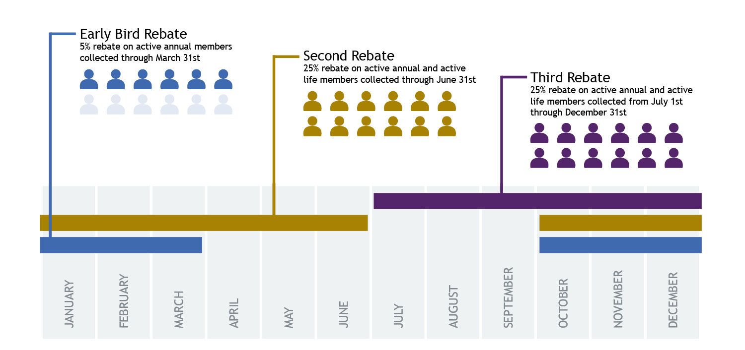
Rebates and Performance Incentives
Notes:
Membership Performance Incentive (formerly 25% Rebate)
Any state at or above 50% membership will be eligible for a 25% rebate on all Active Annual and Active Life dues collected, input into the NGAUS database and post-marked to NGAUS by June 30th
Any state below 50% that increases its membership percentage by at least 1% will be eligible for a 25% rebate on all Active Annual and Active Life dues collected, input into the NGAUS database and post-marked to NGAUS by June 30th
States below 50% that do not improve their membership year over year will not be eligible for the 25% rebate.
*All states, regardless of their membership percentage will receive 25% rebate on all NGAUS Active Life memberships sold.

Slide 48
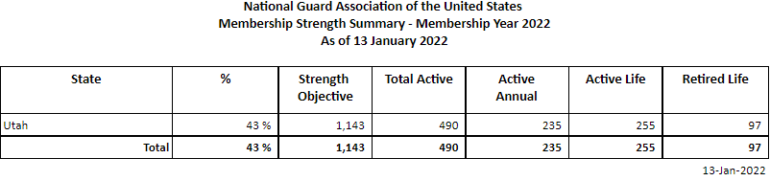
How to Calculate State Membership
Just a few guidelines
2021 Membership = 72%
Percentage for Rebate = 50%
Active Members required for 25% rebate: 571

Slide 49
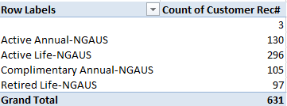
Breaking it Down
Just a few guidelines

Slide 50
Participation & Engagement
Getting Involved
Serving

Slide 51
Participate – Make a Difference
  Write to Congress
    NGAUS provides a tool to write directly to your representative about issues | www.ngaus.org/legislation/write-congress
  Begin learning about issues that have been taken to representatives at the state and national levels
  Work with your state association to develop resolutions
  Create a white paper or use a NGAUS white paper and begin making connections with representatives

Slide 52
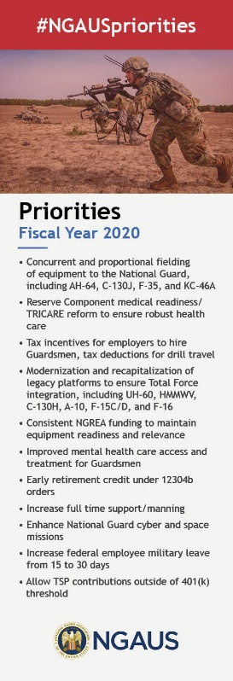
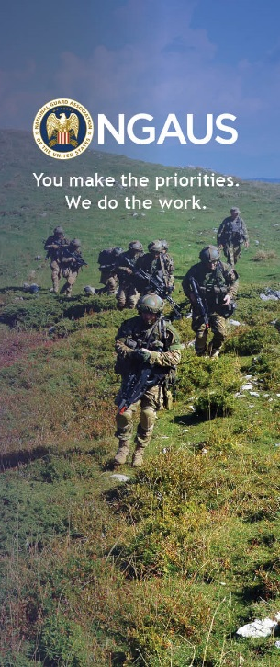
Learn and Teach
Attend the officer professional development at the NGAUS General Conference & Exhibition
Develop and expand membership at your state association
Recognize a fellow Guardsman for a NGAUS Award
Inform other Guardsmen about what NGAUS and National Guard State Associations do for them
NGAUS provides membership informational tools to help with educating others

Slide 53
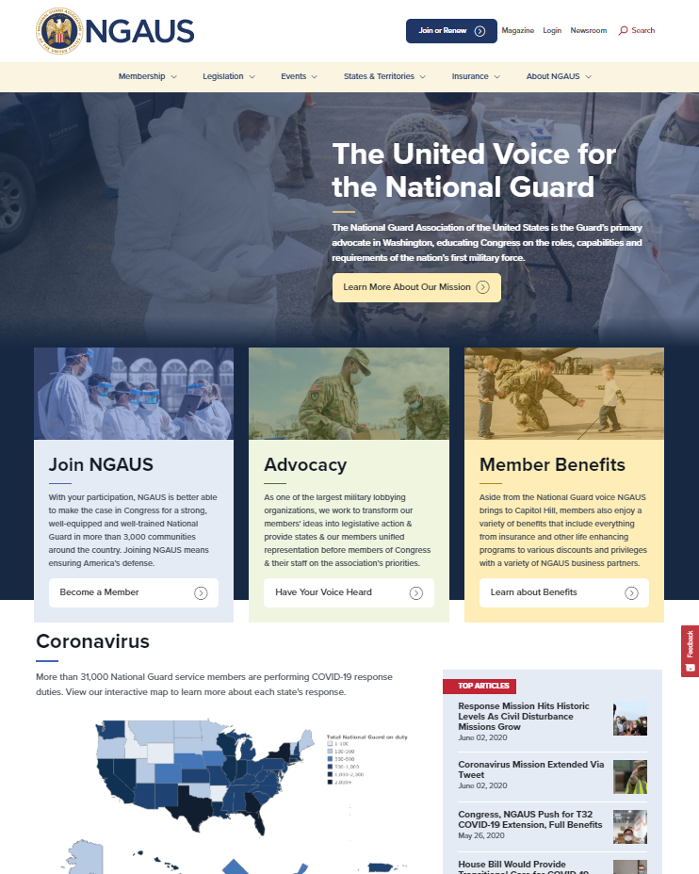
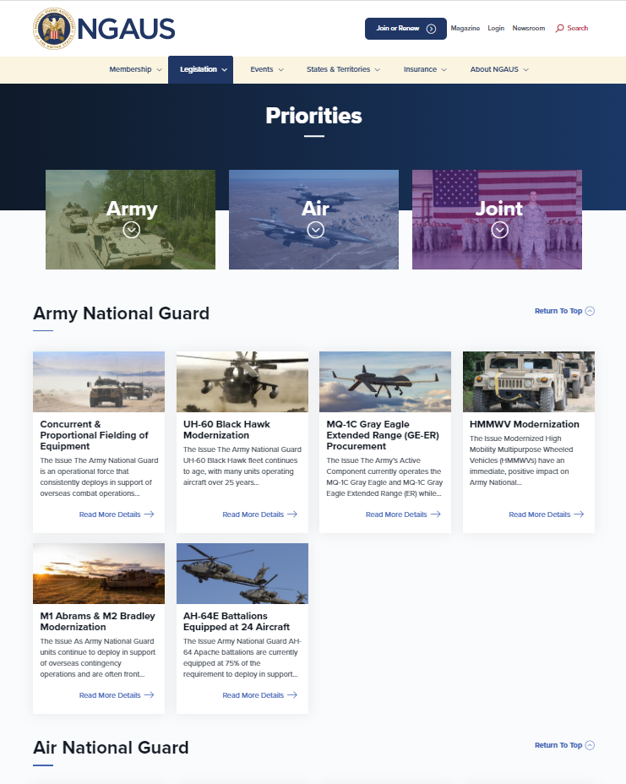
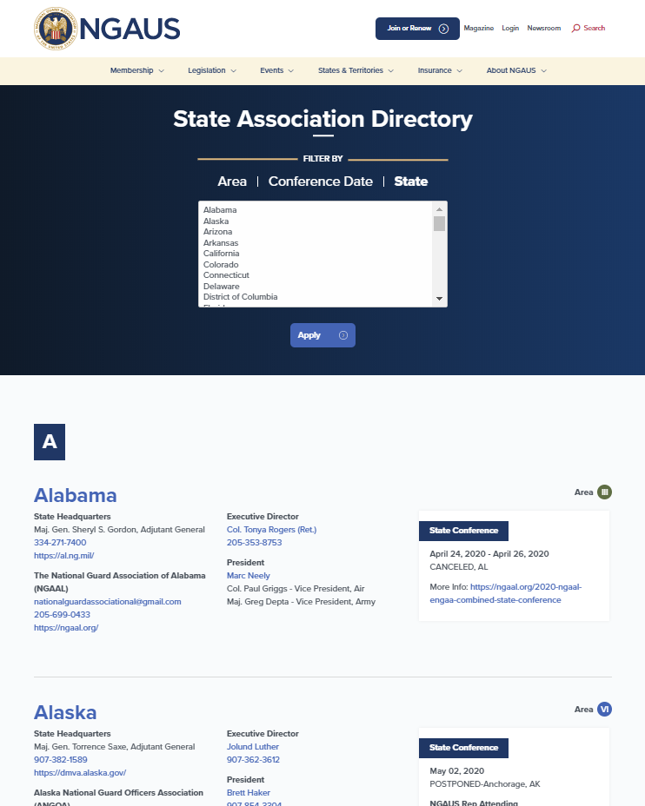
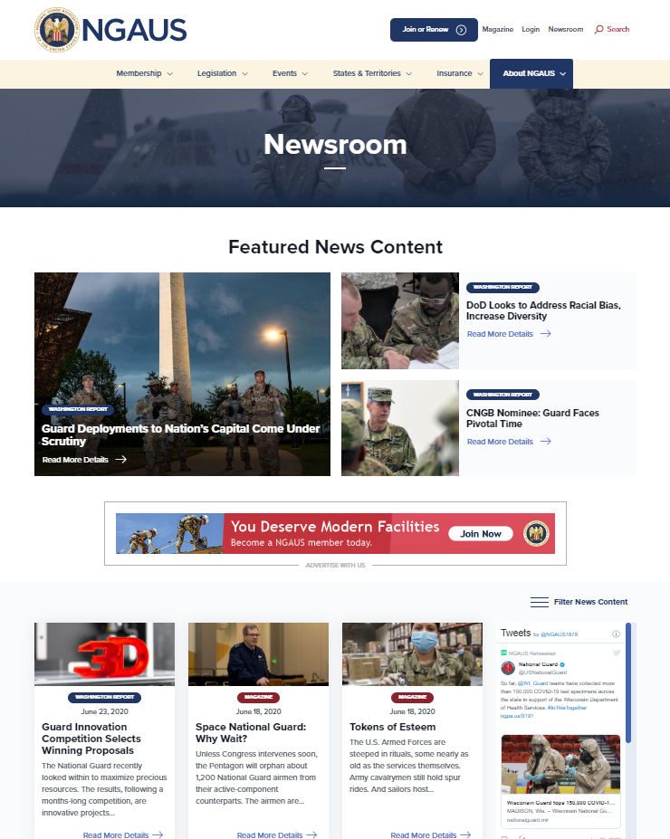
Learn and Teach
The NGAUS (www.ngaus.org) website is your tool to learn about the issues NGAUS is taking to the Hill and what is happening within the Guard all over the 54

Slide 54

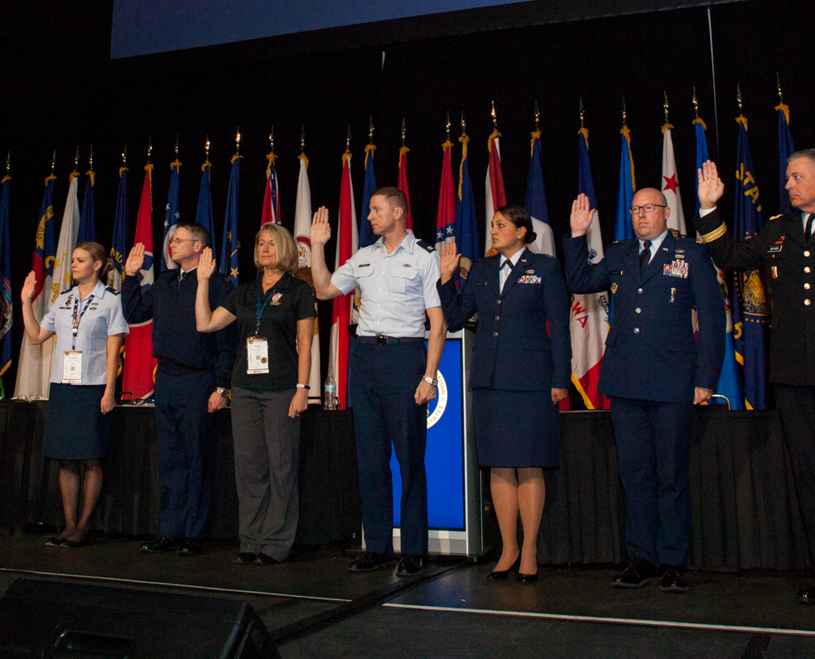
Time to Serve
  Serve on a committee at the state or national level
  Serve on the Board of Directors at the state or national level
  Serve on a task force at the state or national level
  Start a committee your state does not currently have
  Create a community through social media
Notes:
We rely on or members to volunteer and help with association business in any way they can. Here are a few ways to begin getting involved.

Slide 55
Questions?
Brig. Gen. Maria Kelly (Ret.)
Maria.Kelly@ngaus.org

Slide 56
Break

Slide 57
Membership Marketing
Cheyenne Arnold
Membership & Marketing Manager

Slide 58
Agenda
Recruiting Marketing
New Member Marketing
Renewal Marketing
State Resources

Slide 59
Recruiting Marketing

Slide 60
Spreading the Word
Educate
  Teach the importance of a voice at the state level and on Capitol Hill
Make it relatable
  Share your own story
    Why did you become a member?
    How has NGAUS or the state association helped you in your Guard career?
Make it affordable
  Consider applying your NGAUS rebate toward life member payments
  Complimentary memberships are free
Notes:
For those of you that had units respond to the COVID-19 pandemic, NGAUS was pivotal in ensuring that Guardsmen got the benefits that they deserved for their response. We in-turn were successful in getting the Guard refunded for the COVID and Washington DC security mission, which allowed Guardsmen to continue drilling for the last 2 months of FY21.
getting members to apply for comp for free gets us their information and a way to keep in contact with them. Offer digital life membership at $21 per month for two years

Slide 61
Marketing Channels
Brochures and Flyers
  Hand flyers or posters in Wings or Armories
Social Media
  Education
  Events
Graduations
  Membership presentation
Officer Strength Management Offices
  ROTC commissionings
Your Members
  Word of mouth
Host Events
Notes:
Social Media – Use social to educate members and others outside the organization about the priorities and accomplishments that your association is working toward
Presentations – Graduations
Members – Your best marketing tool is your members. It is easier for someone who experienced how NGAUS helped get Guardsmen title 32 status during recent Covid 19 duty to explain the importance of being a part of the National Guard Association. Ask them for testimonials or to get involved in other ways.
Take advantage of QR codes

Slide 62
New Member Marketing

Slide 63
Welcome Your Members
Show your members that you appreciate them
  Thank them
  Let them know what their membership means
Take the opportunity to continue educating them
  Association programs and benefits
  Resolutions Process
Give them direction on how to become more involved with the association
  Volunteer opportunities
  Events
  Educational opportunities

Slide 64
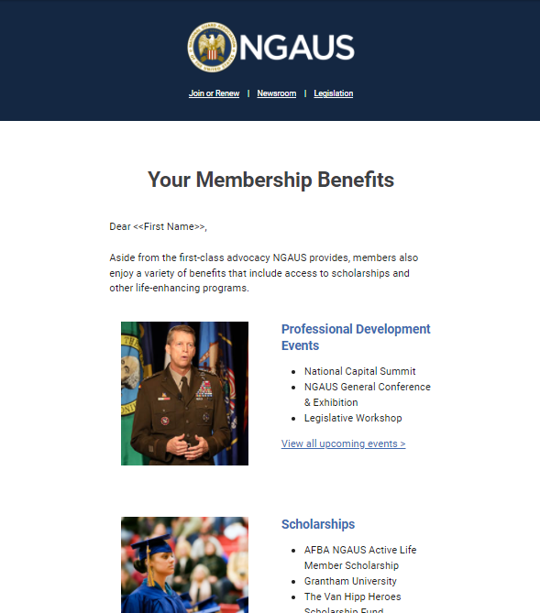
NGAUS Welcome Campaign
NGAUS sends a series of 5 emails when members join
Welcome to NGAUS
Member Benefits
Meet your Legislative Team
Get Involved
Follow us on Social Media
Complimentary members without email addresses receive a welcome letter in the mail
Notes:
Continue communicating with your members even after the welcome emails go out. Send them invitations to events, inform them about your association

Slide 65
Renewal Marketing

Slide 66
Retaining Members
Continue communicating with your members beyond the initial welcome
  Send newsletters or updates
Give members opportunities to get involved
  Join committee
  Attend events
Let them know what is happening with your association
  Legislative initiatives
  Information from board meetings
Invite them to events

Slide 67
Renewal Marketing
Begin your renewal marketing in October
Contact your members through email or social media
Make renewing easy
Inform them of any special deals available
Educate them in any accomplishments the association has had and let them know how their membership helped
Thank them for their contribution to your association
Thank them again after they have renewed

Slide 68

NGAUS Renewal Campaign
NGAUS uses multiple channels to reach expiring members
Magazine Ads
Website Ads
Washington Report Ads
Social Media Ads
Email Campaign
Postcard Mailing

Slide 69
Resources

Slide 70
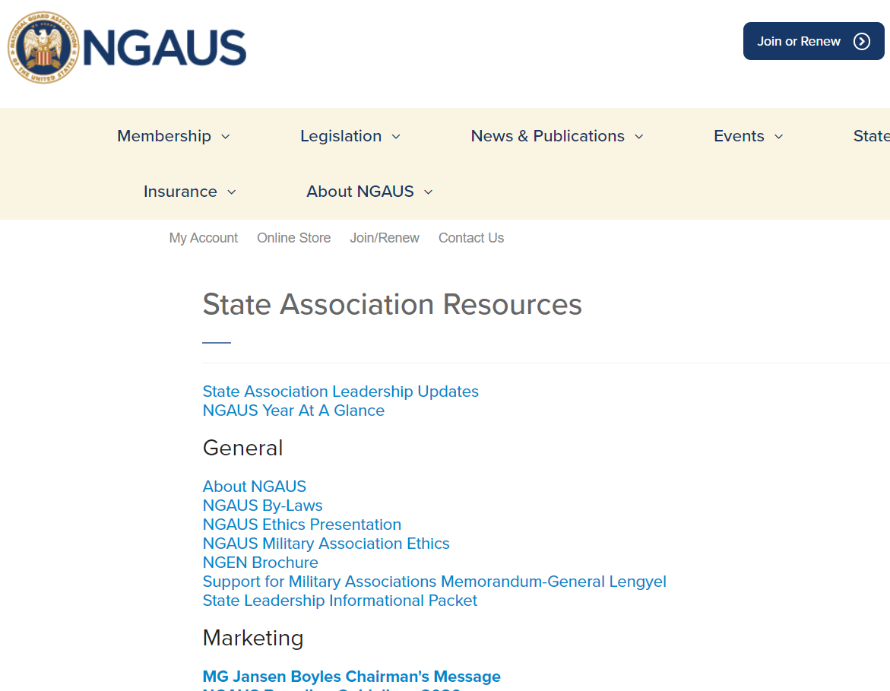
State Association Resources
Marketing materials are available to use on the NGAUS website under State Association Resources.
ngaus.org/stateresources

Slide 71

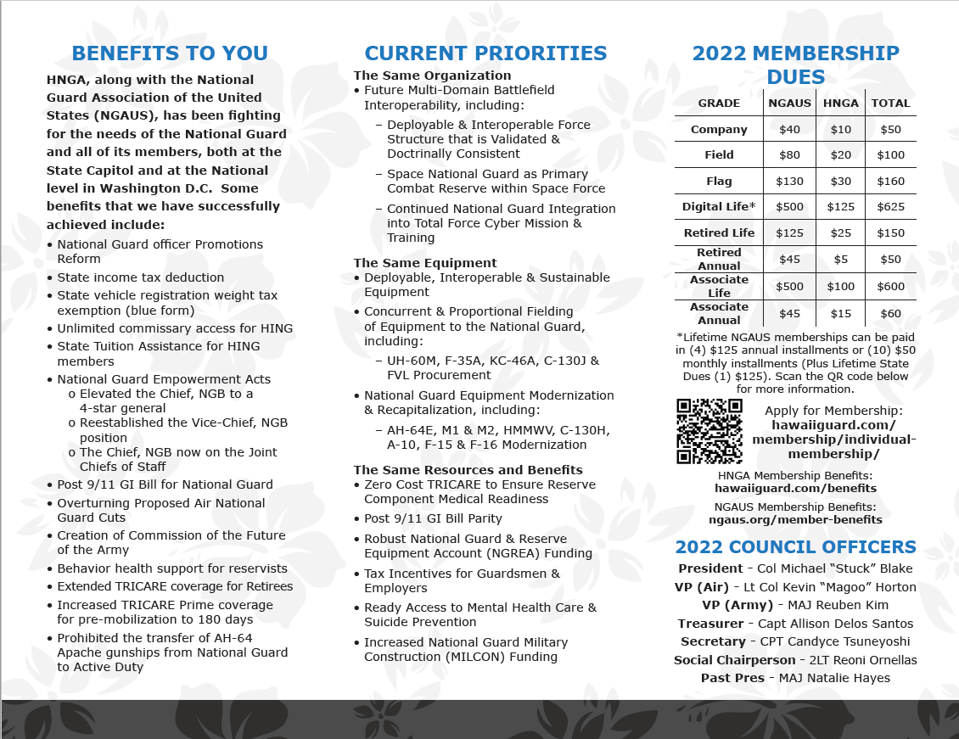
Custom Marketing Materials
NGAUS provides graphic design services for custom membership marketing materials.
Membership Application
Brochure
Flyer
Poster
Please contact membership@ngaus.org

Slide 72
Questions?
Cheyenne Arnold
Cheyenne.Arnold@ngaus.org

Slide 73
Lunch

Slide 74
Membership/ Finance
Melvin Bodmer, Jr.
Database Manager
Laurence Temple
Comptroller

Slide 75
Agenda
eWeb Join Process
Easy Access iWeb Queries and Reports
Strength Report Summary
State Membership Dues

Slide 76
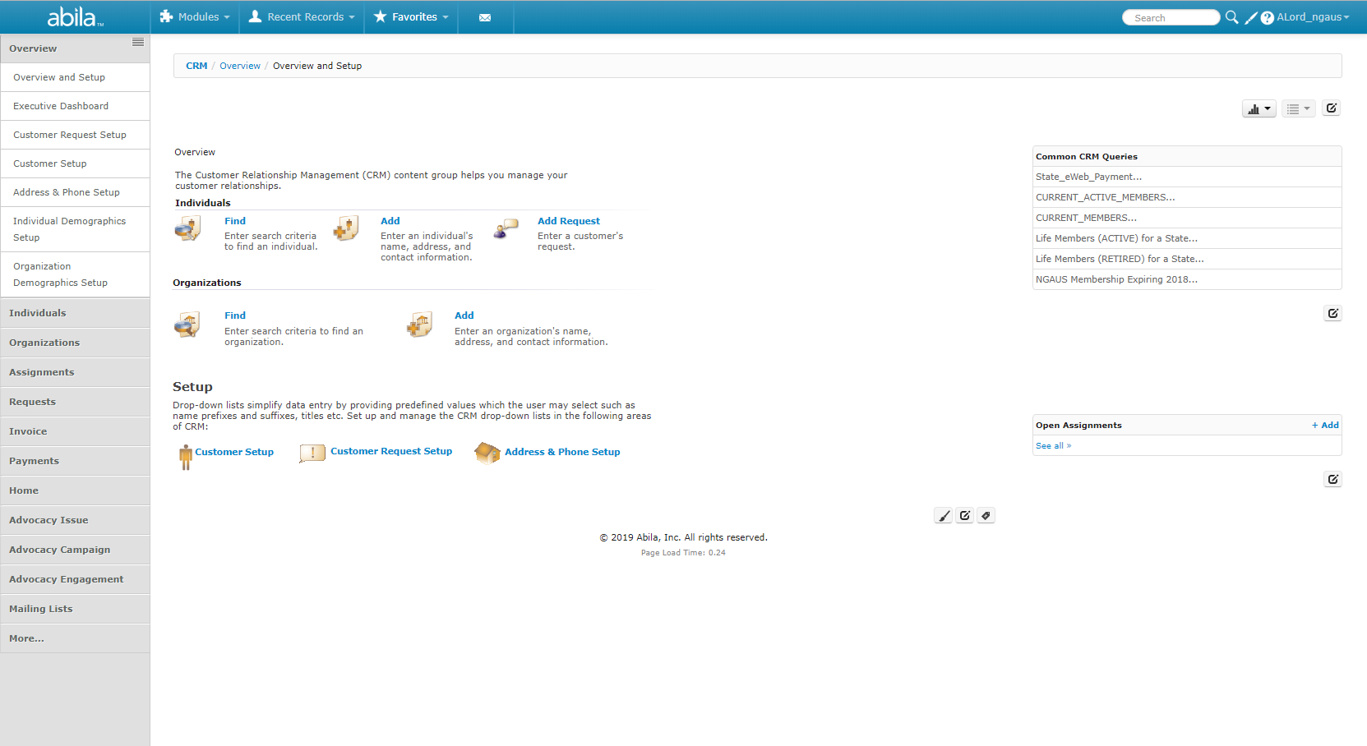
iWeb Front Page

Slide 77
iWeb - State eWeb Payments
View Members who have paid State dues via eWeb

Slide 78
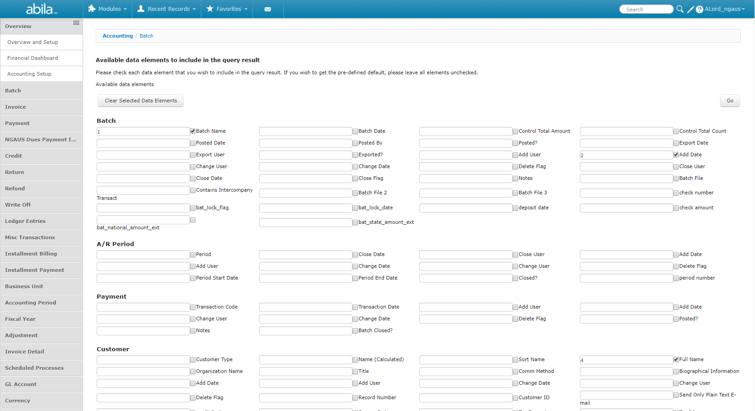
iWeb - State eWeb Payments
Click ‘Go”

Slide 79
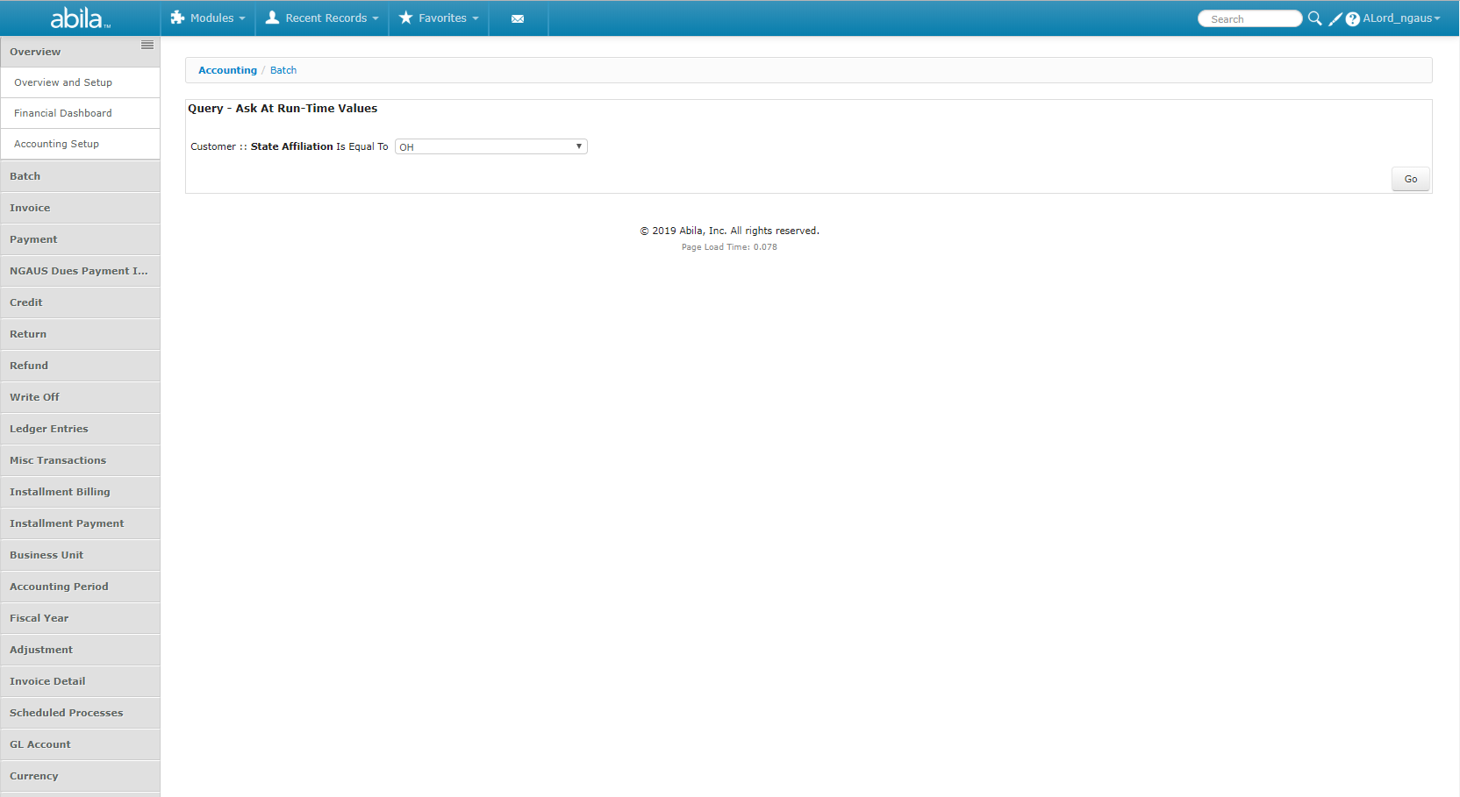
iWeb - State eWeb Payments
Select State
Click ‘Go”

Slide 80
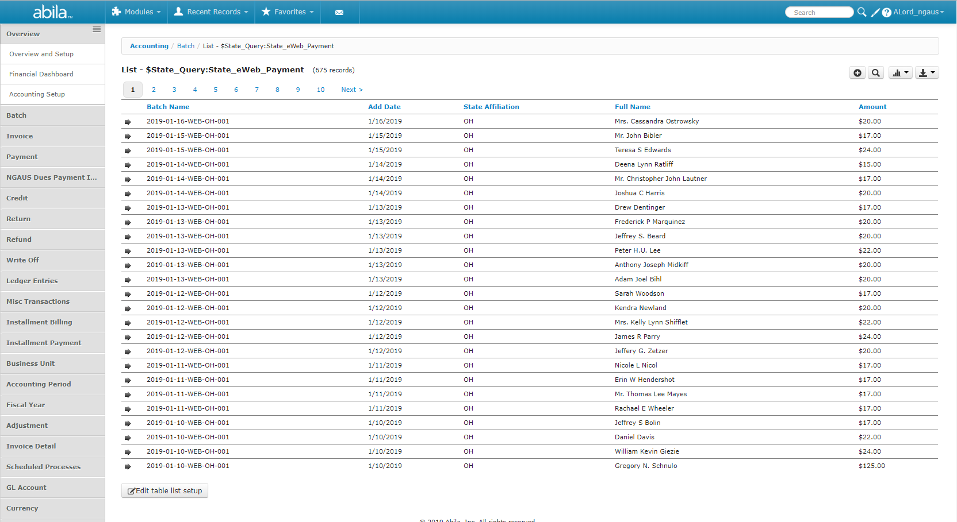
iWeb - State eWeb Payments
Date Purchased
Customer Name
Amount Charged for State Membership
Batch

Slide 81
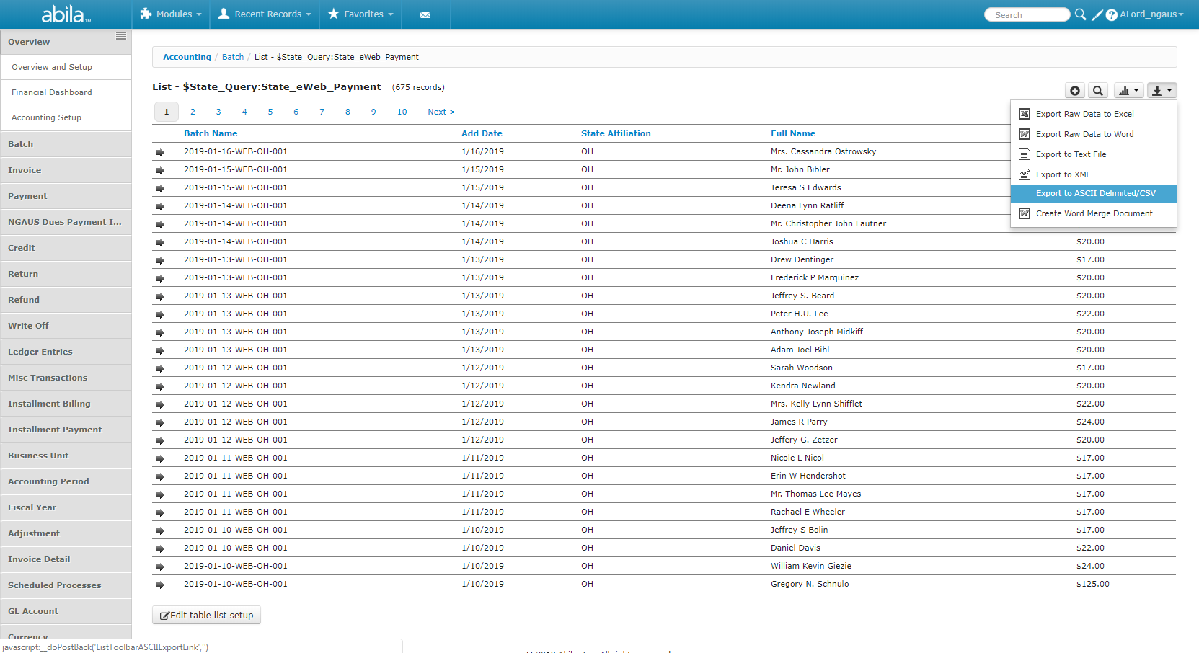
iWeb – Export
Always export to ASCII Delimited/CSV

Slide 82
iWeb - Current Active Members
All NGAUS Active Annual,
Complimentary Annual, Active Life Members (Excludes Retired Life Members)

Slide 83
iWeb - Current Members
All NGAUS Active Annual,
Complimentary Annual, Active Life and Retired Life Members

Slide 84
iWeb – Life Members (Active)
All NGAUS Active Life Members

Slide 85
iWeb – Life Members (Retired)
All NGAUS Retired Life Members

Slide 86
iWeb – NGAUS Membership Expiring 2021
All NGAUS Members who expired in 2021

Slide 87
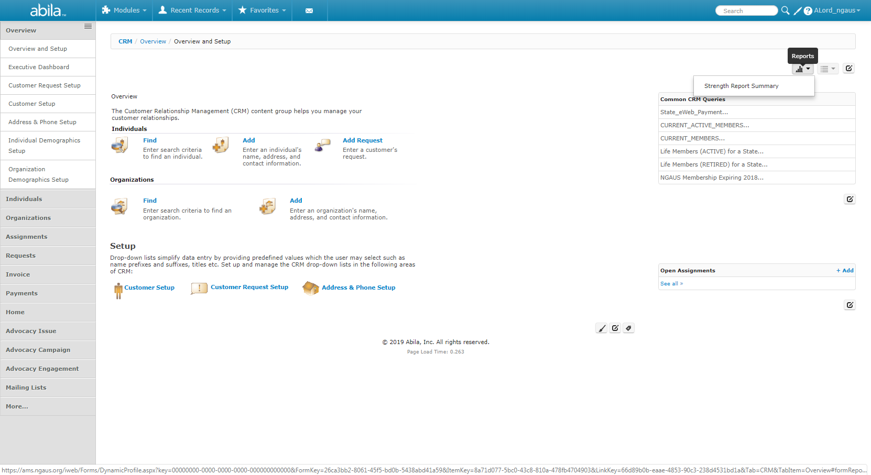
iWeb – Strength Report Summary
Click Reports Icon
Select Strength Report Summary

Slide 88
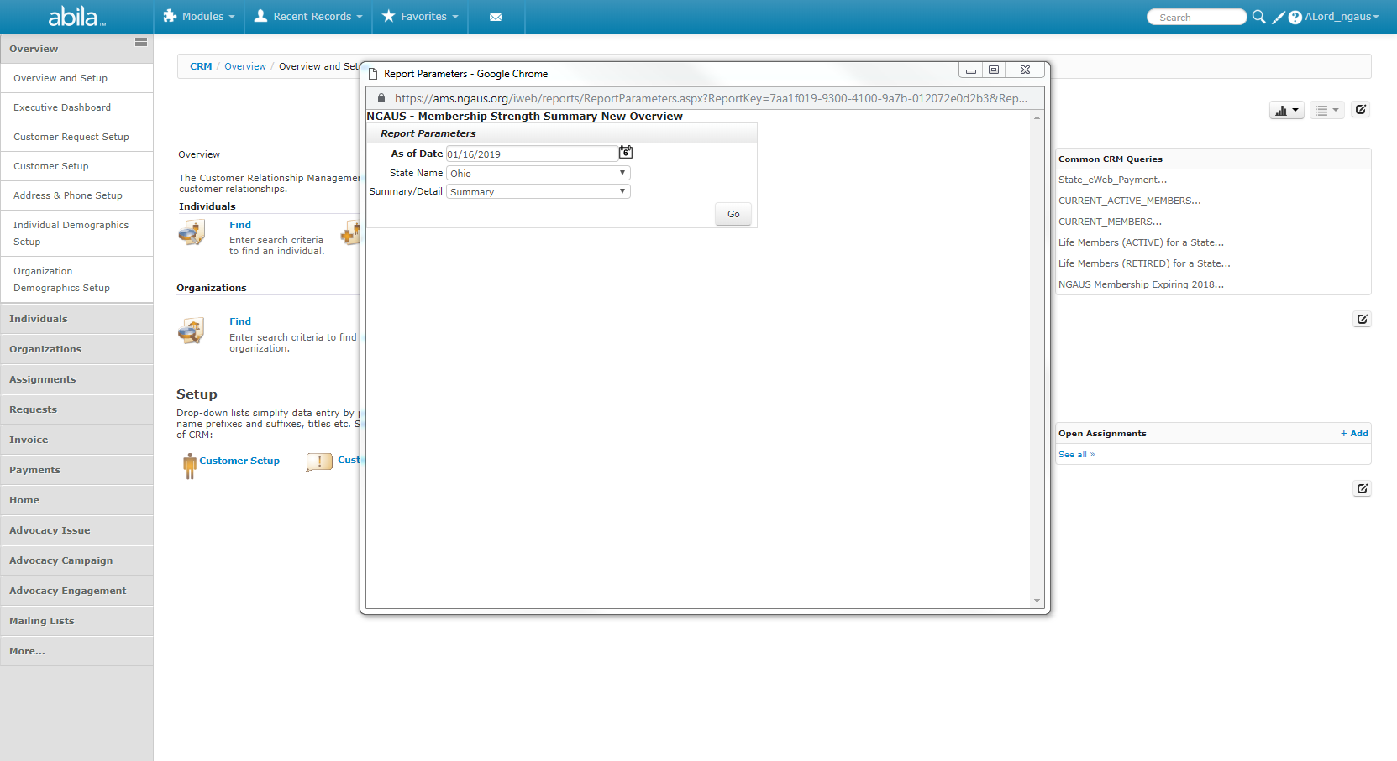
iWeb – Strength Report Summary
Select today’s date
Select State
Select ‘Summary’
Select ‘Go’

Slide 89
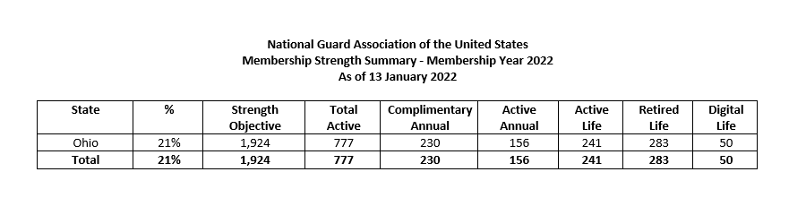
iWeb – Strength Report Summary
Your Membership Percentage
Complimentary Annual, Active Annual, Active Life, Digital Life

Slide 90
State Membership Dues
National Guard Bureau
Assigned Strength by State
As of 30 September 2021
Invoice No. | STATE | ARMY_ASSN | AIR ASSN | Total ASSN | @ .25 per man
State-22-01 | AK | 1643 | 2,198 | 3,841 | $ 960.25
State-22-02 | AL | 9821 | 2,409 | 12,230 | $ 3,057.50
State-22-03 | AR | 6777 | 1,949 | 8,726 | $ 2,181.50
State-22-04 | AZ | 5284 | 2,633 | 7,917 | $ 1,979.25
State-22-05 | CA | 13349 | 4,915 | 18,264 | $ 4,566.00
State-22-06 | CO | 3847 | 1,714 | 5,561 | $ 1,390.25
State-22-07 | CT | 3663 | 1,180 | 4,843 | $ 1,210.75
State-22-08 | DE | 1687 | 1,040 | 2,727 | $ 681.75
By-Laws Article III, Section 3.01
  State: Membership may be issued to and in the name of a State. (Dues to be paid annually in the amount of Twenty-Five cents for each member of the National Guard based upon the assigned strength on 30 September of the preceding year as furnished by the National Guard Bureau.)
Army Enlisted & Officer Strength
Air Force Enlisted & Officer Strength

Slide 91
Questions?
Melvin Bodmer, Jr.
Melvin.Bodmer@ngaus.org
Laurence Temple
Laurence.Temple@ngaus.org

Slide 92
General Conference
It’s “Go” Time
Maria Kelly

Slide 93
Agenda
State Association Preparation for the General Conference and Exhibition
Housing
Registration
Selecting Delegates/Assigning Committees
Arrival and Check-in
Resources

Slide 94
State Association Preparation for the General Conference and Exhibition
It all Begins Here at NGEDA

Slide 95

Who’s On First?
  NGAUS
  General Conference Committee
  Responsible for the overall General Conference
  Business Session
  Exhibit Hall
  On-Site Registration
  Resolutions, Area Meetings, Voting
  Host State
  Hotel Contracts
  Transportation
  Required and optional social events
  Sponsorship
  Opening Ceremony Entertainment
  State Associations
  Selection of Hotel
  Registering delegation
  Selection of Delegates
  Payment of state and individual dues
  On site registration and credentialing
  State caucuses and voting

Slide 96
Hotel Selection and Registration
Touring and selecting hotel rooms and suite for delegation
Payment of room deposits to host state
Register your delegation using the SPARGO Housing Software
Completion of hotel room registration before deadlines
Turn in unused rooms from your room block
Request additional rooms if needed
Confirm room reservations – dates, type of room, etc.. Regularly with your delegation
Coordinate directly with the hotel POC once room blocks go to the hotel
***Who do I call when…… (when to call host state, SPARGO, NGAUS)

Slide 97
Conference Registration and Payment
Register your delegation using the SPARGO registration software
Know the cancelation policies
Remember that payment and cancelations have a direct impact on the host state
Payment is due no later than arrival at the conference in order to credential your state (see above about impact on host state)
Schedule your appointment to check in and pick up badges in advance
Upon Arrival, be sure that state dues are paid and that all batches prior to 30 JUN are paid in full in order to be credentialed
Review delegate and committee assignments
Review name badges
Arrange pick up of conference materials and bags with Host State

Slide 98
Delegates
Why Membership Matters

Slide 99
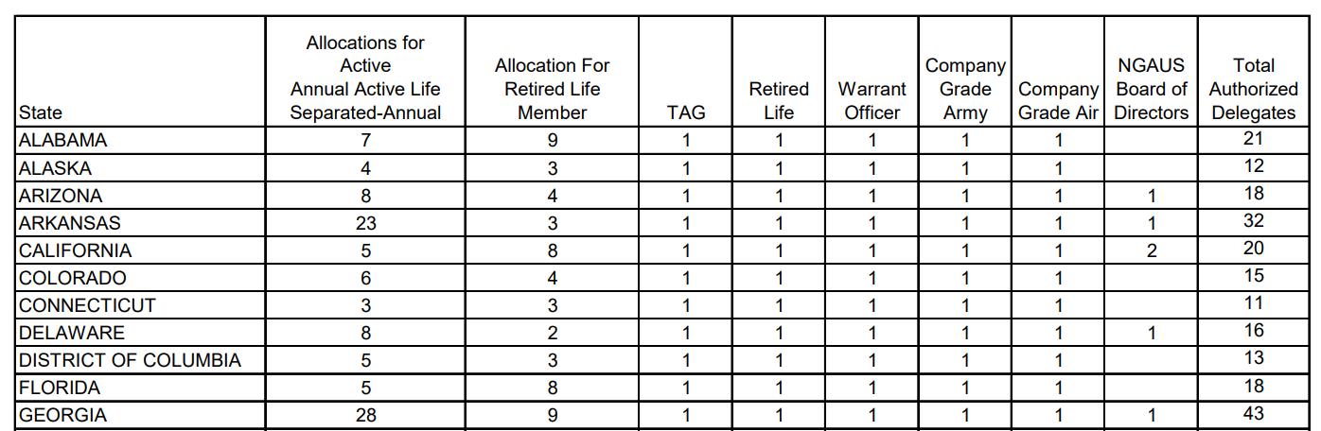
Authorized Delegates – Membership Counts…

Slide 100
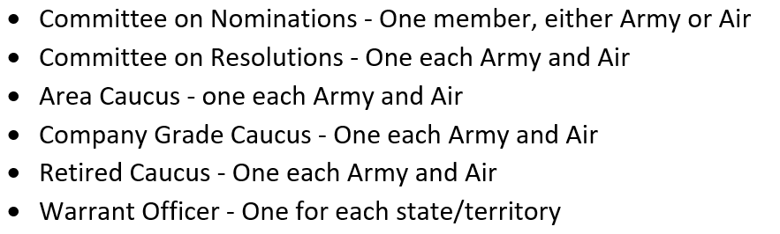
Committees

Slide 101

At the Conference – Know your way around
Conference Area Resources
Information Booth
Registration
Administration Room
Operations Room
Host State Room
NGAUS Booth
Hotel Resources
Host State Welcome Couples
Sales and Catering Staff
Other State Delegations
Transportation and Shuttle Information

Slide 102
Dates & Deadlines
Housing Registration Opens – January 2022
Conference Registration Opens – March 2022
NGAUS Call to Conference – May 2022
Awards Deadline– May 15
By Laws Changes - June
Resolutions Deadline – July 1
Delegate Counts Issued – July 15
NGB Issues OPD Guidance – June/July
Delegate Assignments Due – August 1
Housing – Unused Room Turn in
Housing – Rooming list provided to Hotel
Registration – No deadline, but…

Slide 103
Resources
NGAUS Conference User Guide for Executive Directors
Bi-Weekly Executive Director Updates
NGAUS Membership Office
SPARGO Housing
SPARGO Registration
NGAUS Staff
NGEDA
Fellow Executive Directors
NGAUS Website
NGAUS Conference Page
The Conference App

Slide 104
Questions?
Brig. Gen. Maria Kelly (Ret.)
Maria.Kelly@ngaus.org

Slide 105
Communications & Awards Program
Rich Arnold
Communications Production Manager

Slide 106
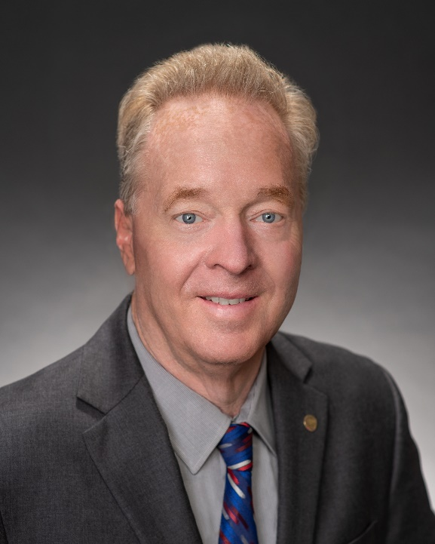

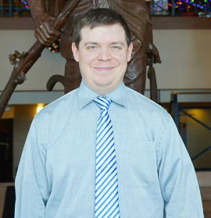
Communications Staff
John Goheen Rich Arnold Donald Lambert
Director Production Manager Staff Writer
Vacant** - Senior Writer/Editor & Digital Content Manager

Slide 107
Communications Products/Duties
NATIONAL GUARD Magazine (monthly)
Washington Report e-newsletter (weekly)
News Digest (daily)
NGAUS.org (website)
Social Media
(Facebook, Twitter, YouTube, LinkedIn, Flickr, Instagram)
Media Relations – Press Releases
Main Sessions, OPD at Conference

Slide 108

Monthly

Slide 109
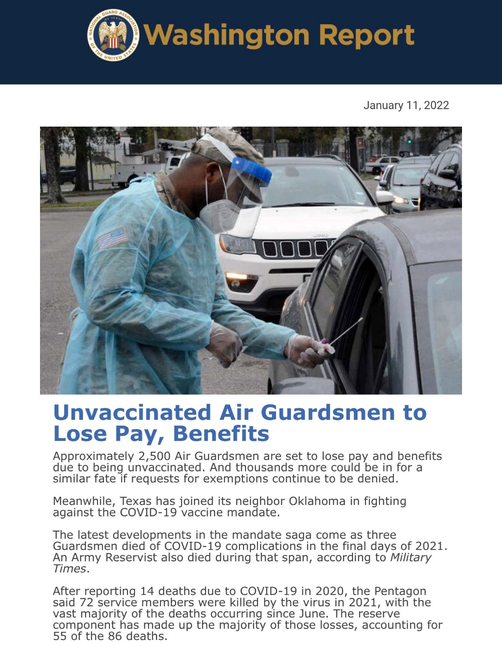
Weekly (Tuesdays
at 2 p.m. EST)

Slide 110
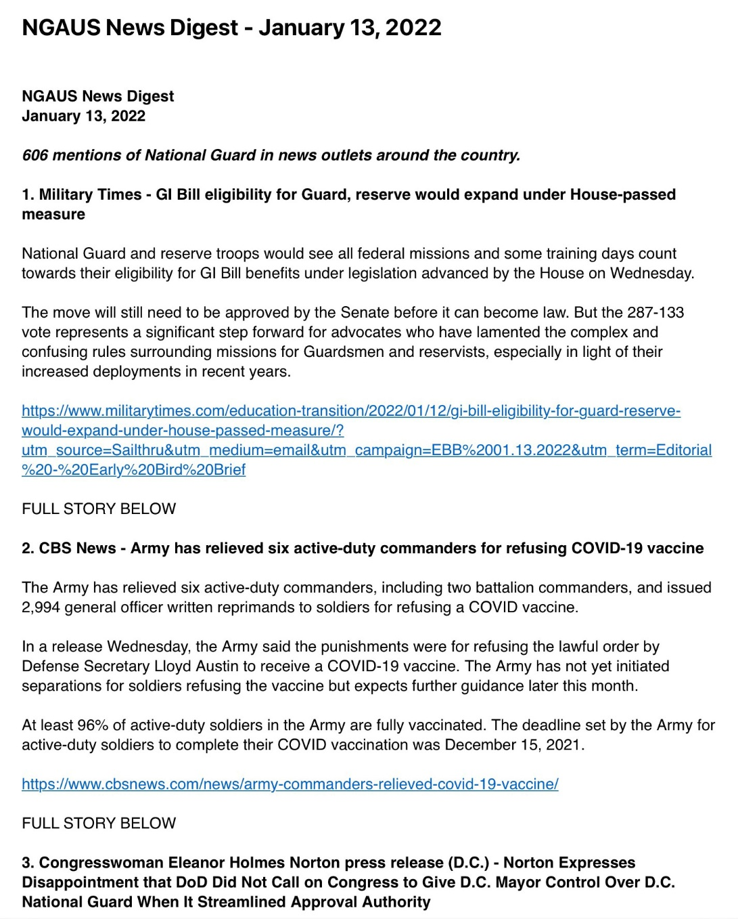
Daily (9-10 a.m. EST)

Slide 111
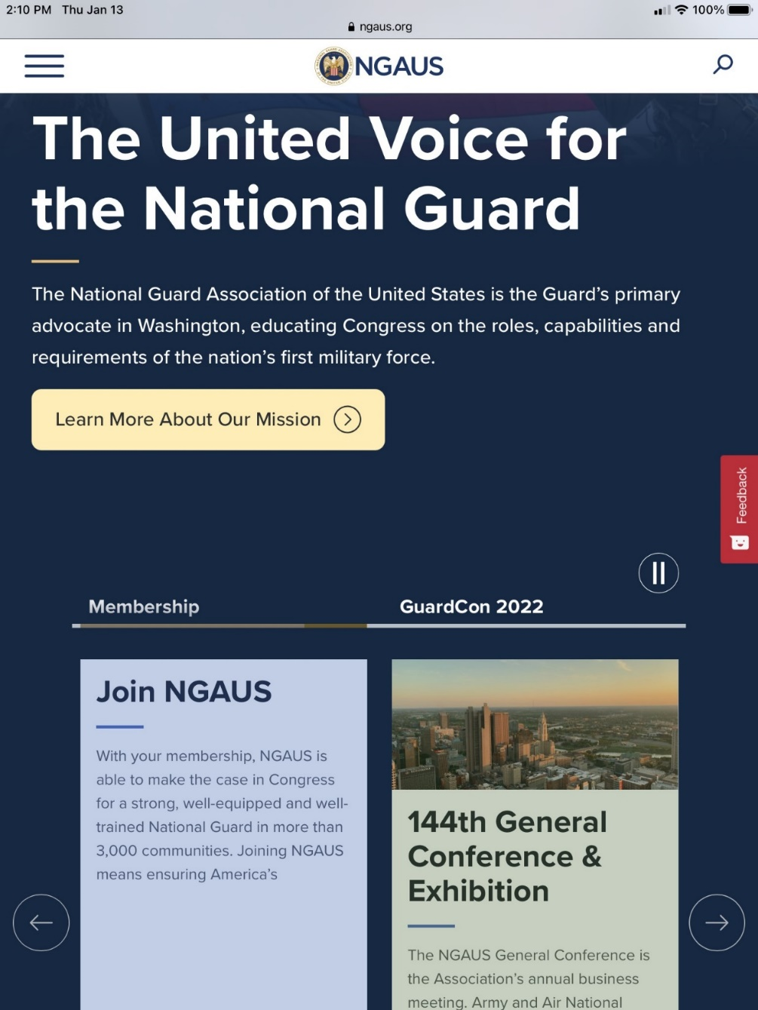
www.NGAUS.org

Slide 112
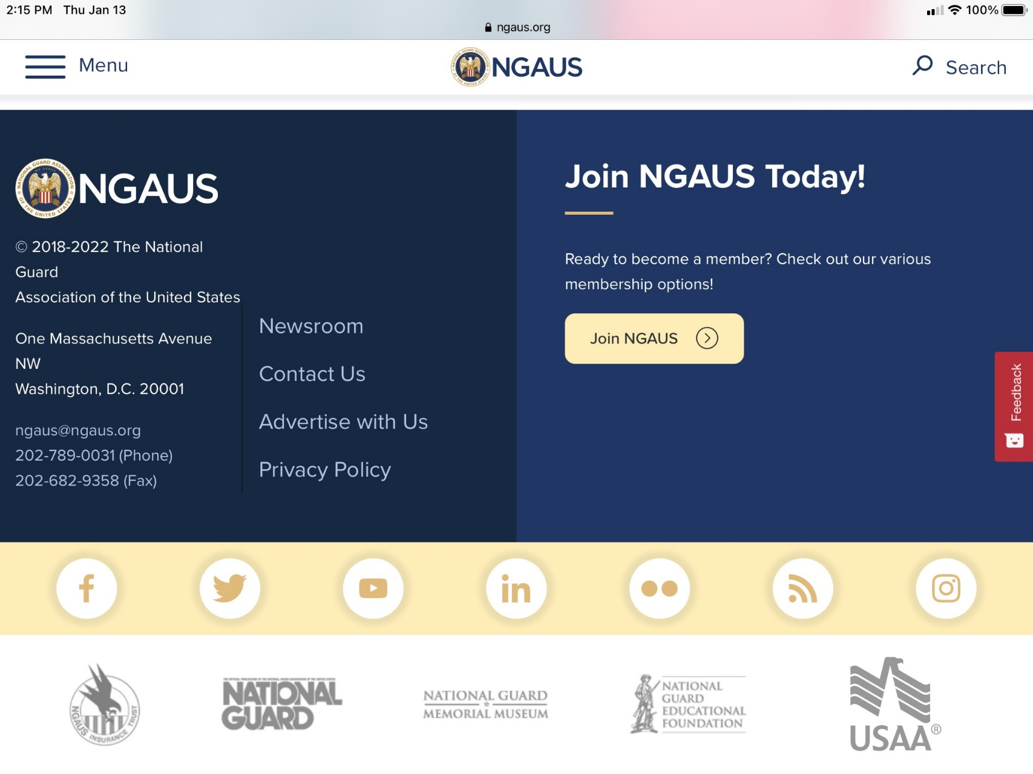
Social Media (Facebook, Twitter,
YouTube, LinkedIn, Flickr, Instagram)

Slide 113
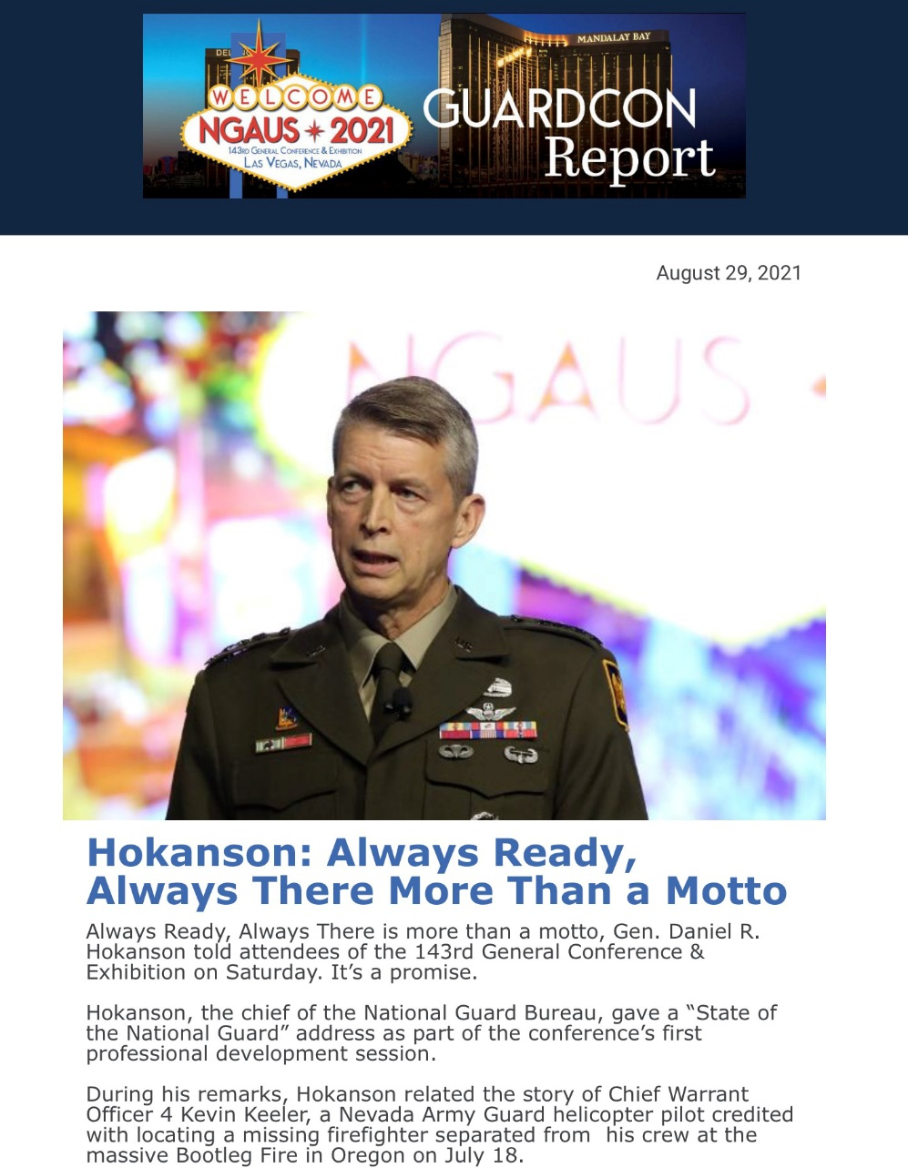
Conference Report

Slide 114
Awards Overview
Process Timeline
Category Breakdown
Participation
39 Highest #
20 Last year
Nominations: 73
Attendance: 35
Website: www.ngaus.org/awards
Email: awards@ngaus.org

Slide 115
NGAUS Awards Process Timeline
Late February – Call to States for nominations
15 May – Nominations due to NGAUS
June or July – Awards Committee meeting (teleconference)
16 July – Board meeting
19 July – Notify states once list is approved

Slide 116
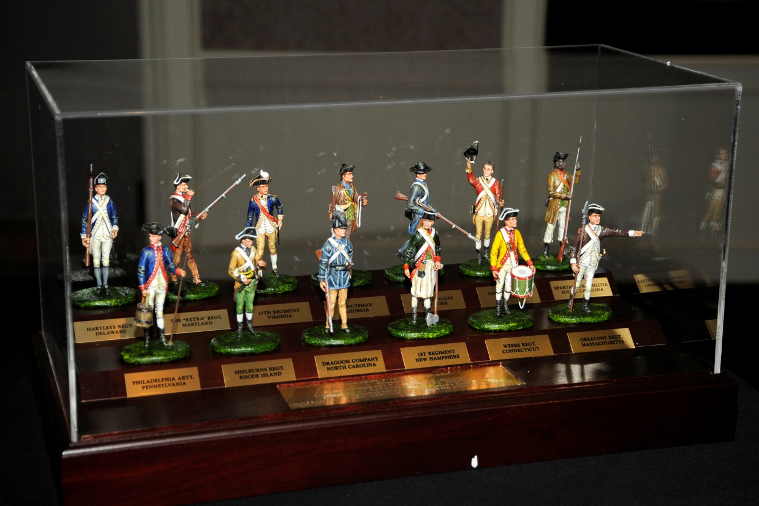
NGAUS Awards
Harry S. Truman Award
Highest NGAUS Award (first presented in 1969)
Top Elected Officials/Military Officers

Slide 117
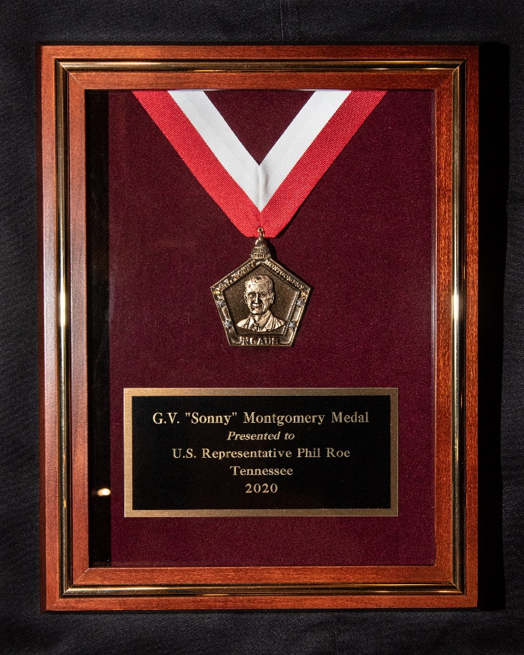
NGAUS Awards
G.V. “Sonny” Montgomery Medal
Second-highest award (first presented 2004)
Top Elected Officials/Military Officers

Slide 118

NGAUS Awards
Charles Dick Medal of Merit
(First presented in 1989)
Elected officials (national & state)

Slide 119
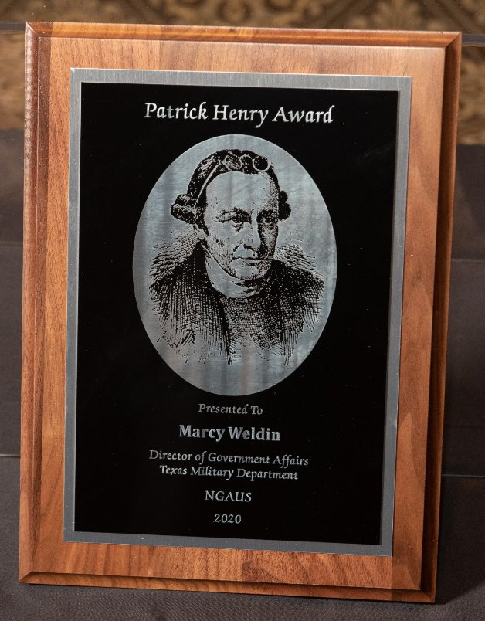
NGAUS Awards
Patrick Henry Award
(First presented in 1989)
Elected officials (state & local)
Staffers & other civic leaders

Slide 120

NGAUS Awards
Distinguished Service Medal
Oldest award (1950)
Outstanding service by a Guardsman or Guard civilian

Slide 121
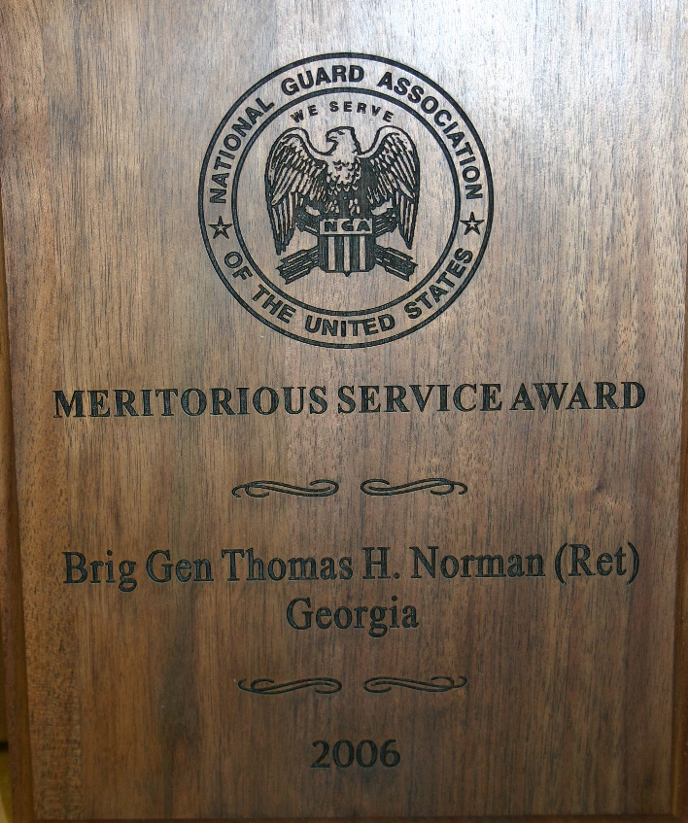
NGAUS Awards
Meritorious Service Award (1972)
Step down from Distinguished Service Medal
Meritorious Service Certificate

Slide 122

NGAUS Awards
Valley Forge Cross for Heroism (1973)
Performing acts of heroism and lifesaving acts
Valley Forge Certificate
Non-life threatening

Slide 123
NGAUS Awards
Garde Nationale Trophy (1989)
Significant achievement in civilian endeavors
Theodore Roosevelt Leadership Award
for Company Grade Officers (2006)
State, territory or D.C. may submit no more than
one ANG and one ARNG nomination each year
Eagle Rising Award for Warrant Officers (2011)
Nominees must be WO1-CW3
State, territory or D.C. may submit no more than
one ANG and one ARNG nomination each year

Slide 124
Unit Awards
***Presented at NGAUS conference, but selected by NGB
Army National Guard
Major General Milton A. Reckord Trophy
(Highest training & readiness)
Certificate of Victory
(Highest weapons qualification)
Pershing Plaque
(Weapons qualification)

Slide 125
Unit Awards
***Presented at NGAUS conference, but selected by NGB
Air National Guard
Spaatz Trophy
(Top flying unit)
Distinguished Flying Unit Plaque
Mission Support Trophy
(Top support unit)
Distinguished Mission Support Plaque
William W. Spruance Safety Award
Winston P. Wilson Trophy**
(Outstanding fighter or recon)
Curtis N. “Rusty” Metcalf Trophy**
(Outstanding airlift or refueling)
Major General John J. Pesch Flight Safety Trophy**

Slide 126
Questions?
Rich Arnold
Richard.Arnold@ngaus.org

Slide 127



Spreading the Word
Background
Use this slide to provide background information and quick points. Just remember that there is such a thing as too much text on a slide, you want your audience to listen, not read.
Use this slide to provide background information and quick points
Use this slide to provide background information and quick points
Use this slide to provide background information and quick points

Slide 128
Two Column Slide
This slide can also be used to provide a visual along with quick points
This slide can also be used to provide a visual along with quick points
This slide can also be used to provide a visual along with quick points

Slide 129
Two Column Slide
This slide can also be used to provide a visual along with quick points
This slide can also be used to provide a visual along with quick points
This slide can also be used to provide a visual along with quick points

Slide 130
Three Column Slide
  It can be a good idea to use this slide to compare items.
  This slide can also be used for showing steps in a process.
  Or for making different case points.

Slide 131

Five Column Slide
Like the three column slide,
This slide can be used to compare items,
To show the steps in a process,
or
For making different case points.

Slide 132





Box Slide
This slide can be used to compare items.
Or for making different case points.
Try adding icons.
Icons can help add interest and break up continuous text.

Slide 133

Two Columns with Four Boxes
Background
Use this slide to provide background information and quick points. Just remember that there is such a thing as too much text on a slide, you want your audience to listen, not read.
This slide can be used to compare items.
This slide can be used to compare items.
This slide can be used to compare items.
This slide can be used to compare items.

Slide 134
Two Columns with Four Boxes
This slide can be used to compare items.
This slide can be used to compare items.
This slide can be used to compare items.
This slide can be used to compare items.

Slide 135
Icons
Available to use within any slide

Slide 136










Available Icons

