Slide 1
NetFORUM Lab
Melvin Bodmer, Jr.
Database Manager
Notes:
The past year and a half has allowed me to learn a lot about NGAUS, my fellow executive directors, and membership. Although we were distant from those we worked with day to day, I got to know state association membership a lot better. I feel that it really set me up for success when I came to NGAUS because I had a better understanding of the experience level of those working with membership. And a better overall understanding that we do not always share a common operating picture.
I also have a better appreciation of the amount of time spent one on one in training. While we are always available for one on one training, I would also like to equip you better with the knowledge on using the tools that will allow you to self help and not wait on someone else who may be in another time zone or otherwise unavailable.

Slide 2
Agenda
Quick Reports
Finance and Accounting
Adding/Updating a Record
Resources
Notes:
I will adapt today’s session to the needs of the group, but it is my intent to focus on the fundamentals first.
Here are a few of the items we will cover over the next half hour or so. And of course, we will leave time for questions/discussion at the end.
Disclaimer!!!!!!

Slide 3
What is Association Management Software (AMS)?
Notes:
Association Management Software (AMS) is a web-based software designed to house member data. AMS keeps track of member demographics, contact information, preference, history, and more in one central, comprehensive system. Data is used as a Marketing tool, as well as the platform from which NGAUS communicates on Legislative issues facing the guard and its members. Any entries made into AMS are viewable in real time and can be retrieved from any computer system with internet access. When a state enters data into the system there is no need to mail anything to NGAUS other than the membership payment.

Slide 4
NGAUS AMS SOP – V.13.1

Slide 5
Quick Reports

Slide 6
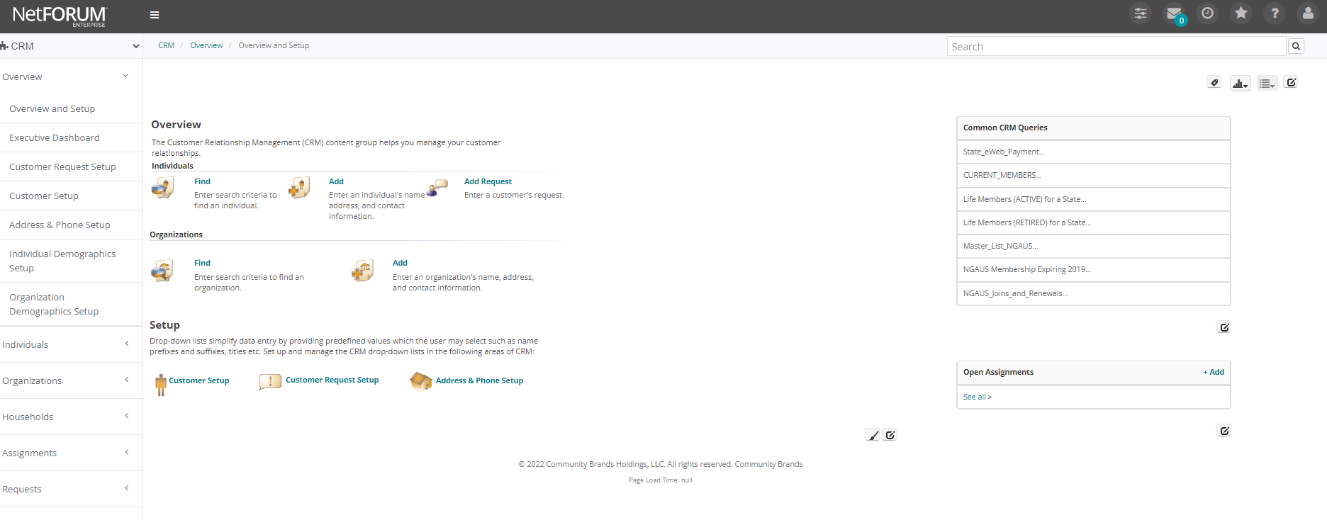
iWeb Front Page

Slide 7
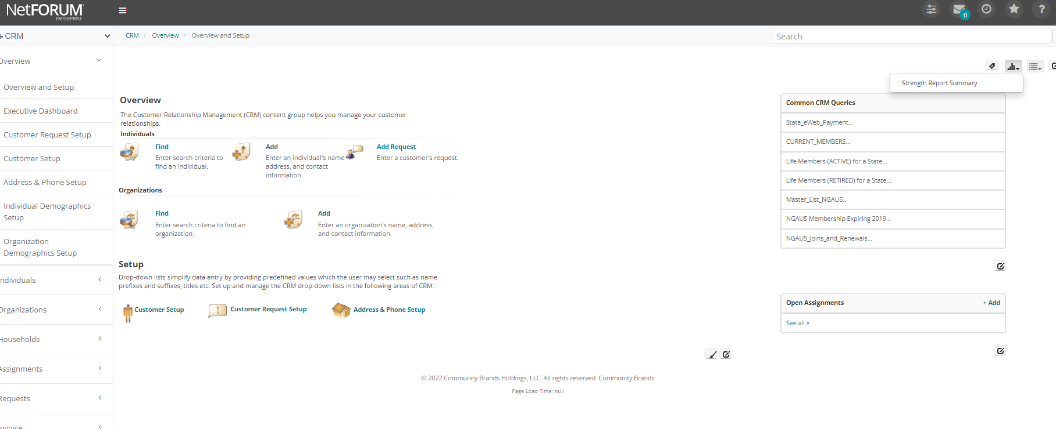
iWeb – Strength Report Summary
Click Reports Icon
Select Strength Report Summary

Slide 8
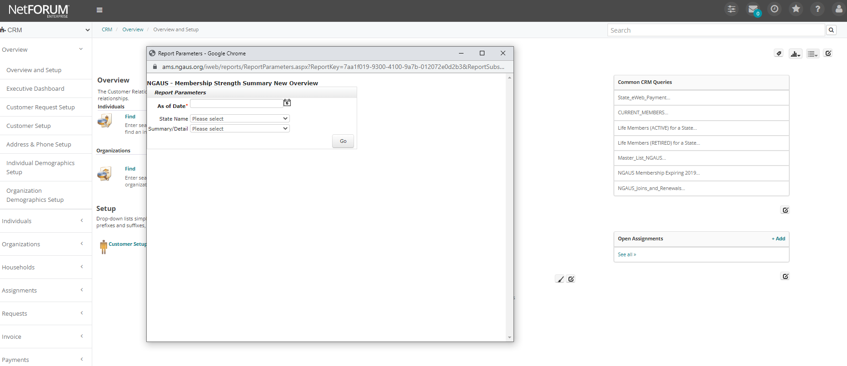
iWeb – Strength Report Summary
Select today’s date
Select ‘Summary’
Select State
Select ‘Go’

Slide 9
iWeb – Strength Report Summary
Complimentary Annual, Active Annual, Active Life, Digital Life
Your Membership Percentage

Slide 10
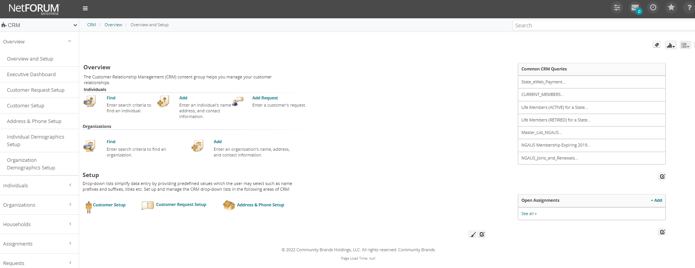
iWeb - State eWeb Payments
View Member who have paid State dues via eWeb

Slide 11
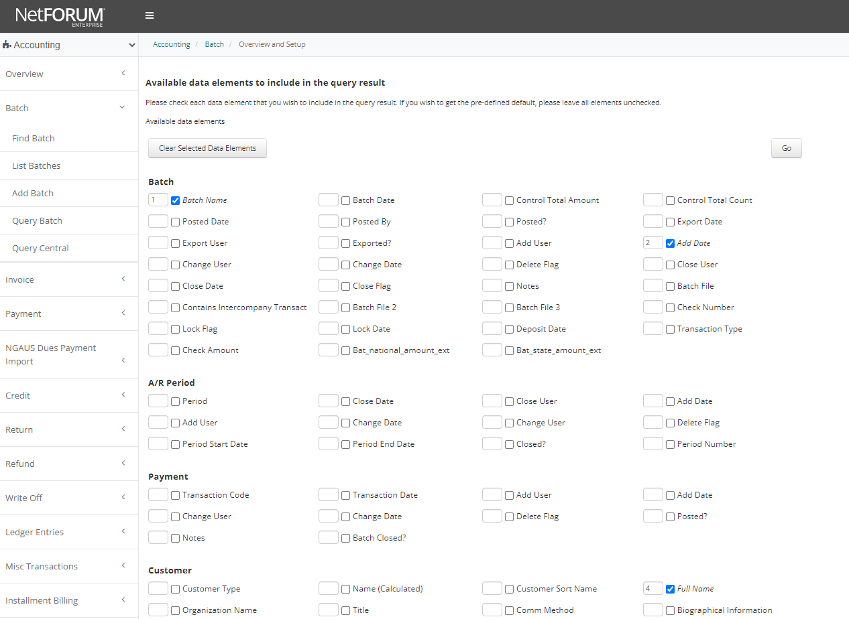
iWeb - State eWeb Payments
Click ‘Go”

Slide 12
iWeb - State eWeb Payments
Select State
Click ‘Go”

Slide 13
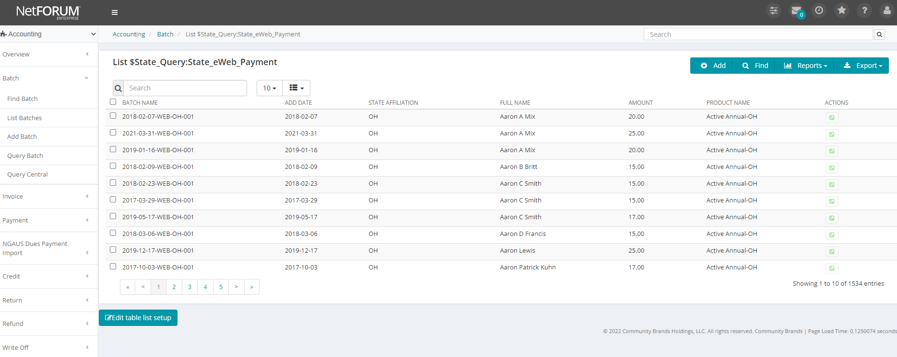
iWeb - State eWeb Payments
Date Purchased
Customer Name
Batch
Amount Charged for State Membership

Slide 14
iWeb – Export
Always export to ASCII Delimited/CSV

Slide 15
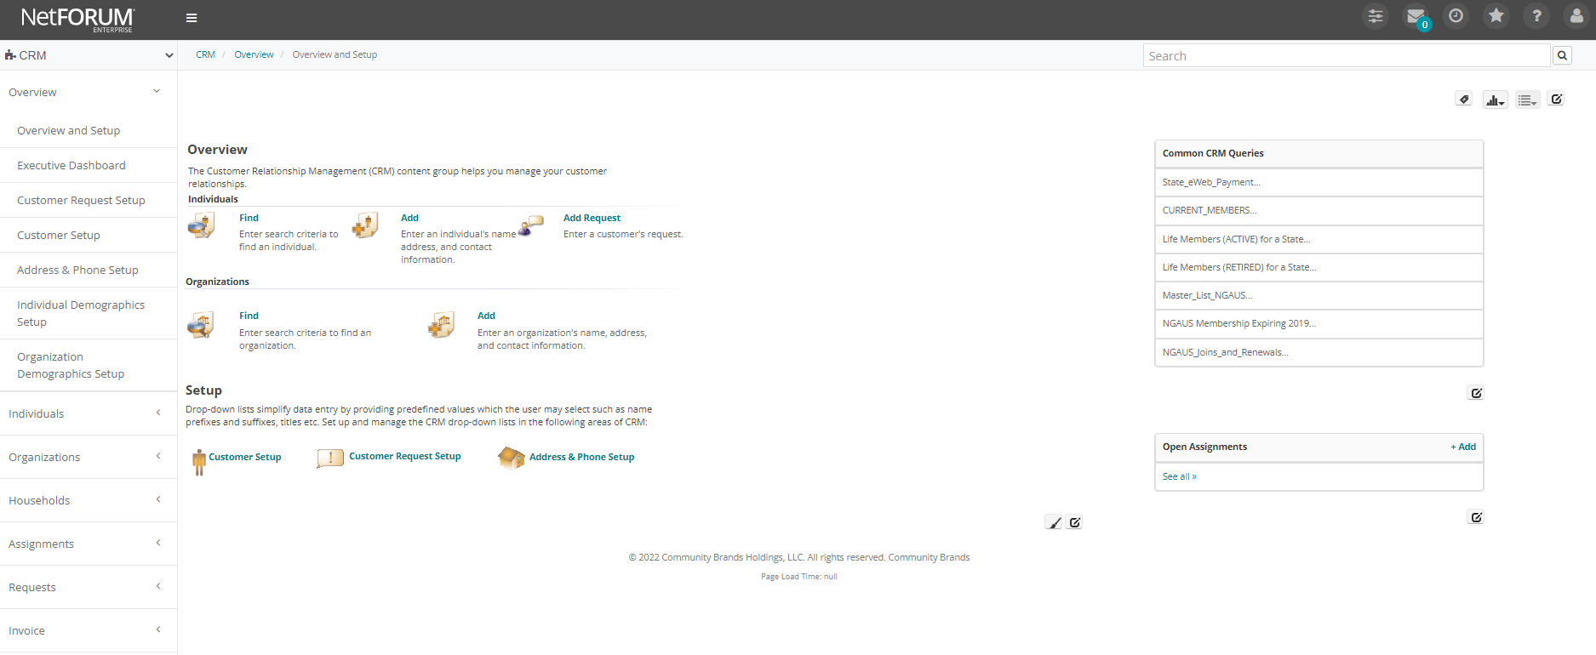
iWeb - Current Active Members
All NGAUS Active Annual,
Complimentary Annual, Active Life, Digital Life & Retired Life Members

Slide 16
iWeb – NGAUS Membership Expiring
All NGAUS Members who expired (You will need to change the year)

Slide 17
Creating a Batch

Slide 18
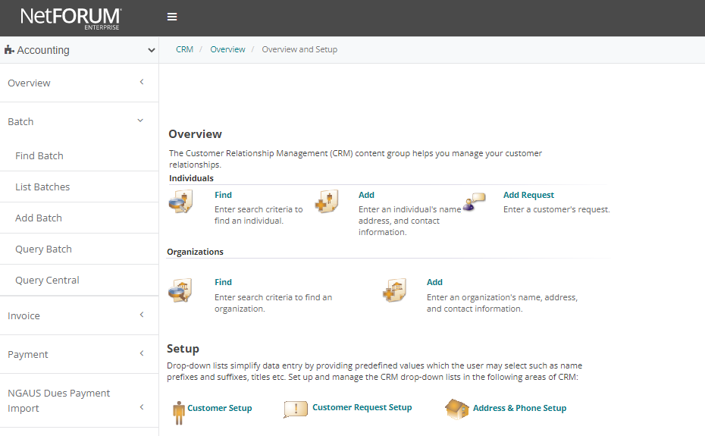
Create a Batch
1. Click “Accounting dropdown modules button” under the NetFORUM button
2. Click on “Add Batch” button

Slide 19
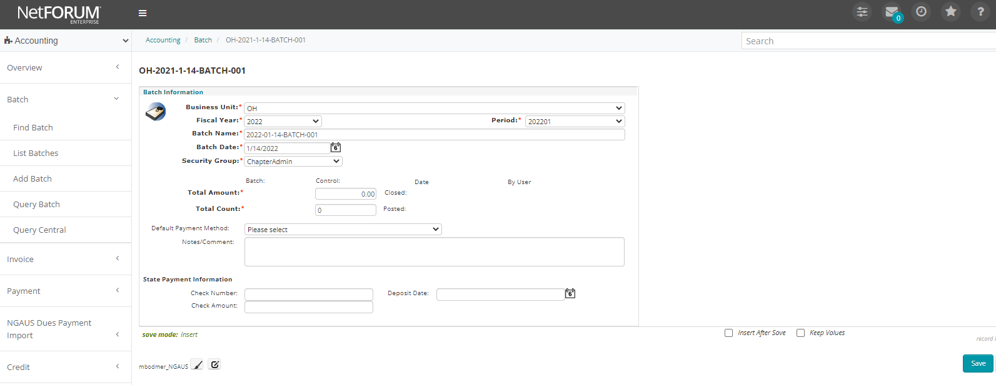
Creating a Batch
Change the business unit to your State/Territory two letter abbreviation.
Fiscal year and Period will auto-populate based on the information in your state profile. Do not change these fields.
The Batch Name and Date will also auto-populate. Add your two-letter state abbreviation to the beginning of the batch, for example OH 2022-01-14-BATCH-001 would indicate Ohio, January 14, 2022, Batch 001.
At this point, select default payment method if you choose (generally cash).
Select ‘Save’ to save the batch.

Slide 20
Search for a Member Record Change a mailing address

Slide 21
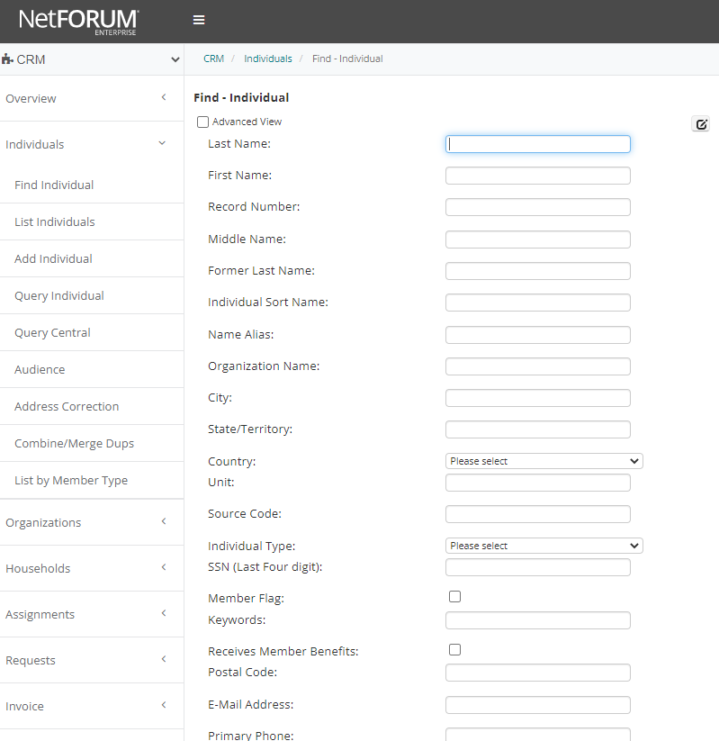
Search for an Individual Record before adding a record:
Pick one field to search for a record:
First Name
Last Name
Email Address
State
When searching, please keep in mind that there a lot of members with the same name. NEVER assume that the person you may find in the correct person.
*If you suspect or believe the individual was previous affiliated with a different state, contact NGAUS before creating a new record. This causes duplicate member records on file.
If you see multiple records for the same person, contact NGAUS.

Slide 22
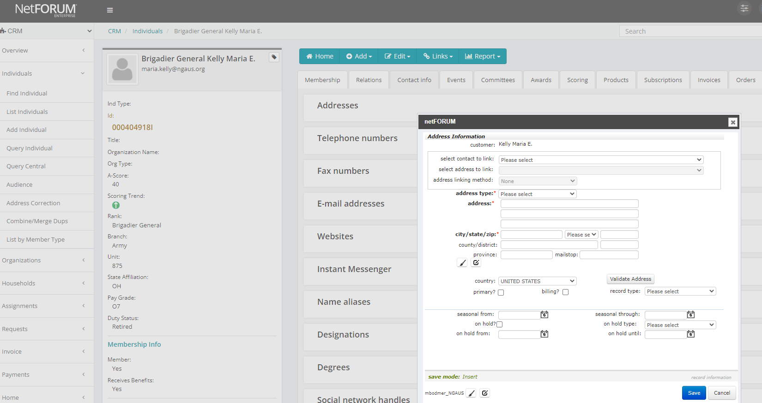
Change mailing address on Profile
1. Click “Contact Info” tab
2. Update mailing address
3. Check the “Primary” button
Click the “Save” button

Slide 23
Questions? Membership 101 Training Tuesday, January 18, 2022 – 1:00p to3:00p Wednesday, January 19, 2022 – 1:00p to 3:00p Melvin Bodmer, Jr., Database Manager Melvin.Bodmer@ngaus.org Office: 202.408.5883 Work Cell: 202.621.4023
Notes:
Mention Digital Life conversion opportunity.
For many of you, this is one of the most complicated times of your life. Some of you graduating college in the past few years, taking command, new job, family, children, and oh – COVID responses, just to name a few. It can seem overwhelming. I remember it well. Hang in there. Don’t feel like you have to jump right in and do it all with your associations. Take some time to learn, write a letter to congress, serve as a committee member, etc. You have an entire career (and beyond) with which to serve. Don’t let this feel like a burden, let it be a tool. We are here to work for you and to represent you. If what you are able to do right now is be an advocate for NGAUS and your state association, that is significant for us and we thank you.

