Slide 1
State Partnership Program
Maj. Gen. Anthony Carrelli, Adjutant General, Pennsylvania
Col. Alvydas Šiuparis, Defence Attaché, Republic of Lithuania

Slide 2
Unclassified, overall classification
Capability development priorities

Slide 3
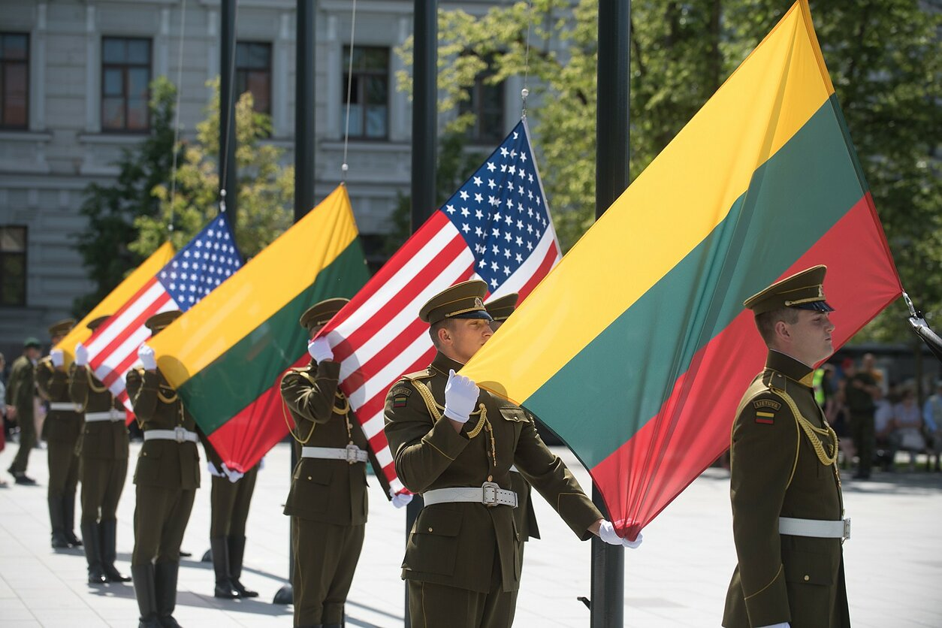
Unclassified
Contents
National defense developments
Capability development priorities
Maritime capability development
Questions

Slide 4
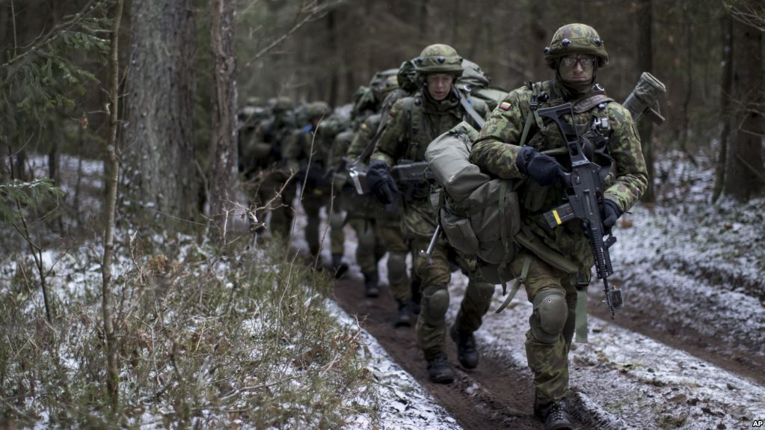
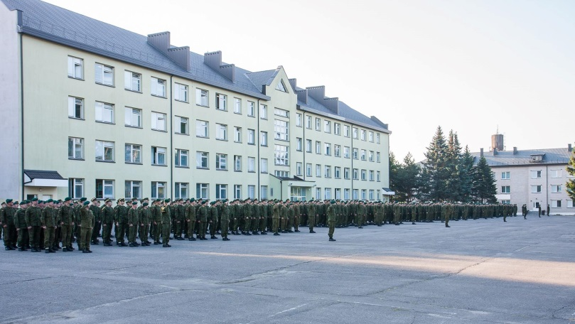
Recent defense developments
Unclassified
Revision of strategic and doctrinal documents
Alignment of peacetime and wartime structures
Enhanced land force structure
National High Readiness Forces (HRF)
Conscription
Increased defense budget
Force modernization

Slide 5
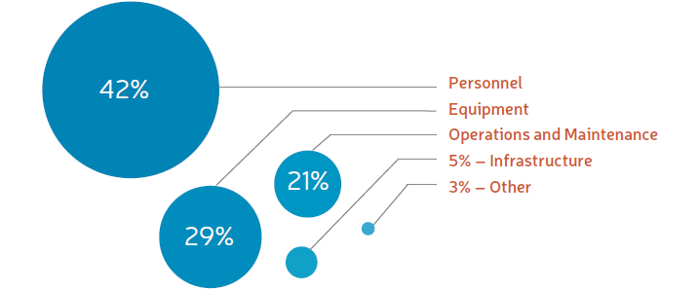
Unclassified
Defense budget
National
* as of end 2018

Slide 6
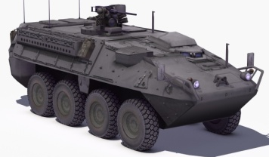
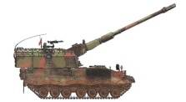
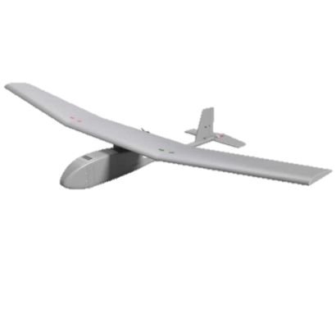
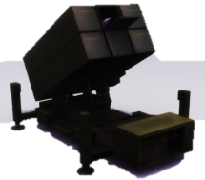
Unclassified
Capability development priorities
Land maneuver
Indirect fire support
Land centric ISTAR
Ground based air defense
Armed forces capabilities
Cyber security
Strategic intelligence

Slide 7
Land capability development
unclassified
Enhance Maneuver capabilities
IFV Boxer (ongoing)
IFV (2024-)
JLTV (ongoing)
Enhance Fire support capabilities
Self propelled howitzer PzH2000 (ongoing)
Anti tank capabilities (constant)
120 mm mortars (2022-)
Enhance ISTAR capabilities:
Observation, thermo-visual equipment (constant)
Unmanned aerial systems (2021-)
Enhance counter mobility

Slide 8
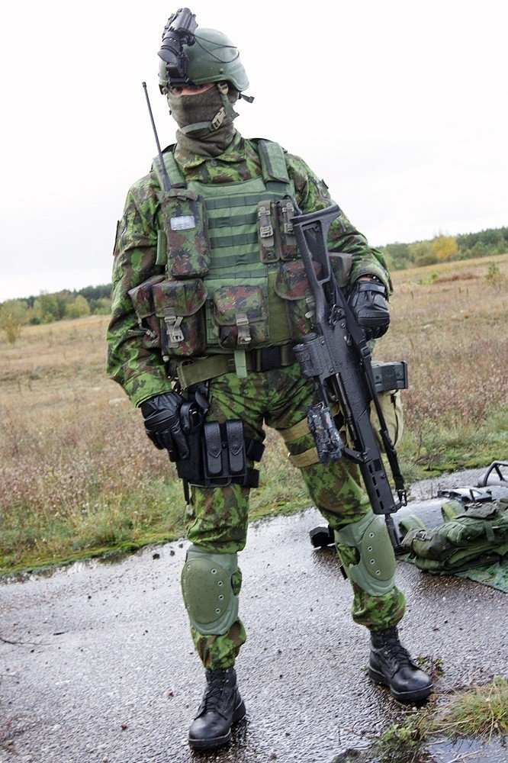
Soldier focus investments
Observation equipment
Protection
BDU
Weaponry
Webbing
Weapon accessory equipment
Survivability kits
Commander’s equipment

Slide 9
Air capability development
unclassified
Enhance Ground Based Air Defense capabilities:
Command and control network (ongoing)
Medium range AD systems NASAMS (ongoing)
Maneuver SHORAD (2027-)
Enhance Air surveillance:
Long range (ongoing)
Medium range (2021-2023)
Passive mean (TBD)
Replace legacy (Mi-8) helicopters
Enhance Air base capabilities:
Equipment (constant)
Infrastructure (constant)
Retain current tactical air transport capabilities (C-27 Spartan)
Develop counter-UAS capabilities

Slide 10
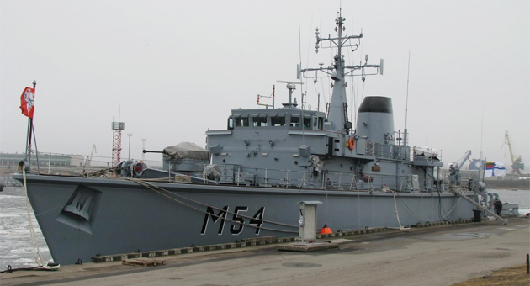
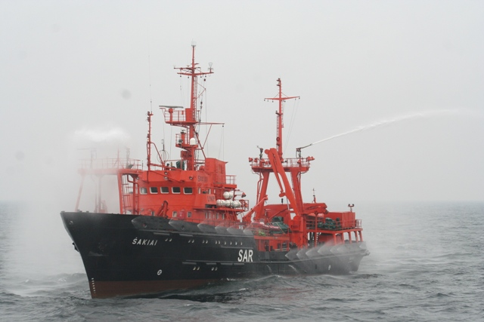
Maritime capability development
unclassified
Retain current maritime capabilities:
Search and rescue
Mine counter measure
Enhance Maritime Domain Awareness (MDA)
Develop Deep water/ external harbour

Slide 11
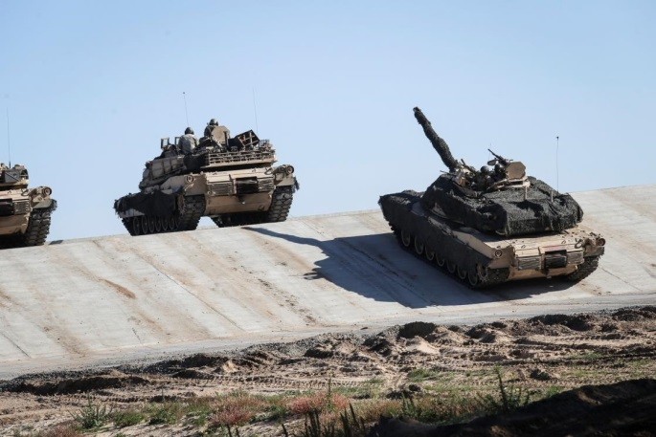
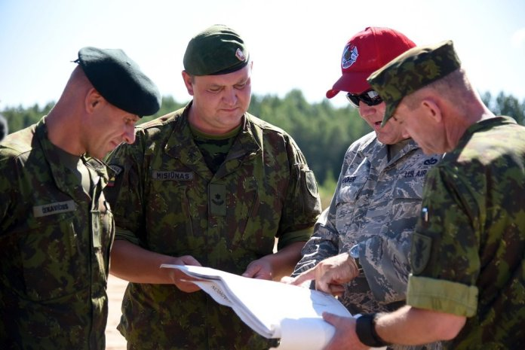
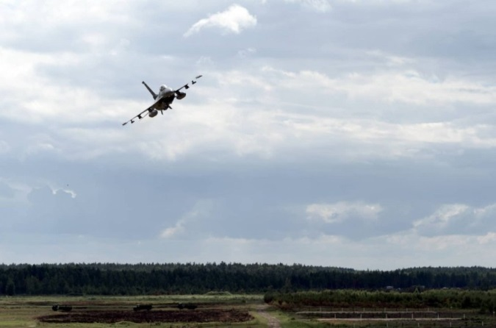
Infrastructure and logistics
unclassified
Develop adequate infrastructure to support national and Allied deployment and training
Infrastructure development priorities:
Host Nation Support (Baltic Air Policing , enhanced Forward Presence, reception of Allied forces)
Training infrastructure
Ammunition holding areas
Logistics
Ammunition
Maintenance units
Transportation
Medical support role 1/2

Slide 12
2018 LTU Defense system reform: defense planning and C2
MoND
MoND
Before reform
After reform
Political guidance
Capability requirements and plans
Resources
Defence staff
Joint staff
Strategic command of Armed forces
Operational command of Armed Forces
Capability requirements and plans

Slide 13
2018 LTU Defense system reform: Acquisitions
MoND
MoND
Before reform
After reform
Materiel Resource Agancy
Acquisitions policy
Project management
AF
Implementation of Centralized acquisitions
Other units and institutions
Other units and institutions
Department of material resources
Implementation of Centralized acquisitions of AF
Implementation of acquisitions for infrastructure and communication part

Slide 14
Questions?

