Slide 1
NGAUS Resolution Process

Slide 2
Notable References - First, understand the strategy, priorities, and processes -
NGAUS Resolutions website https://www.ngaus.org/legislation/resolutions
NGAUS YouTube training video (About 7 minutes long) https://www.youtube.com/watch?v=FX_LiBSTJTo
Resolutions SOP and Task Force SOP on the NGAUS website
National Guard and Reserve Equipment Report published annually https://prhome.defense.gov/Readiness/Publications/
Air National Guard priorities books https://www.ang.af.mil/Home/ANG-Priorities-Books/
DOD, USAF, and DA strategic documents, i.e. National Defense Strategy, Army Network Modernization Strategy, etc.

Slide 3
Resolutions Overview – Pg 1
Resolutions are legislative proposals, submitted by states, territories, and the District of Columbia to enhance National Guard equipment, capabilities, and benefits parity
Types of Resolutions
Standing – Already approved by NGAUS membership at the annual conference and help guide NGAUS legislative efforts
Draft – Changes/deletions to standing resolutions or a new resolution no approved by the NGAUS membership
Emergency – Resolutions submitted after the deadline of 01 Jul but before 31 Jul prior to the national conference (see SOP for what constitutes an emergency)
Key stakeholders in the resolution process include state associations, Adjutants General, NGAUS Task Forces, members of congress, and industry partners

Slide 4
Resolutions Overview – Pg 2
Resolutions begin at the state association level by NGAUS members
Throughout the spring and early summer months, members are encouraged to submit draft resolutions through their state, territory or District association.
NGAUS Task Forces serve as advocates, subject matter experts, and advisors to members for their specific area, e.g. Sustainment, DOMOPS, C4I
Once a draft resolution passes a state conference, the state association submits it to NGAUS for consideration at the NGAUS General Conference & Exhibition.
Once considered and approved at the NGAUS conference, the resolution becomes part of the NGAUS legislative priorities and advocacy in Washington

Slide 5
Dec State Draft
Jun-Jul NGAUS Review
Jul NGAUS BoD review
Sep NGAUS Conf consideration
Oct-Nov Prioritization Leg Action Plan
Jan-May State Approves
Aug
Final/Prep
NGAUS Resolutions Cycle

Slide 6
Resolutions in Detail pg 1
Providing Input on Tracking Sheets
Tracking sheets serve as an administrative method to compile the views of the various stakeholders in the resolutions process, including NGB, task forces, and NGAUS BoD. In preparation for the annual general conference, task force chairs will review all draft resolutions and provide their input (support/non-support and comments if necessary) to the appropriate NGAUS program manager (Joint, Army, Air) NLT the Wednesday prior to the summer Board of Directors meeting.
Resolutions Committee Meeting
Task force chairs (or designated alternate; vice chair, etc.) are expected to attend and participate in resolutions committee meetings (Joint, Army, Air) during the general conference to provide task force support/non-support and any additional comments for applicable resolutions.
Resolutions Accuracy
Task Forces are responsible for identifying outdated information and new information to add to standing resolutions. They must work with the state associations to ensure draft resolutions are submitted through the proper process in order to update standing resolutions. This should begin in January by reviewing standing resolutions and contacting states prior to their state association conference.

Slide 7
Resolutions in Detail pg 2
Establishing Top Priorities
One of the primary duties of NGAUS task forces is to establish top priorities.
After adoption of the resolution packet at the general conference by the membership, each task force will confer to establish top priorities (3-5 in rank order; all resolutions are assigned to a specific task force). This may be accomplished in any manner the task force chooses; meeting, teleconference, e-mail, etc., but should be a collaborative process of the full task force.
Fact Sheets
Task forces are responsible for providing information for the development of NGAUS fact sheets. NGAUS fact sheets are detailed point papers used by the NGAUS legislative staff to educate and inform members of Congress and their staff on the association’s top legislative issues.

Slide 8
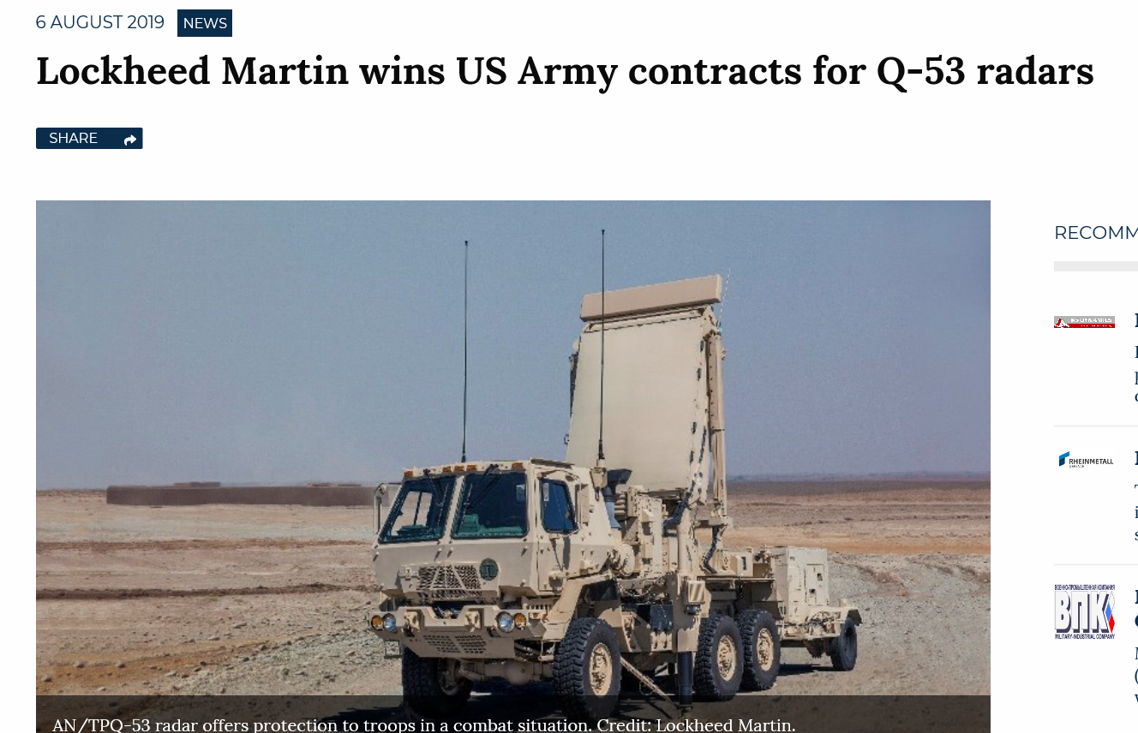
Examples of Recent Resolutions
AH-64D Apache upgrades for all National Guard Attack Systems and modernization of Attack Systems with AH-64E
Counter Battery Target Acquisition Radars (Q-53 and LCMR Q-50)
High Mobility Multi-Purpose Wheeled Vehicles (HMMWV)
M870A4 40-Ton Semi-Trailers
Fund and procure Active Electronically Scanned Array (AESA) for ANG F-15 C/D aircraft

Slide 9
NGAUS Task Forces
NGAUS task forces are special committees appointed by the NGAUS Chairman of the Board, with concurrence of the Board of Directors (reference NGAUS by-laws Section 6.02). Task forces work closely with the NGAUS legislative staff to provide input on resolutions and fact sheets, advise the general conference committee on resolutions, and address special issues assigned by the Chairman of the Board.

Slide 10
NGAUS Task Forces
Task forces are grouped into three general areas; Joint, Army or Air and then broken down by issue categories or weapon system grouping.
Joint Task Forces
Personnel and Benefits
Medical
Homeland Security
Army Task Forces
Fire Support
Combat Vehicle/Ground Combat Task Force
Army Sustainment
Army Aviation
C4I
Engineer
Air Task Forces
Combat Air Forces
Mobility Air Forces
Combat-Mission Support

Slide 11
Task Force Membership
Task Force Members
Task force members must be currently serving National Guard members and current members of NGAUS. They should have in-depth knowledge of the subject matter to be considered by the task force. It is recommended that each task force have a minimum of seven members to avoid tie votes, and to ensure that all six NGAUS areas are represented. All votes of the task force will be conducted in executive session by members of the task force. Task force membership includes the following:
Chair
Each task force will have a chair appointed to preside over all meetings of the task force. The NGAUS Chairman of the Board will appoint task force chairs and vice chairs.
Vice Chair
The vice chair will assume the responsibilities of the chair in his or her absence
Professional Staffers – Non-members
The role of professional staffers is to provide expert assistance and coordination to the task force.

Slide 12
Meetings
Meetings
Meetings of the task force are at the call of the task force chair. At least two-thirds of the voting body of the task force must be present to satisfy quorum requirements. Teleconference meetings are encouraged.
It is recommended that task forces meet as necessary. However, a minimum of two meetings per year are requested in order to facilitate NGAUS business in a timely and effective manner:
Resolutions Review Meeting: This meeting shall take place prior to NGAUS Board of Directors Summer Meeting. The purpose of this meeting is to review and comment on NGAUS draft resolutions to be considered at the upcoming general conference.
NGAUS General Conference: The task force chair, or vice chair when chair is unavailable, will attend the NGAUS General Conference. They will participate in the resolutions meetings and hold a task force meeting at the designated time per the master agenda. Industry presentations are encouraged at this meeting. Task Force Chairs are also encouraged to walk the exhibit floor to meet industry members who have an interest in their task force.
Prioritization Meeting: Following the NGAUS general conference, task forces meet to prioritize the adopted resolutions. This must be accomplished by the deadline for the legislative objectives book. In addition to prioritizing resolutions, the task forces must also assist in formulating fact sheets and drafting new resolutions for the following year’s resolution process.

Slide 13
Task Force Chair Duties
Presiding over all meetings of the task force
Ensuring meeting minutes are recorded and provided to the NGAUS legislative staff, who will then forward a copy to the Chairman of the Board, vice Army &Air, and an information copy to the NGAUS president.
Providing comment (support/non-support) at the NGAUS general conference resolutions committee meeting
Recruiting members and professional staff to serve on the task force
Delivering an annual report to the NGAUS Board of Directors, as required by the Chairman of the Board (Legislative Staff will provide example report)
Ensuring that the applicable NGAUS Program Manager is provided with a roster of task force members

Slide 14
POCs
Keith Klemmer, BG (Ret)
NGAUS Corporate Advisory Council
Keith.Klemmer@me.com
571-294-9087
Mike Hadley, COL (Ret)
NGAUS Legislative Director
Mike.Hadley@ngaus.org
Mark Malizia
NGAUS Legislative Analyst
Mark.Malizia@ngaus.org

