Slide 1
National Guard Association of the United States (NGAUS) Corporate Advisory Panel (CAP)
CAP
Corporate Advisory Panel
Doing Business with the National Guard 101
Notes:
This presentation is an attempt by the Corporate Advisory Panel to give Corporate Partners that may not have extensive military backgrounds or knowledge, a basic primer on the National Guard. It is not meant to be a one stop shop for all information on the Guard. It will probably spark more questions, but is a start point.
Also, for those that have active duty experience, may not be aware of some of the nuances about the National Guard.
The CAP was formed as a panel by NGAUS for two main reasons.
To advise the director and staff on Corporate Issues that will make the relationship stronger and more mutually beneficial
The CAP is elected to represent the needs of the Corporate members in a small enough number to be efficient in presenting those needs and issues to the NGAUS staff.

Slide 2
National Guard Overview
CAP
Corporate Advisory Panel
The National Guard has been defending the nation for over 377 years
There are 54 separate National Guard organizations in the 50 States, 3 Territories, and the District of Columbia
The National Guard is a “Dual Status” organization with a Federal and State mission
The Federal mission is to serve as the operational reserve component of the Army and the Air Force
The State mission is to respond to domestic and homeland security emergencies under the Command and Control of the Governor.
Currently there are 335,500 Soldiers in the Army National Guard and 105,500 Airmen in the Air National Guard.
The Army Guard is in over 2,600 communities across the nation
Notes:
The NG is the oldest military organization in the U.S., the State militias predate the country
There are 54 different cultures. It can take years to understand what works in one State but not another. They all have the same basic organization, they each have their own unique way of doing business.
When a NG member joins they swear an oath to both the Governor and the President. The type of orders they are on determines which is their Commander-in-Chief at any particular time. The vast majority of the time it is the Governor.
The NG is the most community-based military organization in the military

Slide 3
The Role of the National Guard Bureau
CAP
Corporate Advisory Panel
NGB is:
defined as a joint activity of the Department of Defense
led by a Four Star General who serves on the Joint Chiefs of Staff
serves as the channel of communication on all matters pertaining to the States
oversees the allocation and use of all federal funding provided to the States, Territories and the District of Columbia
Notes:
The National Guard and it’s place in the Department of Defense is very complex.
Both the Army and Air National Guard have direct lines to both the Regular Army and Air Force but also to the Chief of the National Guard.
The Adjutant’s General are under the direct control of the Governor of their state.
While very complex, this is a prime example of the “Dual-Status” of the National Guard.

Slide 4
Associations
CAP
Corporate Advisory Panel
NGAUS- National Guard Association of the United States.
EANGUS- Enlisted Association of the National Guard of the United States.
AGAUS- Adjutant’s General Association of the United States.
NGEDA- National Guard Executive Directors Association.
Notes:
Each association is unique and depending on the service/product you provide one or two may be more beneficial than the others.
It is up to you to decide what is best for your company/corporation

Slide 5
CAP
Corporate Advisory Panel
National Guard Association of the United States (NGAUS)
NGAUS is a professional non-profit association and lobbies on behalf of the officers of the Army National Guard.
NGAUS develops their legislative priorities through the development of resolutions that once submitted by the various states are voted upon by the national membership at the NGAUS annual conference. These priorities are published and released each December at the NGAUS Industry Day.
NGAUS Task Forces are special committees appointed by the NGAUS Chairman of the board to assist the NGAUS Legislative team on processing and prioritizing state submitted resolutions. Corporate members participate in Task Force meetings.
NGAUS received corporate input through the NGAUS Corporate Advisor Panel.
State Associations meet in the March through June timeframe.
NGAUS holds an annual conference in the August-September timeframe. This year the annual conference will be held in Denver, CO, 30AUG-3SEP.
Notes:
This association’s membership is Officer Centric
Very powerful lobbying organization.
Does deal with major programs of record.

Slide 6
The Enlisted Association of the National Guard of the United States (EANGUS)
CAP
Corporate Advisory Panel
EANGUS is the only military association that concentrates solely on the enlisted members of the Army and Air National Guard both active and retired. It represents the 400,000 plus enlisted Soldiers and Airmen of the National Guard to ensure they have the proper equipment on hand to perform both their Federal and State mission.
EANGUS also lobbies the Congress for benefits for all members of the National Guard and coordinates their efforts with NGAUS and AGAUS.
Most state association meetings are held between February and June. Some are separate from state NGAUS conferences and some are held jointly.
EANGUS holds an annual conference in August. This year the conference will be in Des Moines, Iowa, 3-8 August.
Notes:
This association primarily deals with individual Guardsmen’s readiness, equipping, and training.
They usually do not deal with major programs of record.

Slide 7
The Adjutants General Association of the United States (AGAUS)
CAP
Corporate Advisory Panel
AGAUS represents the senior leadership of the Army and Air National Guard of the 54 States, Territories and District of Columbia.
AGAUS is committed to a central leadership role in promoting and supporting an adequate state and national security, the efficiency of the Army and Air National Guards of the respective states, and in facilitating and improving the administration of the National Guard affairs through the agencies of the Department of Defense and the several states.
AGAUS is committed to ensure the National Guard is organized, equipped, and postured to fulfill their responsibilities across the full spectrum of operations.
AGAUS meets twice yearly at the AGAUS Annual meeting in June and the AGAUS Mid-winter meeting in February.
AGAUS met in Whitefish, MT, 2-6 June, 2019
Industry is welcome to attend.
Notes:
This is a small group of current and retired Adjutant’s General.
Adjutant’s General are responsible for everything National Guard within their states.
They are the final say, but usually delegate authority for decisions to other members of the staff.

Slide 8
National Guard Executive Directors Association
CAP
Corporate Advisory Panel
To provide a forum for the exchange of timely information of common interest for the mutual benefit of members and the organizations they represent.
To encourage and assist, when feasible, each state, commonwealth, territory and the District of Columbia to organize and maintain a National Guard association.
To participate in improving the operational readiness, training and image of the National Guard on both state and national levels.
NGEDA usually meets in January at the location of the upcoming NGAUS conference city. They will meet 19-23 January, 2020 in Boston, MA.
Industry is welcome to attend
Notes:
This group runs the day to day operations of individual State Associations.
I find that the winter meeting at the site of the next NGAUS annual meeting has been a good investment to attend.

Slide 9
Key Leaders in NG States
CAP
Corporate Advisory Panel
TAG- The Adjutant General- Two Star General, can be Army or Air. Senior Officer in the State. Primary Military Advisor to the Governor
CoS- Chief of Staff, Usually a Colonel, responsible for running all staff functions in a State
CCWO- Command Chief Warrant Officer- Ranking Warrant Officer in the state
SEL- Senior Enlisted Leader- Joint billet, senior enlisted advisor to the TAG, can be Army or Air.
SCSM- State Command Sergeant Major, Senior Army Enlisted Soldier
SCCM- State Command Chief Master Sergeant, Senior Air Enlisted Airman
SAO- State Aviation Officer
Notes:
The Adjutant General, TAG, is appointed by the governor in most cases. They are a State employee unless put on federal orders. Usually they run the State’s military department. Many times they have other state assignments including but not limited to: State Emergency Management, State Veteran’s Affairs, State Cemeteries, etc….
CoS- one of the best sources of information on directing you to the best point of contact for your product or service. They usually know everything that is going on in the State.
CCWO- a great guide to getting you to specific subject matter experts in your field.
SEL, SCSM, SCCM- Deals with all individual readiness, equipping, and training..
SEL focuses on Joint issues, SCSM on Army, SCCM on Air
SAO- If your product/service is aviation oriented, this is the best POC.

Slide 10
Staff Positions
CAP
Corporate Advisory Panel
G1- Deputy Chief of Staff- Personnel
G2- Deputy Chief of Staff- Intelligence
G3- Deputy Chief of Staff- Operations
G4- Deputy Chief of Staff- Logistics
G5- Deputy Chief of Staff- Plans
G6- Deputy Chief of Staff- Signal
G8- Deputy Chief of Staff- Finance
USPFO- United States Property and Fiscal Office
Notes:
Depending on your service/product this list will help you find the right leader.
For Example, if you are an education company, the G1 is the right person to contact.
Training- G-3
Equipment- G-4
Computers and Programs- G-4 and G-6
ETC
The USPFO is a unique position in the State. They are on T10 Federal Orders, and are responsible for monitoring and ensuring that Federal Funds are allocated and used appropriately.

Slide 11
Key Logistic Positions in a State
CAP
Corporate Advisory Panel
USPFO- Usually a Colonel on Title 10 Orders (Federal) that reports to NGB. Responsible for insuring federal funds and property are properly distributed and managed.
G4- Usually a Colonel that coordinates all logistics efforts in a State
G4 SGM- Senior logistics NCO in a state, usually focuses on individual equipment and training of all supply NCO’s in a state.
Supply and Service Officer- Officer in the G4 office responsible for supply issues in the state. Sometimes in charge of the Central Issue Facility (CIF)
CIF Manager- Manages the CIF usually a Warrant Officer.
Notes:
Explain slide

Slide 12
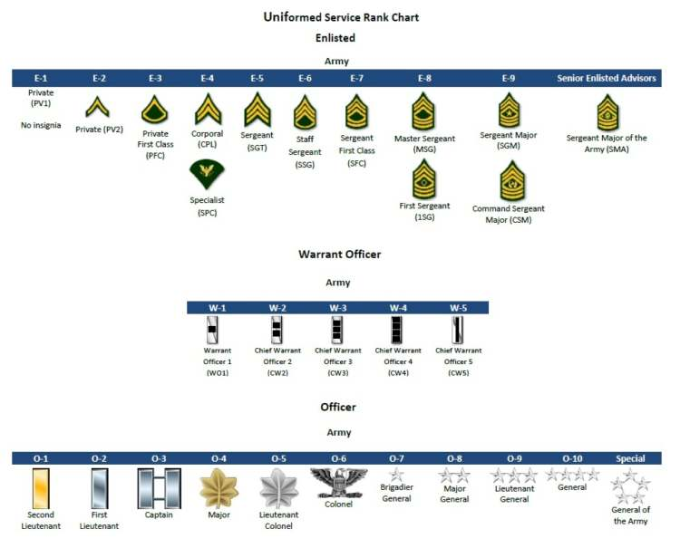
CAP
Corporate Advisory Panel
Notes:
Explain Slide

Slide 13
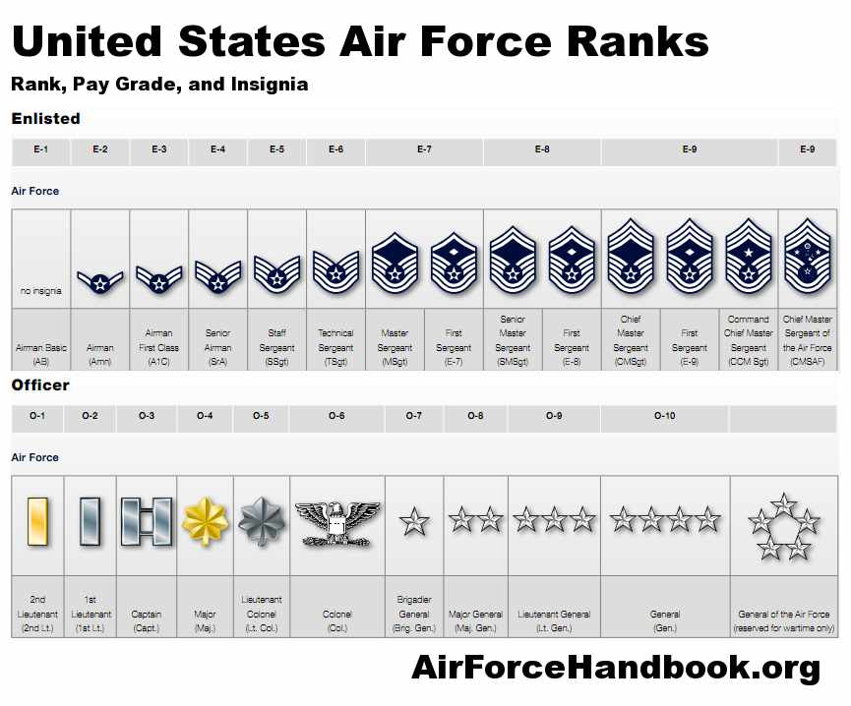
CAP
Corporate Advisory Panel
Notes:
Explain Slide
One key difference between Army and Air is that the Air Force does not have Warrant Officers. Most of the time Senior NCO’s or Junior Officers fill those roles.

Slide 14
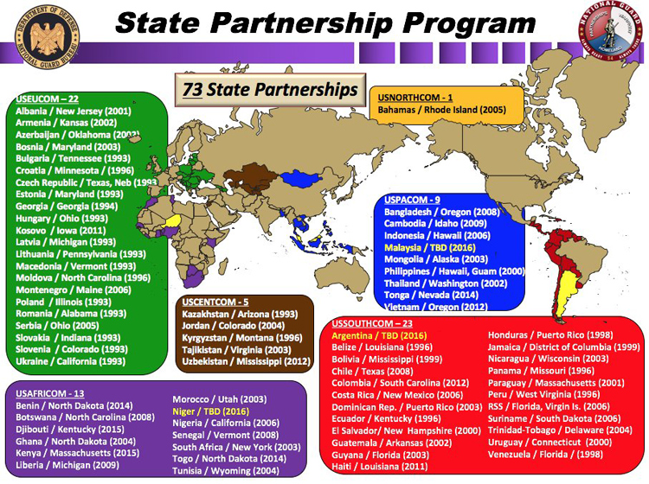
CAP
Corporate Advisory Panel
Notes:
If you are an international organization, knowing which State has which partner may be beneficial to help with business overseas.

Slide 15
Questions
CAP
Corporate Advisory Panel

Slide 16
Flow of Funds to the Army National Guard
CAP
Corporate Advisory Panel
Congress
Office of Management & Budget
DoD Comptroller
ASA (FM&C)
Chief, NGB Grants Authority
ARNG Comptroller
ARNG Installations
OMNG
NGPA
Other Appropriations
MCNG
Notes:
Explain Slide

