Slide 1

Legislative Update
Mike Hadley
NGAUS Legislative Director

Slide 2

Agenda
NGAUS Legislative Team
NGAUS Resolutions
NGREA
Legislative-Industry Relations
Congressional Cycle Update
Priorities for a 21st Century National Guard

Slide 3
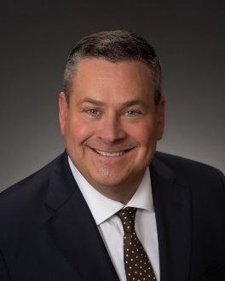


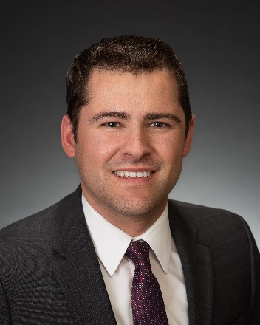


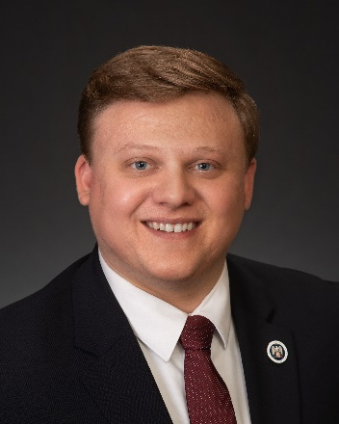
NGAUS Legislative Team
BG (Ret) Roy Robinson
NGAUS President
president@ngaus.org
COL (Ret) Mike Hadley
Legislative Director
mike.hadley@ngaus.org
Priya Ghosh Ahola
Deputy Legislative Director & General Counsel
priya.ghosh@ngaus.org
JC Cardinale
Legislative Programs Manager
jc.cardinale@ngaus.org
Adrienne Jackson
Legislative Programs Manager
adrienne.Jackson@ngaus.org
Mark Malizia
Legislative Analyst
mark.malizia@ngaus.org
Blaise Lemke
Legislative Assistant
blaise.Lemke@ngaus.org

Slide 4
NGAUS Resolutions
What They Are
Foundational topics for NGAUS advocacy
Proposals received annually from State Associations
  Ideas to improve equipment, capabilities, and quality of life for Guardsmen and their families
  Feed directly into NGAUS priorities
What They Are Not
Appropriations or NGREA funds
Authorizations
Programs of Record

Slide 5
NGREA
Requirements
Items of Special Interest (ISIs)
Not all products are good candidates for NGREA

Slide 6
Legislative-Industry Relations
Strategy Development
Intelligence Comparison
Networking/Idea Socialization

Slide 7
Congressional Cycle Update
All Fiscal Year (FY) 2020 Defense Legislation is Pending
Appropriations
Continuing Resolution (CR) signed on November 21, continues government funding until December 20
Authorizations
FY20 National Defense Authorization Act (NDAA) currently in Conference Committee
  Contentious issues include border wall funding, Space Force structure, paid family leave, PFAS restrictions, election security
  Full NDAA possible this week

Slide 8
Priorities for a 21st Century National Guard
Ensuring Deployability, Sustainability, and Interoperability with the Active Component through…
The Same Equipment
Concurrent & Proportional Fielding of Equipment to the National Guard, includes:
  UH-60M, MQ-1C, F-35A, KC-46 & C-130J Procurement
  AH-64E Apache Battalions Equipped at 24 Aircraft
National Guard Equipment Modernization & Recapitalization, includes:
UH-60V Black Hawk & HMMWV Modernization
C-130H, A-10, F-15 & F-16 Modernization
The Same Resources
Future Multi-Domain Battlefield Interoperability, includes:
  National Guard Integration into Total Force Cyber Mission & Training
  Space National Guard as the Primary Combat Reserve within Future Space Force
  Like Force Structure
Increased Full Time Support/Manning
Robust NGREA Funding
Increased National Guard MILCON Funding
The Same Benefits for the Same Missions
Zero Cost TRICARE to Ensure Reserve Component Medical Readiness
Ready Access to Mental Health Care & Suicide Prevention
Protecting National Guard Equities in Duty Status Reform
Tax Incentives for Guardsmen & Employers
Providing Benefits & Leave Policies Befitting the Operational National Guard

Slide 9
Questions?

Slide 10
Backup

Slide 11
NGAUS Mission
Serve as the strongest advocate for National Guard servicemembers, their families, and veterans in Washington, D.C.
Work to continuously improve National Guard readiness, modernization, and quality of life within the Total Force
Promote the National Guard’s rich militia heritage as the first military organization of the U.S.

Slide 12
Organizational Structure
Board of Directors
NGAUS President
Chief of Staff
Executive Staff
Legislation
Communications
Membership & Marketing
Industry Relations
Contracts/Finance/HR
Director
Director
Director
Director
Director
Deputy Director
Communications Staff
Membership Staff
Industry Relations Staff
Deputy Director
Legislative Staff
Marketing Staff
Finance Staff

Slide 13
NGAUS Strategic Overview
Advocacy
Apolitical & Non-Partisan
Goals & Best Practices
  Lobby for National Guard equipment parity and benefits equity
  Develop strong relationships with Congress and staff, especially local staff
  Collaboration with Department of Defense (DoD), Services, National Guard Bureau (NGB), Veterans Affairs (VA), and Department of Homeland Security (DHS)
  Grassroots engagement

