Slide 2
About the Annual Conference
A NGAUS tradition, the annual conference allows members to gather and vote on the top legislative priorities for NGAUS, share information and celebrate camaraderie of being National Guard and NGAUS members.
The 2020 Conference will be held at the Boston Convention and Exhibition Center (BCEC).
More than 5,000 members of the military, national Administration officials, elected officials and private industry representatives who comprise the NGAUS will be in attendance.
Since 2020 is a Presidential election year, the nominees of the major political parties are expected to attend. Join us in Boston as we showcase the patriotic and innovative spirit of New England’s companies.

Slide 3
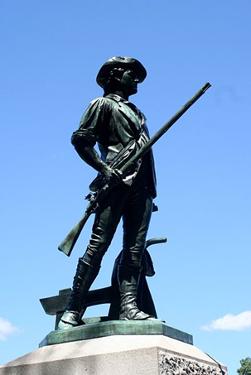
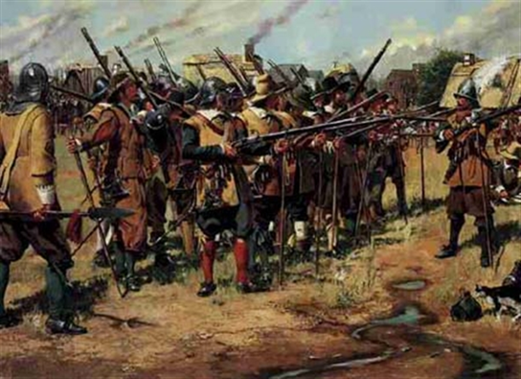
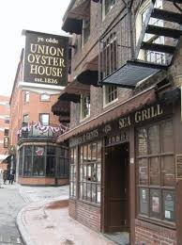
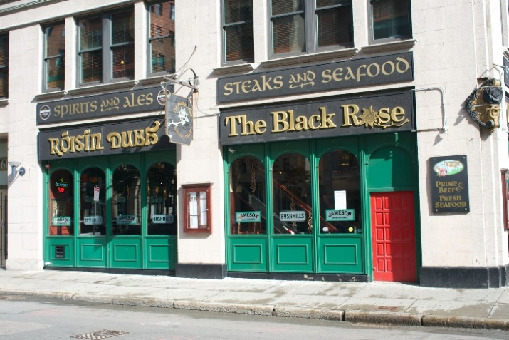
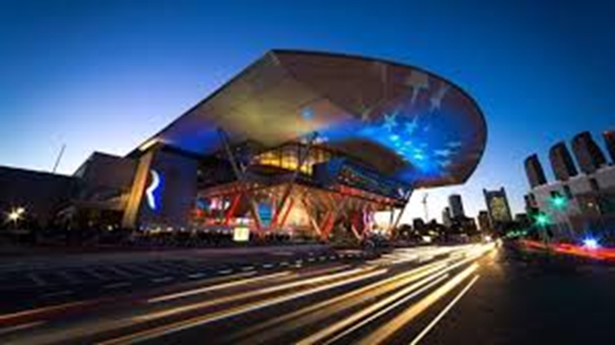
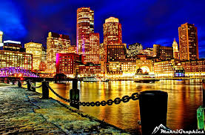
Why Visit Boston?
The History
The Nightlife
The BCEC
The Experience

Slide 4
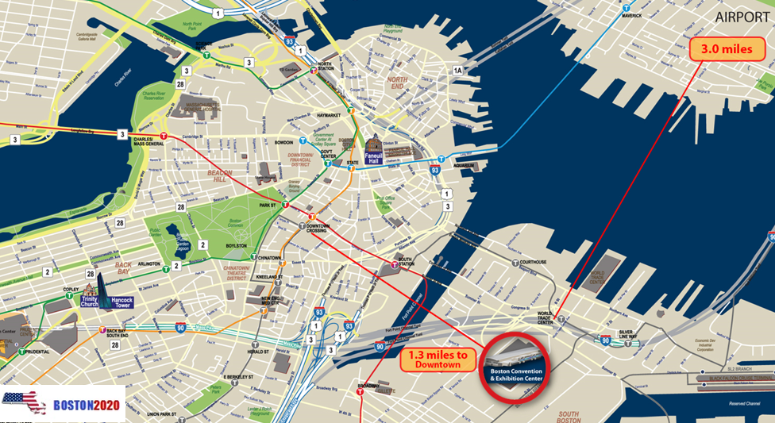
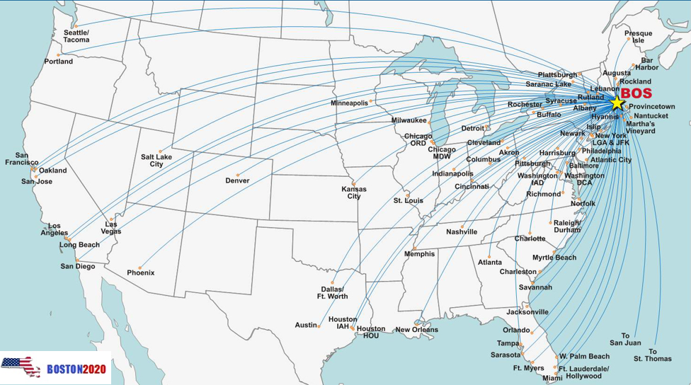
Boston is Easily Accessible!
Direct Flights to 76 Domestic Cities
AMTRACK regional service from Washington DC
Minutes from Major Highways
8 Minutes from Boston Airport to the Convention Center
America’s Walking City
Major Historical Sites Walking Distance Apart

Slide 5
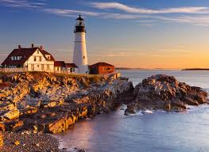
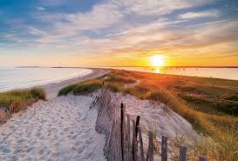
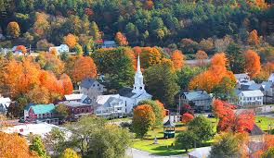
New England has a lot to offer!
Turn your visit to the conference into a longer stay by experiencing what New England has to offer!
Cape Cod (MA)
Newport (RI)
Burlington (VT)
Portsmouth (NH)
York Beach (ME)

Slide 6
Timeline
Thursday, August 27, 2020
Patriot Golf Tournament (Vendor)
Exhibitor Reception
Friday, August 28, 2020
Patriot Golf Tournament (NGAUS)
TAG Reception
Saturday, August 29, 2020
Exhibition Hall Officially Opens
Governor’s Reception
Sunday, August 30, 2020
Spouse Luncheon
Hospitality Night
Monday, August 31, 2020
TAG Spouse Luncheon
State’s Diner

Slide 7
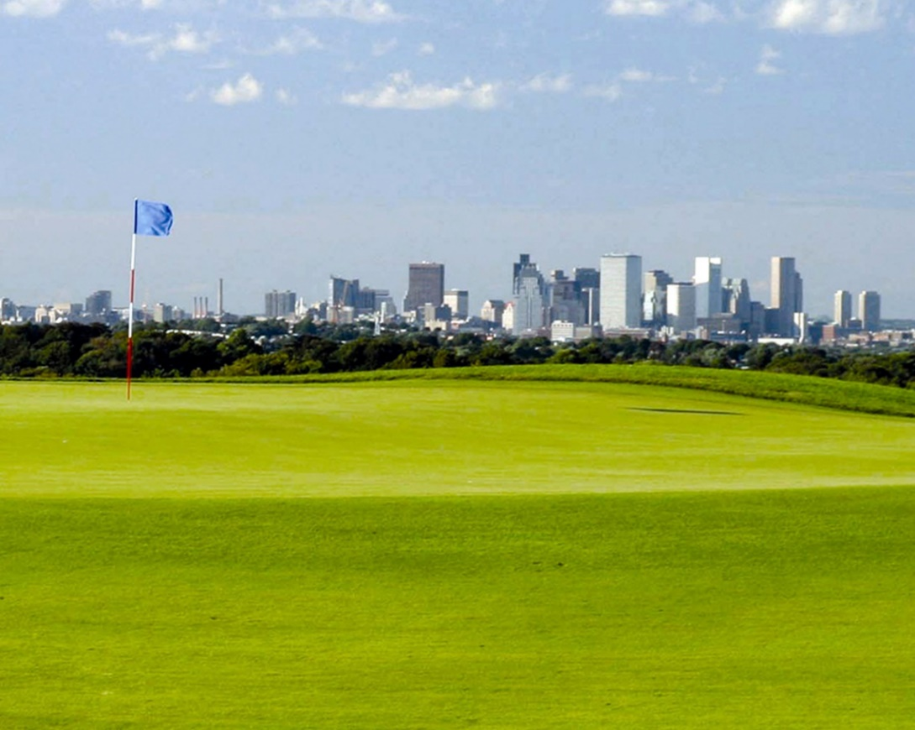
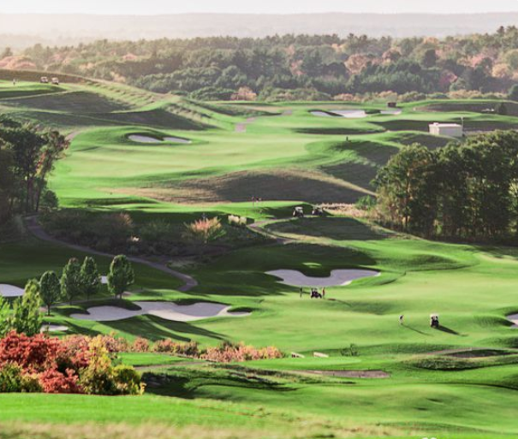
Events – Patriot Golf Tournaments
Granite Links Gold Club
Beautiful Top Rated Championship Golf
Views of Boston Skyline
Challenging Layout

Slide 8
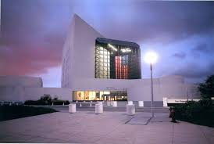
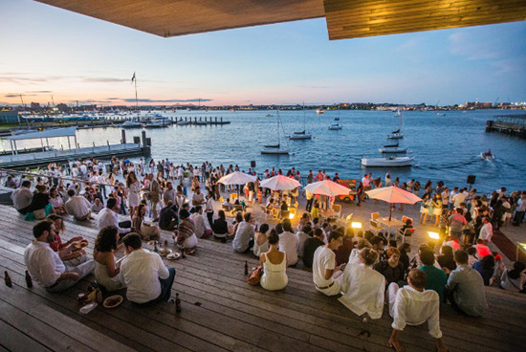
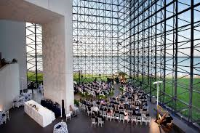
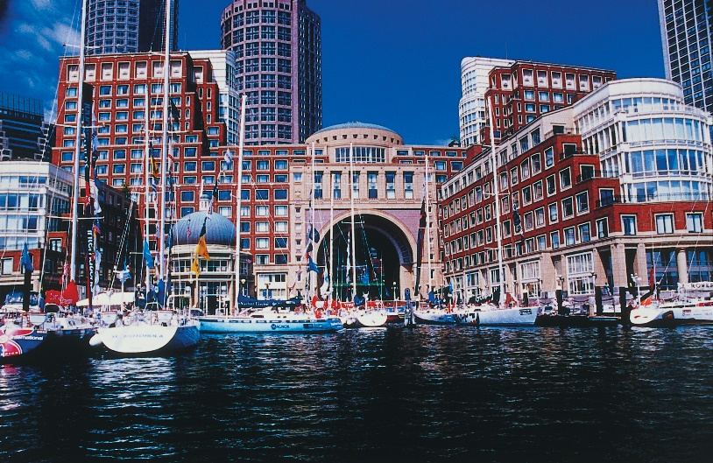
Events – TAG & Senior Leader Functions
JFK Presidential Library – TAG Sponsor Reception
Boston Harbor Hotel– TAG Spouse Reception

Slide 9
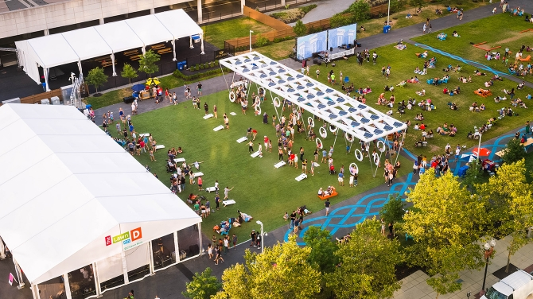
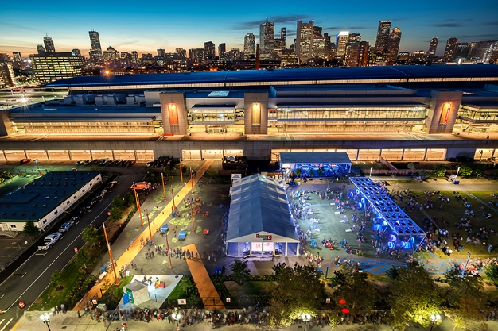
Events – Governor’s Reception
The Lawn on D
Seaport District of Boston (Next to BCEC)
Live Entertainment and with Regional Refreshments

Slide 10
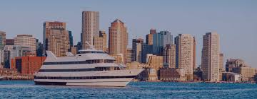
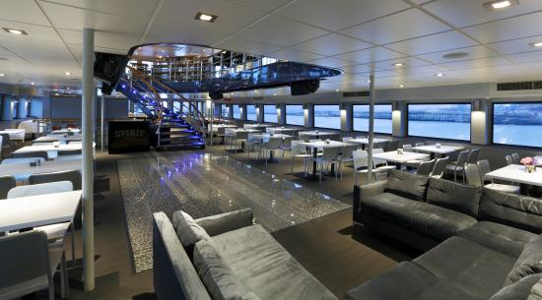
Events – Spouse Luncheon
Spirit of Boston Harbor Cruise
Luxurious Accommodations

Slide 11
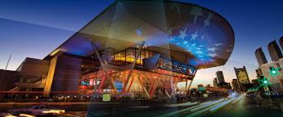
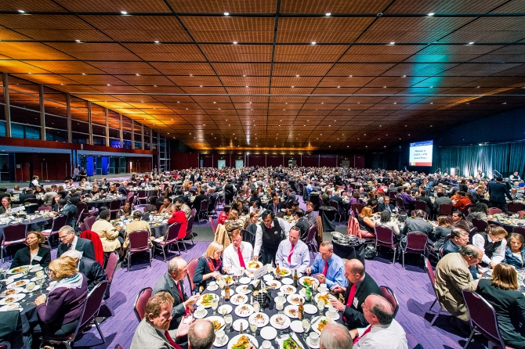
Events – State’s Dinner
Held the last night at the BCEC
The theme is Red, White, and Blue

Slide 12
Participating in the Exhibition
The NGAUS General Conference & Exhibition is the largest
event for National Guard officers from 50 states and U.S. territories.
More than 4,000 professionals will be in attendance from the Guard and industry.
Multi-Billion Dollar Opportunity – The recently signed budget provides billions to
the National Guard.
Captured attention for 3 days - An immersive environment where officers of the
National Guard dedicate 3 continuous days to information sharing, strategic planning,
and collaboration building.
Buying Authority – 90% of attendees are involved in the buying process and are at
the event to discover new solutions!
Shape the Future – this is your opportunity to provide input into the strategic vision
of the National Guard’s future and its implementation of new solutions.
Generate leads, meet the industry, launch new products, build your brand, enhance
your knowledge!

Slide 13
Sponsorship Opportunities
Sponsorship is separate from Exhibiting at the Conference.
Sponsorship comes with a variety of benefits from Premier logo placement on materials or at events, to invitations to premier events such as the TAG Reception and Golf Tournament.
Sponsorship exists at several levels, with custom packages available to meet your needs!

Slide 14
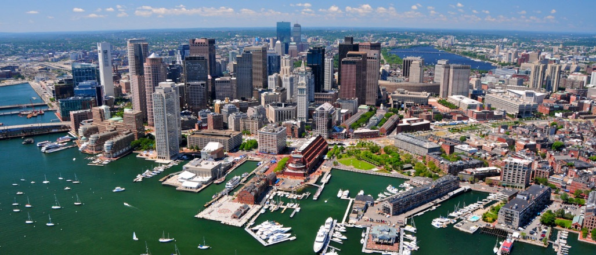
Boston 2020 - An Amazing Conference in A Historic city!
America’s National Guard – Citizens, Warriors, Patriots!

Slide 15
Boston 2020 Leadership
COMMITTEE CO-CHAIRS
John Driscoll
Committee Chair, Boston 2020, Inc.
Frank Magurn
Vice Chair, Boston 2020, Inc.
EXECUTIVE DIRECTOR
Augie Grace
Executive Director, Massachusetts National Guard
Association and Boston 2020, Inc.
BOARD & COMMITTEE
Gary Keefe
Board Member
Ex Officio, Boston 2020, Inc.
Steve Greco
President, National Guard Association of New Hampshire
Board Member, Boston 2020, Inc.
Nick Macsata
Board Chairman, Boston 2020, Inc.
Jason Oberton
Board Member, Boston 2020, Inc.

Slide 16
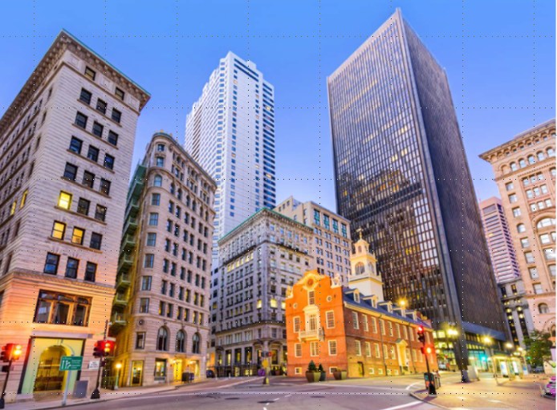
We hope to see you in Boston!

