Slide 1
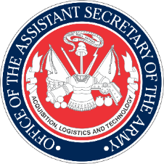
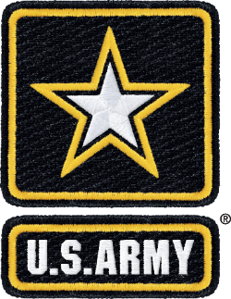
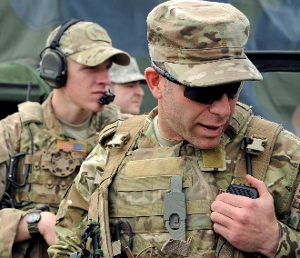
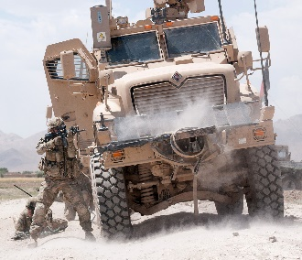
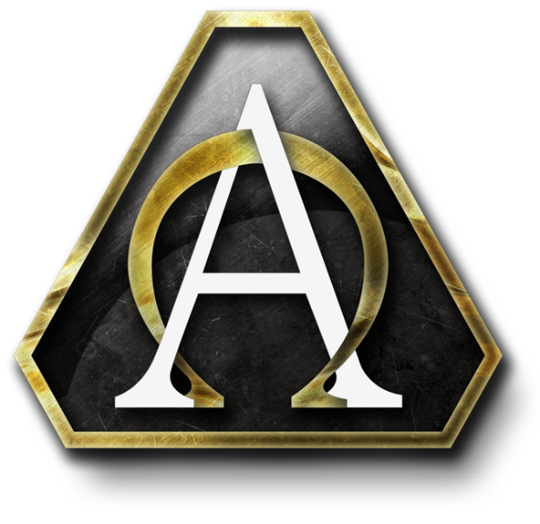

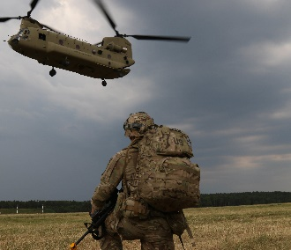
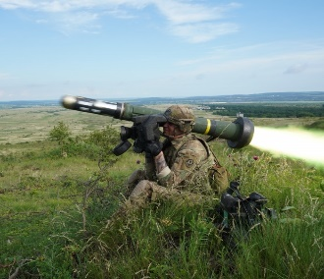
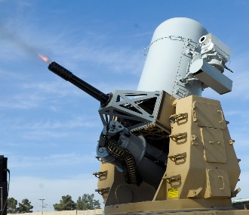
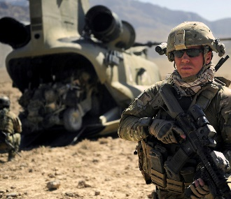
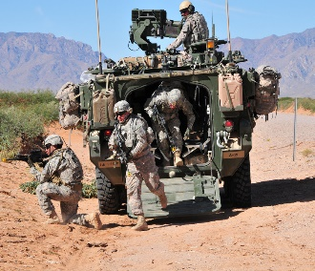
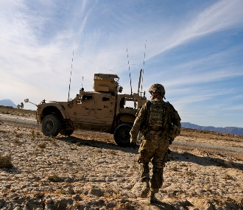
Office of the Assistant Secretary of the Army
Acquisition, Logistics and Technology
National Guard Association of the United States
23rd Annual Industry Day
Jeffrey S. White
Principal Deputy Assistant Secretary of the Army (Acquisition, Logistics and Technology)
December 10, 2019
UNCLASSIFIED

Slide 2
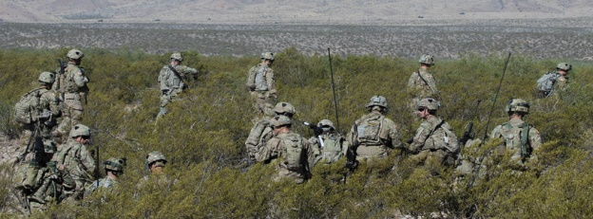
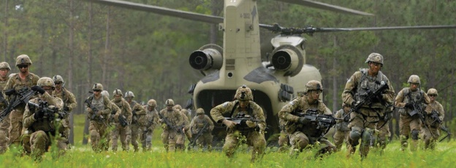
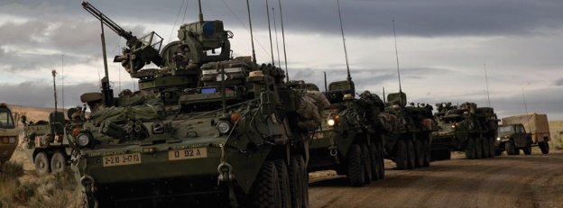
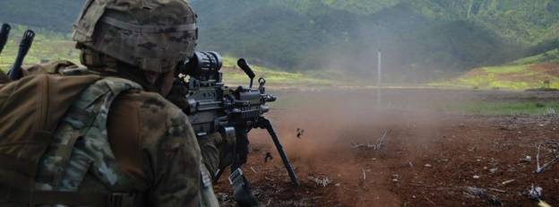
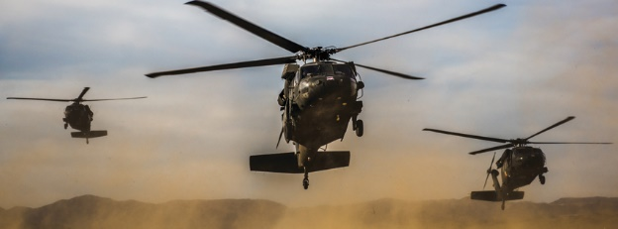
ASA ALT Mission Statement
A Clear Path Forward
Continuously modernize the U.S. Army through the development and timely delivery of overmatch capability to the Soldier in order to fight and win our Nation’s wars.
UNCLASSIFIED

Slide 3
Building Readiness …
… While Modernizing for the Future
FY20 Budget Submission
Army Total Obligation Authority = $150.7B
S&T;
$2.67B; 8%
Fires;
$2.48B; 8%
Air & Missile Defense;
$2.87B; 9%
Sustainment
Systems;
$2.29B; 7%
Mission Command;
$3.75B; 12%
RDA
$34.0B
Other PEGs;
$1.76B; 5%
Ammunition;
$1.57B; 5%
Soldier Systems;
$1.37B; 4%
Aviation;
$4.97B; 15%
Protection;
$1.21B; 4%
Note: Numbers may not add due to rounding
UNCLASSIFIED

Slide 4
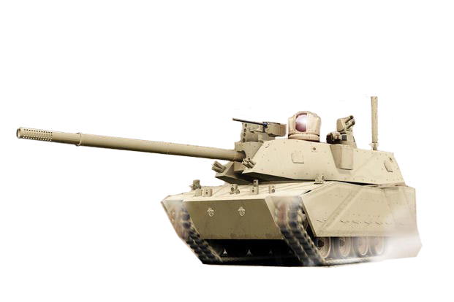
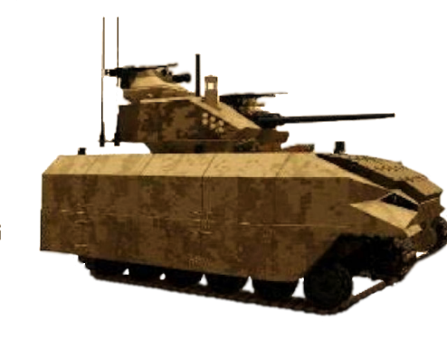
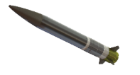

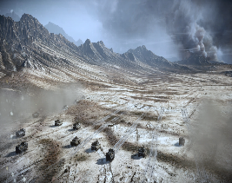

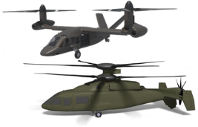
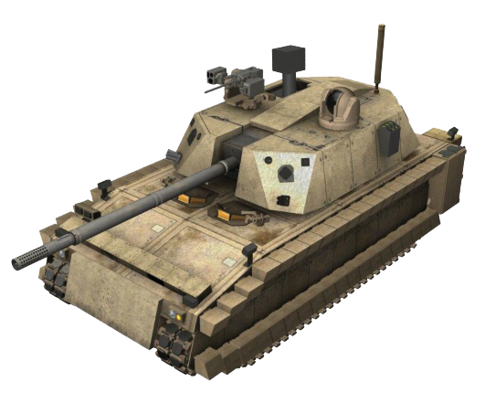
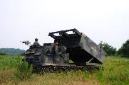

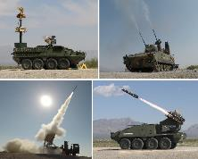
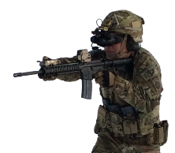
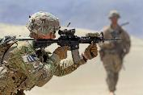



Modernization Priorities
Preparing for Tomorrow’s Fight Today
Long-Range Precision Fires
Next Generation Combat Vehicles
Future Vertical Lift
Army Network
Air and Missile Defense
Soldier Lethality
UNCLASSIFIED

Slide 5

Balancing Modernization
Current and Projected Missions
UH-60M
UH-60V
AH-64 Block IIIA
HMMWV
UNCLASSIFIED

Slide 6


Changing the Culture
Delivering Products to Soldiers Faster
Reduce requirements development process
Making the
Process
Better
Prototype capability early, test and then learn
Quickly deliver capabilities to Soldiers
Improve collaboration with industry
UNCLASSIFIED

Slide 7
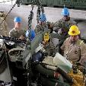



Other Transaction Authority
Reforming Acquisition
Streamlines the acquisition process
Expands technological innovation
Attracts non-traditional companies
Removes barriers to entry and bureaucracy
UNCLASSIFIED

Slide 8
Middle Tier Acquisition
Reforming Acquisition
Focuses on rapid acquisition with support from the executive level leadership
Expedites the requirements process
Provides direction to streamline the acquisition process
UNCLASSIFIED

Slide 9

UNCLASSIFIED
Intellectual Property Policy
Reforming Acquisition
Foster Open Communication with Industry & Mutual Protection of IP
Plan Early & Develop Customized IP Strategies
Negotiate Early in Process for Competitive Prices for IP
Negotiate Custom Data and /or Licenses

Slide 10
UNCLASSIFIED
Advanced Manufacturing
Revolutionizing Materiel Capabilities
What is Advanced Manufacturing?
Why Now?
Advanced Materials
Digital Thread
Technology is evolving rapidly and manufacturing techniques are transforming.
Near peer adversaries are employing and heavily investing in advanced manufacturing research & development.
The Army and defense industrial base must rapidly innovate to keep pace.
Obsolete parts, diminishing sources of supply, and sustained operations in austere environments challenge readiness.
An integrated view of everything about a system throughout its lifecycle. System data is created, modeled, analyzed, and stored continuously as systems move through the lifecycle from concept to production and sustainment to product improvement.
Advanced Manufacturing
Robotics
The use of innovative technology to improve products or processes. It includes new ways to manufacture existing products and new products resulting from advances in technology.
Additive Manufacturing
Also referred to as 3D printing, is the process of joining materials to make three-dimensional objects, usually layer upon layer.
Artificial Intelligence
Advanced manufacturing will revolutionize the way we design, develop, produce, and sustain materiel capabilities.

Slide 11

Innovation
Critical to Successful Military Operations
“Innovation is the result of critical and creative thinking and the conversion of new ideas into valued outcomes.”
--The U.S. Army Operating Concept, 2020-2040
UNCLASSIFIED

Slide 12
Office of the Assistant Secretary of the Army
Acquisition, Logistics and Technology
National Guard Association of the United States
23rd Annual Industry Day
Jeffrey S. White
Principal Deputy Assistant Secretary of the Army (Acquisition, Logistics and Technology)
December 10, 2019
UNCLASSIFIED

