Slide 1
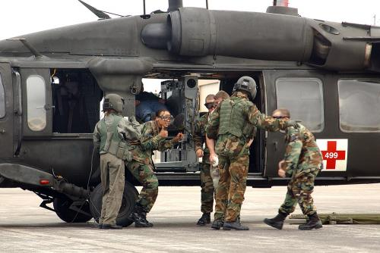
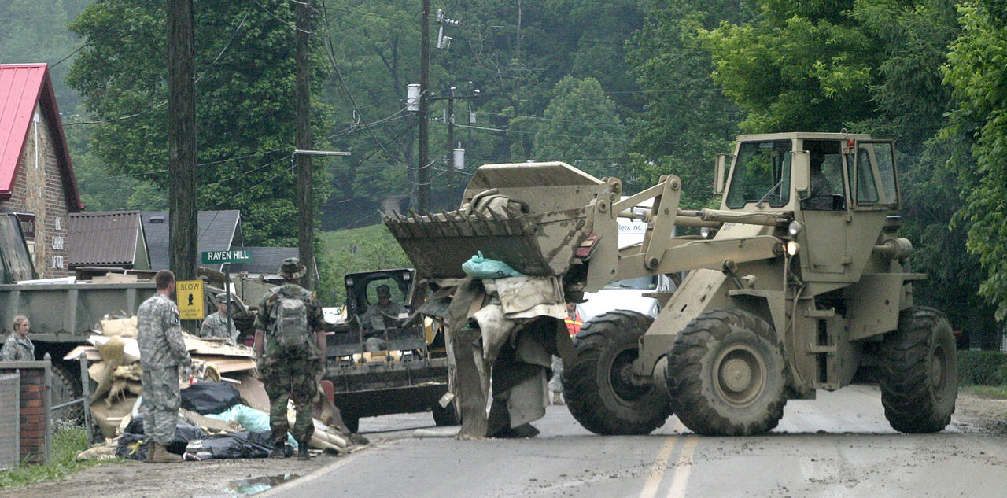
Army National Guard NGREA Orientation
Colonel John Moreth
Chief, Force Development Division
NGB/G3(FD)

Slide 2
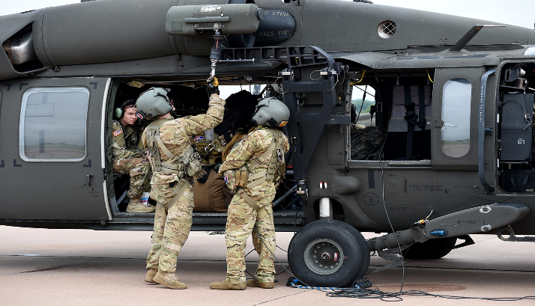
Capabilities Overview
Authority / Intent of NGREA
NGREA Buy List Generation
Modernization Equipping Requirements Conference
NGREA FY21 Buy List Timeline
ARNG and Industry
Overview

Slide 3
Capabilities Overview
Current state of program:
  ARNG is modernizing according to the CSA’s “Least to Most” strategy
Program needs and priorities:
  Timely cascades of Abrams and Bradley systems from the Active Component
  Additional resources to offset Armored Brigade and Army Prepositioned Stock growth
Future outlook:
  The Army moves to a digital two variant fleet – modernizing the final 3 ARNG Armored Brigade formations through AC cascades, 1 per year
Current state of program:
  ARNG Chinook fleet is completely modernized with F-model aircraft
Program needs and priorities:
  Additional resourcing to support Unmanned Aircraft Systems
Future outlook:
  Attack Reconnaissance Battalions (ARBs) will modernize to the same Apache model as Active Component
  ARNG will modernize the Blackhawk to an all digital fleet
Current state of the program:
  Moderate modernization shortfalls in Engineer and Mobility, Combat Service Support Sustainment and Transportation portfolios
Program needs and priorities:
  Resourcing to maintain modernization efforts for enablers – authorized substitutes driving high equipment on–hand rates and diminishing modernization levels
Future outlook:
  Multiple systems across the hardware portfolios will require NGREA to fully modernize
Current state of the program:
  NGREA Conference March 2020
  Critical Dual Use Equipment on Hand Status 95%
Program needs and priorities:
  Funding allows the ARNG to maintain current modernization compatibility and interoperability with the AC
  ARNG’s tactical and domestic operation equipment requirements continue to out-weigh NGREA funding levels and require strategic resourcing decisions
Future outlook:
  FY20 Pending Congressional Review

Slide 4
Authority/Intent of NGREA
Special Defense Appropriation that complements each Reserve Component’s base procurement appropriations.
NGREA is not programmed or budgeted as part of the Planning, Programming, Budgeting, Execution (PPBE) process…No “POM” or President’s Budget Request.
Intended to procure critical shortfall and modernization items of equipment/systems that the base appropriation is not able to fund.
Complies with Appropriation language and:
  Equipment/systems require sustainment funding or sustainment plan;
  Not intended for Operational Needs Statement (ONS) or JUONS;
  A validated requirement – MTOE, TDA, or ARNG-G3 Equipment Requirements Validation (ERV)
  DoD Financial Management Regulation Investment Criteria –
  System should be managed by a PM or cost => $250,000.
JUONS: Joint Urgent Operational Needs Statement
POM: Program Objective Memoranda, the “5-year” resourcing plan
MTOE: Modified Table of Equipment
TDA: Table of Distribution and Allowances

Slide 5
NGREA Buy List Generation
Nominations:
  Originate from the “54”, ARNG G-staff, and NGB J-staff
  Adjudicated at ARNG Modernization Equipping Requirements Conference (MERC); state representation
  ARNG-G3 validates MERC adjudicated nominations
Procurement Focus Areas:
  Army Modernization Priorities
  Critical Dual Use (CDU) / Homeland Defense (HD) Items
  Congressional Interest Items
  ARNG-G3 Capability Priorities
Considerations:
  Line Item Number (LIN) (Standard or Non-developmental)
  Procurable in a 24 month window
  Authorization fill rate of 90% or less

Slide 6
Modernization Equipping Requirements Conference
Provides National Guard leaders a coordinated, vetted modernization equipping strategy utilizing NGREA resources to improve the overall readiness
Empowers the “54” with a direct / coordinated voice
  Representatives in attendance to include designated MRAC co-chairs
10 Portfolio Groups:
    Intelligence Electronic Warfare and Sensors & Security
    Unified Mission Command Network
    Assured Mobility, Force Protection and Chemical, Biological, Radiation, and Nuclear
    Aviation
    Defense Support of Civil Authorities
    Fires and Maneuver
    Soldier Systems and Robotics
    Transportation and Sustainment/Logistics
    Training
    Installations
Outcome: Synchronized, prioritized, and staffed list of validated requirements shaped by the 54

Slide 7
ARNG NGREA FY21 Buy List Timeline
Complete
Not Complete
List Approved
December
NGREA List Submitted to Congress
November
(Pending notification of appropriation)
NGREA List Submitted to OSD
October
(Pending notification of appropriation)
DARNG/CNGB NGREA List Approval
October
(Pending notification of appropriation)
Resource Alignment (ARNG NGREA CoC IPT) **July/August/September
Nomination Validation (ARNG G-3)
**June
Modernization Equipping Requirements Conference (MERC)
**March
Guidance and nomination solicitation sent to the States, Territories, District of Columbia, ARNG G-Staff, and NGB J-Staff
**October
** Modernization Requirements Advisory Council (MRAC) Touchpoints
All dates are notional

Slide 8



ARNG and Industry
ARNG and Industry:
  Cooperation
  Alignment

Slide 9
Questions

Slide 10
Backup

Slide 11
Significant Major Item Shortfall List
(NGRER 2020)
Heavy Equipment Recovery Utility Live and Evacuation System (Hercules)
Joint Effects Targeting System (JETS)
Multi-Role Anti-Armor Weapons System
Semi-trailer: Flatbed 34-ton
Next Generation Automatic Test System (NGATS)
Hydraulic Excavator (HYEX)
Distribution Systems, Fuel & Water
Heavy Expanded Mobility Tactical Truck (HEMTT) Wrecker
Transportable Tactical Command Communication (T2C2)
Calibration Sets, Secondary Transfer Standards
All Terrain Crain, Type II

