Slide 1

LTG Dan Hokanson
Director, Army National Guard

Slide 2
Army National Guard Priorities
People – Soldiers, Families, Civilians, Soldiers for Life…Retirees and Veterans
  Recruiting and Retention
  Readiness: How ready do we need/want to be?
  Full Time Support (FTS): T10 positions review/manpower study
  1:5 Mobilization-to-Dwell
  Integrated Personnel & Pay System – Army (IPPS-A)
  Division alignment for training
  Readiness Advisory Councils (RACs)
  Mobilization exercises
  The Army of 2028 (Multi-Domain Operations (MDO) and Large Scale Ground Combat Operations (LSGCO))
  Army Modernization Priorities
Enduring Requirement: Take care of soldiers (highest priority)!

Slide 3
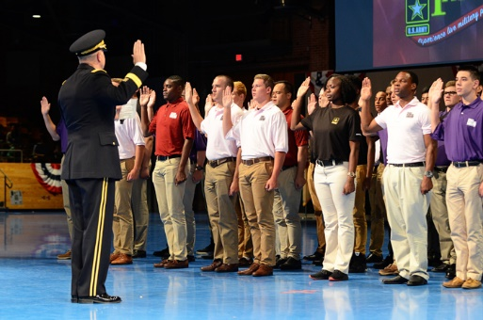
Recruiting and Retention
Notes:
The Recruiting & Retention enterprise comprises of approximately 20% of the Total AGR force structure.
ARNG increased Recruiter manning, bonuses, incentives, and marketing to better equip Recruiting and Retention battalions.
Challenges in recruiting 17-24 year-olds (our target market) stems from potential recruits with health problems, lack of physical fitness, and poor academics.
Moral and legal issues preclude 71% of the population from eligibility to serve.
In FY19, the ARNG achieved our recruiting goal of 335,500; final end strength was 335,973.

Slide 4
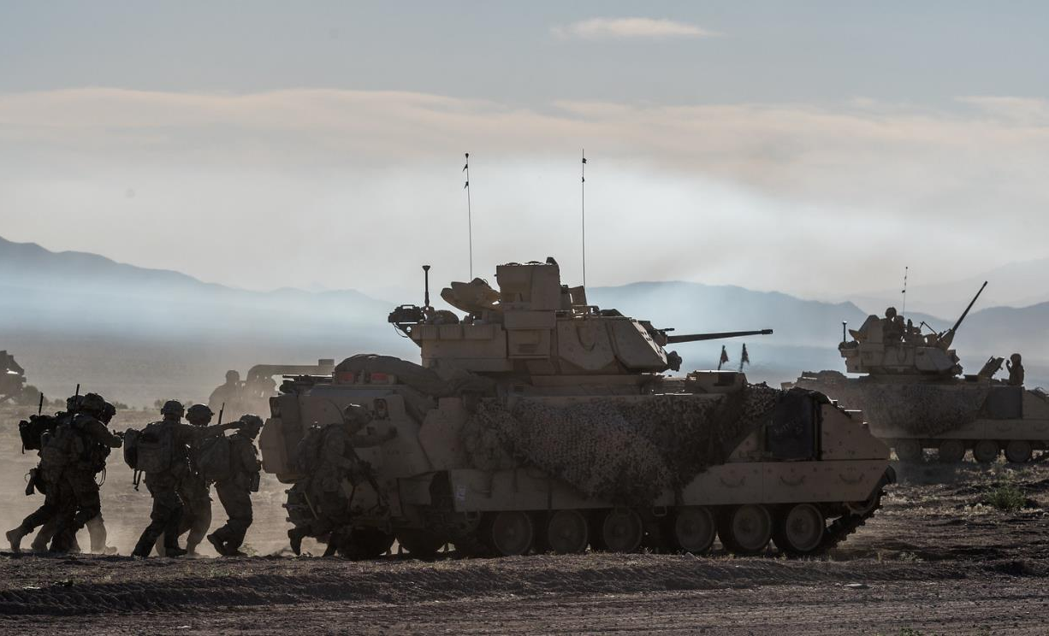
Readiness
Notes:
Readiness remains the Army National Guard’s (ARNG) #1 priority. Our readiness to defeat a near-peer adversary in large scale contingency operations has improved, but must continue to do so to further reduce risk to the mission and force.
The ARNG needs resources to reach current readiness targets or a strategic reduction in risk to personnel and operational tempo demands. One of the leading contributors to declining readiness is partial (non-MTOE) mobilizations. Other factors include force structure change, including MTOE conversions and equipment fielding synchronization, are impacting training readiness levels.
A reduction of funding from current levels would reverse recent readiness gains. In FY20, the ARNG received 80% of Home Station funding (77% ground OPTEMPO and 3% Overseas Contingency Operations). Four CTC rotations (double the historical average) are included in this funding level. The desired end state is increased training proficiency and leader development. ARNG CTC rotations are funded only to meet T2 readiness objectives.
The ARNG has markedly increased its contribution to the overall readiness of the Army’s Total Force since FY17 (15,557 Guardsman deployed). The ARNG has sustained its operational demand in FY19 with a total of 22,033 Guardsman deployed to support 140 Title X missions globally. In FY20, the ARNG is projected to deploy 24,157 Guardsman to geographic combatant commands in EUCOM, CENTCOM, AFRICOM, SOUTHCOM and INDO-PACOM. The ARNG has continued to devote resources to Sustainable Readiness objectives. However, over the last two years, the ARNG has shown a decline in readiness level reporting.
If called to fight a near-peer today we would prevail, but it would come at high cost and require the undesirable decision of sending less-ready forces now to meet required operational timelines, or delaying their deployment at increased risk to accomplishing the mission.

Slide 5
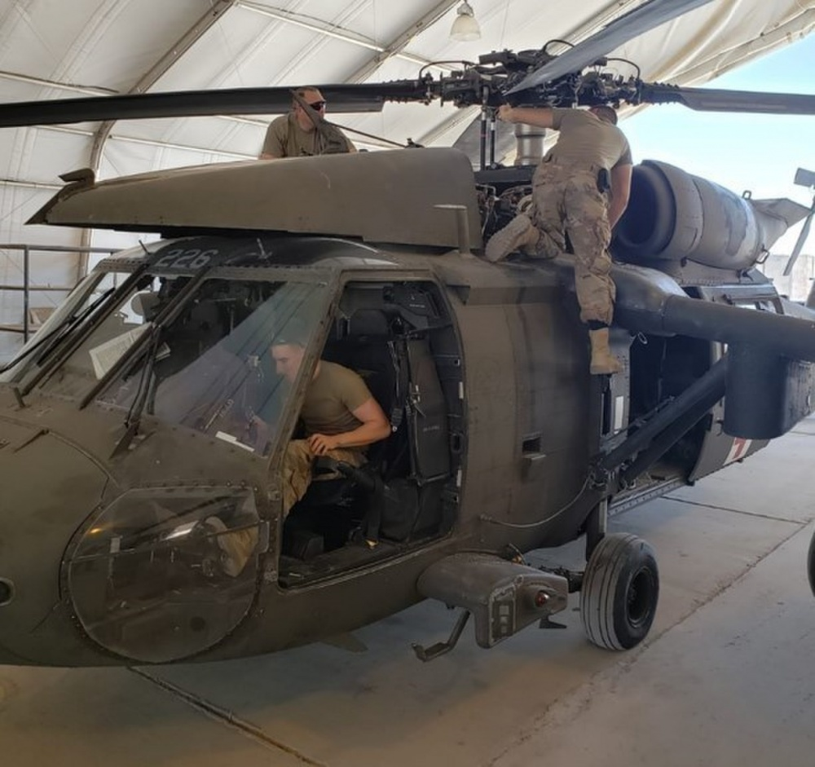
Full Time Support
Notes:
The Army National Guard is currently funded at 64% of Full Time Support (FTS) requirements. All other major readiness accounts are funded at 80% or higher. The ARNG believes that 64% FTS cannot generate the readiness required in order to meet the current demands of the Army. To reach 80% of the FTS requirement for non-JFHQ units the ARNG would need to convert roughly 1,000 traditional Guardsmen to FTS per year for 10 years.
FTS below 80% of the requirement has a detrimental effect on all aspects of ARNG unit readiness. Under resourced units are less effective at recruiting, maintenance, and executing training. Units resourced to less than 80% of FTS cannot meet post-mobilization timelines and readiness aim points.
The ARNG is only completing approximately 52% of the annual/bi-annual services required to maintain equipment. This is partially due to limited FTS, but it is important to note that our M-day force is not completing the preventative maintenance checks and services nor performing maintenance repairs, which contributes to the low completion rate.
Due to current resource constraints, the ARNG has not been able to process over 11,400 equipment transfers to support filling shortages across all components because the transfers require FTS to conduct 10/20 inspections and repairs prior to transfer, but States do not have the FTS to complete this task.
ARNG has approximately $64M tied up in reparable parts credits and averages 463 days turn-around time to turn-in reparable parts due to the limited FTS in maintenance.
Units will need to consider forgoing training requirements so Commanders can ensure Soldiers are provided 25 percent of inactive duty training (IDT) to perform required operator preventive maintenance checks and services (PMCS) on individual and organizational equipment in accordance with Army Regulation 750-1, Army Materiel Maintenance Policy.
There is a direct correlation to the FTS Technician MLR rate and aircraft OR rate. Increasing Technician MLR rate will have a direct impact on aircraft operational readiness.
ARNG Aviation aircraft operational rate (OR) four year average is 60.2%. During this time, states continue to execute their flying hour programs (FHP) and fulfilling mission requirements, which include overseas contingency operations, domestic operations, aircrew readiness level training and air support missions.
In FY20, Technician full time support (FTS) managed level of resources (MLR) allocation was reduced to 51.17%. This MLR change is a 5.86% reduction from previous year’s MLR rate. This FTS reduction coupled with a strong economy and low unemployment rates has increased demand for trained maintenance personnel to work in the civilian sectors. Civilian aviation agencies often provide higher compensation and increased benefit packages.
RRR Incentives: States have an option to use discretionary funding to execute a FTS recruiting, retention, relocation (RRR) incentive program to hire and stabilize designated job fields with high personnel turnover rates. ARNG-HRA is available to assist states with incentive packets and submitting unfunded requests to support incentives. RRR incentives are state level approved.

Slide 6

1:5 Mobilization-To-Dwell
Prepare Year 1
Prepare Year 2
Prepare Year 3 Prepare Year 4
48.5 Training Days 60 Training Days
(21 AT Days) (30 AT Days)
Mission Year
39 Training Days
(15 AT Days)
39 Training Days
(15 AT Days)
39 Training Days
(15 AT Days)
T4 T4
T4 T4
T3 T3
T2 T2
C2 C2
T3
C3
T4
C4
C4 C4
C4 C4
C3 C3
Prepare Year 1 39 days | Prepare Year 2 39 days | Prepare Year 3 48.5 days | Prepare Year 4 60 days | Mission Year 39 days | ECHELON
STAFFEX, DEPEX, STX, LFX, TEWTs, CREW TABLES, TM TRNG, CLASSES | CPX, BWFX, STAFFEX, DEPEX, STX, LFX, TEWTs, CREW TABLES, TM TRNG, CLASSES | XCTC, CPX, FTX, FCX, STAFFEX, DEPEX, STX, LFX, TEWTs, CREW TABLES, TM TRNG, CLASSES | MCTC, FCX, BN/BDE-STX-V, LTP, CALFEX, STAFFEX, DEPEX, STX, LFX, TEWTs, CREW TABLES, TM TRNG | CPX, FTX, STAFFEX, DEPEX, STX, LFX, TEWTs, CREW TABLES, TM TRNG, CLASSES | ARNG ABCT / HHC
Notes:
During the fall of 2016, in order to meet defense planning guidance requirements, the army increased the readiness of selected army national Guard (ARNG) armor and STRYKER brigade combat teams (ABCT and SBCT) by accelerating their training cycle from five (5) years to four (4) years.
Since taking that action, army force readiness requirements have decreased and the number of regular army armor BCTS has increased. As a consequence, the army no longer needs to periodically produce as many ARNG armor/Stryker BCTS at c-2 readiness to meet defense planning guidance.
Beginning September 2019, all ARNG ABCT and SBCT will build readiness using the 5-year training model with the exception of those ABCT and SBCT already scheduled for a combat training center (ctc) rotation in fiscal year (FY) 2019 and fy20, with ARNG BCTS continuing to conduct four (4) combat training center rotations per FY.

Slide 7
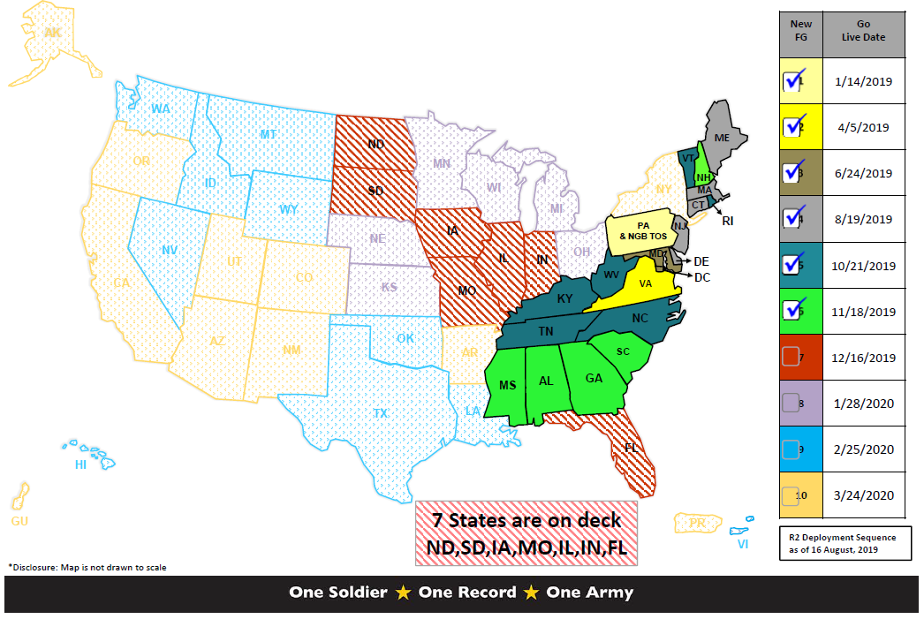
Integrated Personnel & Pay System
Notes:
IPPS-A is a Web-based HR system that provides integrated personnel and pay capabilities and a comprehensive HR record for all Soldiers in each Component. Once IPPS-A is fully deployed, the system will enable HR transactions to automatically trigger Soldier pay. In addition, Soldiers will have CAC access to their own personal information 24 hours a day via the IPPS-A Self-Service Web Portal.
IPPS-A's ability to combine personnel and pay functions (e.g., a promotion or call to Active Duty) will address current inefficiencies caused by complex interfaces among more than 40 "stove-piped" HR systems. As a result, IPPS-A will leave fewer opportunities for error and will become the authoritative and comprehensive source of Army personnel and pay information.
Fielding Group FG 7 (FL, IA, IL, IN, MO, ND, and SD) is set to go live on 16 December. SIDPERS for those States have been turned off and not receiving updates.
Currently, 20 of the 54 states/territories have transitioned from SIDPERS to IPPS-A, and we are on track to have all 54 running by March 2020.
Successful migration lessons learned include: States embracing the change of systems while taking ownership of the process, and full coordination between States and the LNO teams.

Slide 8
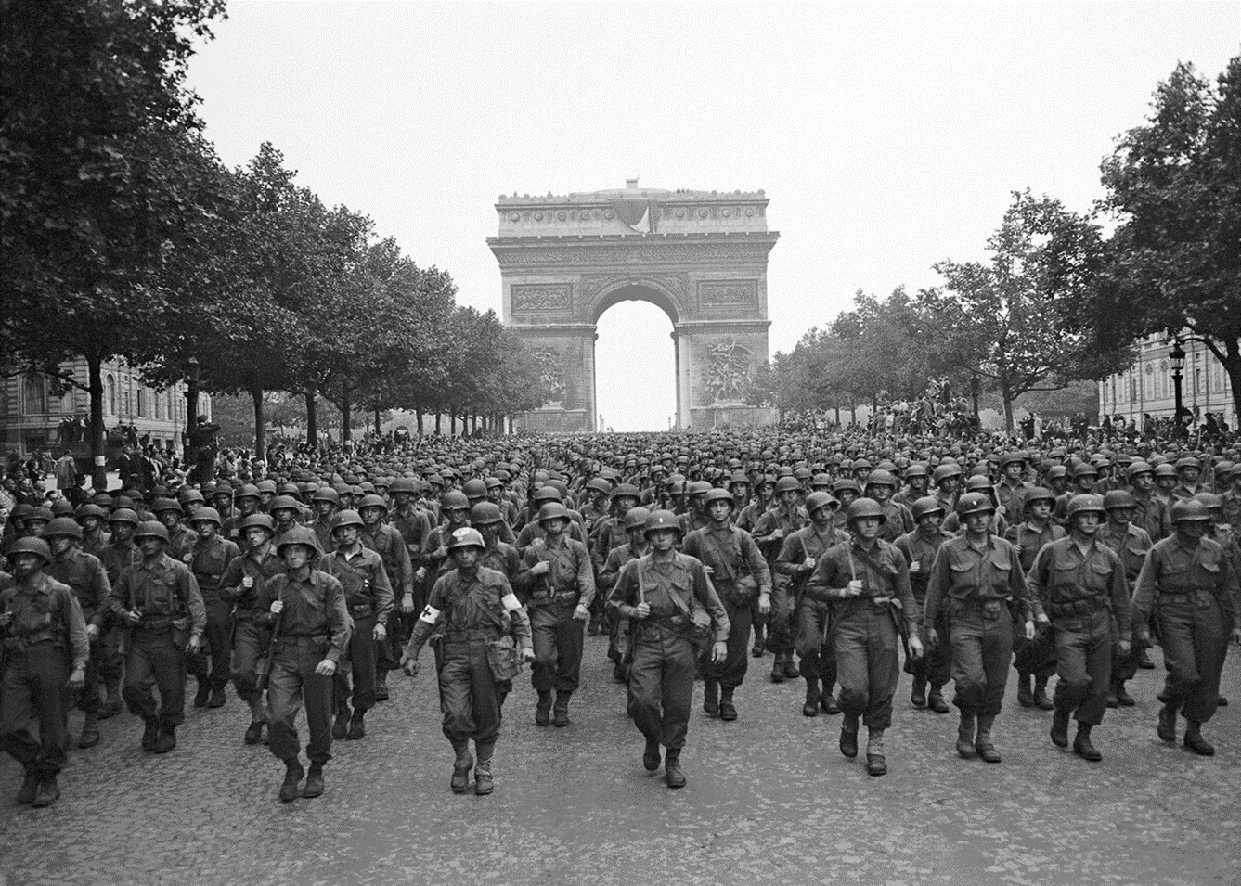
Division Alignment for Training

Slide 9
Readiness Advisory Councils
Conditions
Lethality & Readiness
End State
Domestic and Global Requirements
Resource constraints
Unprioritized Requirements
Mission Balance
Strength Management Challenges
Approaching Modernization Plan
New Personnel Systems
Prompt, sustained land power ready to support Combatant Commanders and Governors
Air, Space & Missile Defense
End Strength/ Force Structure
Maneuver Support
Special Forces
Fires
Maneuver
Division CDRs
Modernization
Sustainment
Human Capital (People)
Redesigned human capital system that aligns personnel resources with desired personnel outcome
Leader Development
Recruit, Retain, & Train
Resilient Forces
Suicide Prevention
SHARP
SARC
Homeland & Partnerships
Robust interdependent relationship with domestic and int’l partners for local and global ARNG missions
Cyber
CBRN Response Enterprise
Counter Drug
Homeland Response
Partnerships
SPP
Local
ARNG Governance Strategy LOEs organize RACs to resolve critical ARNG issues in support of the National Defense and Military Strategy
Notes:
To deliberate on matters affecting the ARNG, such as prioritizing resources, shaping force structure, and ensuring the ARNG meets Department of Defense and Army expectations in support of the National Defense Strategy and National Military Strategy, I really heavily on our Readiness Advisory Councils, or RACs.
All of our RACs are organized along 3 strategic lines of effort, Lethality & Readiness, Human Capital (our People), and the Homeland & Partnerships.
The RACs advocate and sensitize the most critical issues through these 3 strategic lines of effort. The chairs of each RAC also serves as voting members for our General Officer Advisory Council.

Slide 10



Mobilization Exercises
Notes:
In World War I, some National Guard units were already mobilized for the border crisis with Mexico in 1916. Units were mobilized into 16 division-level organizations, and had their own temporary training camps in states across the Southern and Southwest US.
In World War II, National Guard units began to mobilize in September of 1940, after President Roosevelt declared a National Emergency following Germany’s success in Poland and France. National Guard divisions were sent to “unready” and new mobilization sites built by the Army Corps of Engineers.
During the Gulf War (Operation Desert Shield/Storm), the majority of mobilized ARNG units were combat support.
No initial ARNG combat units mobilized.
Combat brigades later mobilized as “round out brigades,” but never deployed (training issues).
ARNG Artillery brigades deployed and successfully conducted ground combat operations.
_______________________________________________________________________________________________________________________________________________________________
There are currently 7 inactive Mobilization Force Generation Installations (MFGIs) poised ready to handle ARNG large scale mobilizations.
4 MFGIs are ARNG lead, 3 are USAR lead, all 7 are designated as mobilization platforms for ARNG units.
The ARNG also maintains an additional 9 major training centers, with ARNG training center and installation capacity in nearly every State and Territory.

Slide 11
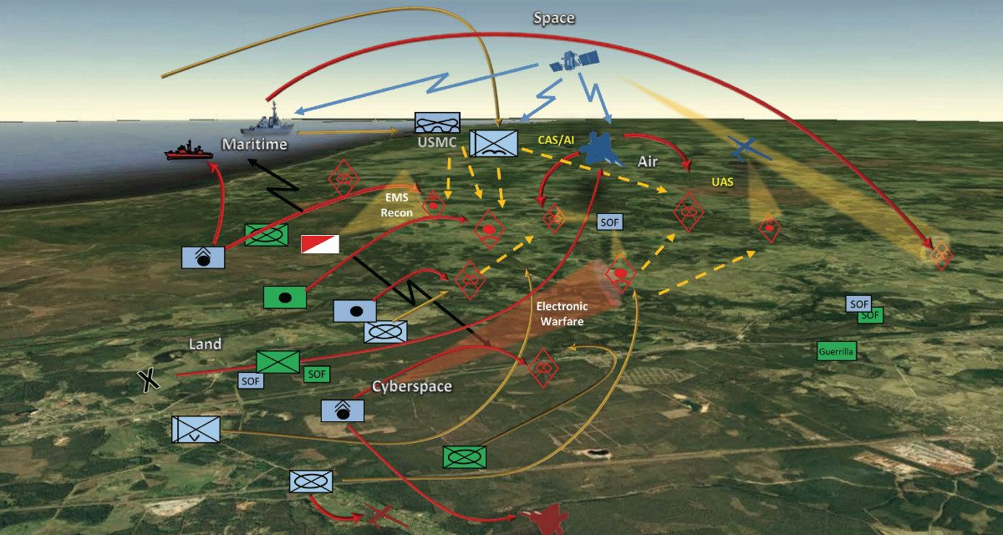
The Army of 2028 MDO & LSCGO
Notes:
America’s adversaries have studied US operations since the Gulf War to now.
Our strategic competitors are synthesizing emerging technologies with their analysis of military doctrine and operations, and are deploying capabilities to fight the US through multiple layers of stand-off in all domains – Space, Cyber, Air, Sea, and Land.
Therefore, the American way of war must evolve and adapt by integrating all domain operations for the future as an vital part of the Joint Force.
As the ARNG prepares for Large-Scale Ground Combat Operations within a multi-domain contested environment, we are ensuring that ARNG formations, as Expeditionary Forces, are ready and equipped to maneuver from the US across strategic distances while in contact with our adversary’s reconnaissance, long-range fires, space, and cyberspace capabilities.
To ensure dominance over our adversaries in all domains, the ARNG underwrites technological advancements visualized through the Army’s Modernization Priorities.

Slide 12
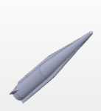
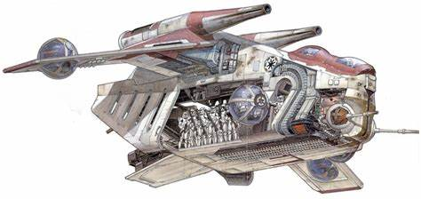
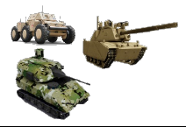
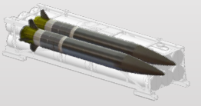

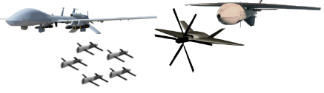
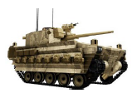
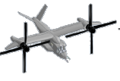

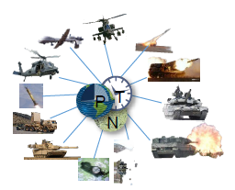
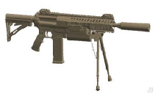
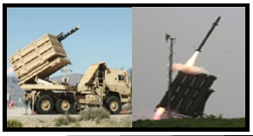
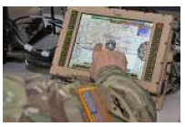
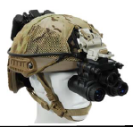

Army Modernization Priorities
Long Range Precision Fires
Next Generation Combat Vehicles
Future Vertical Lift
Top Six
Air & Missile Defense
Army Network
Soldier Lethality
Notes:
The Army’s Modernization Strategy has one focus: Make Soldiers and units more lethal to win the nation’s wars, then come home safely.
The modernization process will leverage commercial innovation, cutting-edge science and technology, prototyping and warfighter feedback.
Unity of command and unity of effort for the Army’s modernization effort ensures accountability, transparency and responsible stewardship of the nation’s resources.
In support of the overall National Defense and Military Strategies, the Army’s SIX modernization priorities include:
1. Long Range Precision Fires
2. Future Vertical Lift (Imperial Storm Trooper Troop Carrier)
3. Air & Missile Defense
4. Soldier Lethality (Darth Vader w/ Light Saber)
5. Army Network
6. Next Generation Combat Vehicle (Imperial Armored Walker)

Slide 13
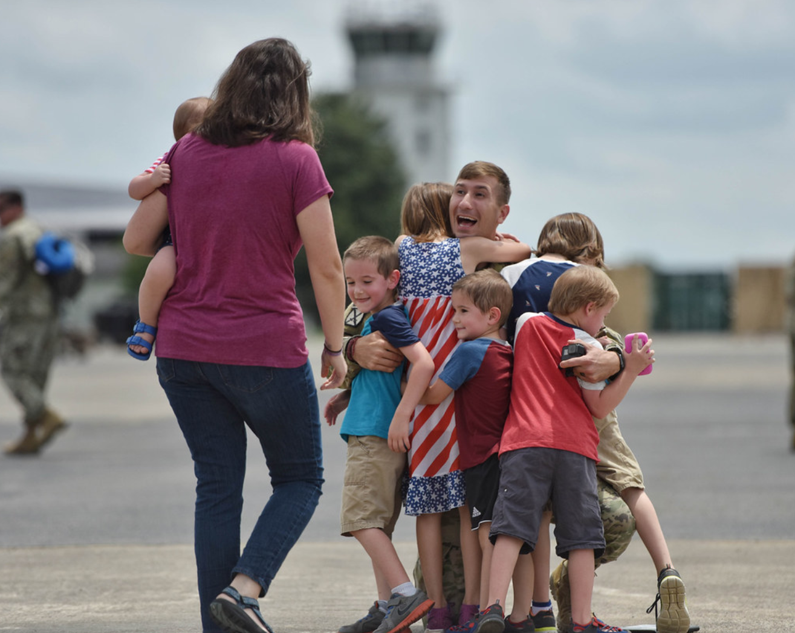
Our Highest Priority

Slide 14
Discussion

Slide 15
Back Up
Slides

Slide 16


















Proposed Training Associations
34th ID
MN
38th ID
IN/OH
(MN)
1/34 ABCT
(IN)
278 ABCT
TN
Alaska
34 ID
MN/OH
34 ECAB
ID/ND/MN/MT
38 ID
2/34 IBCT
IA/MN
108 SUST
IL
33 IBCT
IL/PR
32 IBCT
WI/MI
196 MEB
SD
39 IBCT
AR/MO/NE
(NY)
42nd ID
NY
76 IBCT
IN
42 ID
44 IBCT
NJ/MA
38 ECAB
IN/NC/SC/OH/MI
27 IBCT
NY/MA/RI
38 SUST
IN
149 MEB
KY
42 ECAB
NY/SC/MD/MA
369 SUST
NY
Hawaii
26 MEB
MA
GUAM
(PA)
(CA)
28 ID
28th ID
PA
40 ID
56/28 SBCT
PA
40th ID
CA
2/28 IBCT
PA/MD
81 SBCT
WA/CA/OR
(VA)
37 IBCT
OH/MI/SC
79 IBCT
CA/PR
29 ID
28 ECAB
PA/NJ
41 IBCT
OR/NM/WA
29th ID
VA
371 SUST
OH
(TX)
30 ABCT
NC/SC/WV
29 IBCT
HI/AK/AZ/WY/GU
36 ID
36th ID
TX
(KS)
55 MEB
PA
35 ID
116/29 IBCT
VA/KY
40 ECAB
CA/UT/WA
116 ABCT
ID/MT/OR/NV
35th ID
KS/MO
PR
224 SUST
CA
72/36 IBCT
TX
155 ABCT
MS/KS
53 IBCT
FL/AL
17 SUST
NV/IN
56/36 IBCT
TX/RI
45 IBCT
OK/NE/IN
29 ECAB
MD/AZ/VA/FL/KY
36 ECAB
TX/AR/MS
256 IBCT
LA/AL
VI
113 SUST
NC
226 MEB
ND
36 SUST
TX
35 ECAB
MO/NE/KS/UT
226 MEB
AL
111 SUST
NM
230 SUST
TN
136 MEB
TX
110 MEB
MO

Slide 17
Army Campaign Plan 2019+
Concept of Operations
Strategic Efforts
Lines of Effort
Strategic Objectives
Vision
All Things Europe
All Things Pacific
All Things Mobilization & Power Projection
Army Pre-positioned Stocks
Aviation Enterprise
Filling Holes in Units
Holistic Health & Fitness
Total Army Capability Management Model
Army 2028 Force Mix
Army Network Plan
Information Warfare & Cyber Electro-
Magnetic Activities
Operational Resilience in Cyberspace
Army Space Operations
Counter-Unmanned Aerial Systems
Interoperability
Strategic Engagement Campaign
Security Force Assistance Capacity
Acquisition Reforms
Medical Reforms
Operational Transformation
The Army of 2028 will be ready to deploy, fight and win decisively against any adversary, anytime and anywhere, in a joint, combined, multi-domain, high-intensity conflict, while simultaneously deterring others and maintaining its ability to conduct irregular warfare.
The Army will do this through the employment of modern manned and unmanned ground combat vehicles, aircraft, sustainment systems, and weapons, coupled with robust combined arms formations and tactics based on a modern warfighting doctrine, and centered on exceptional Leaders and Soldiers of unmatched lethality.
Man
Man operating force units fully for large-scale ground combat
Doctrine
Drive Army transformation through integrated Multi-Domain Operations concepts & doctrine
Main Effort
Build Readiness
OBJ 1-1: Implement the Sustainable Readiness Process to meet Defense Planning Guidance requirements
OBJ 1-2: Apply the Dynamic Force Employment concept to the Total Force
OBJ 1-3: Calibrate force posture to support the Global Operating Model
Organize
Structure warfighting formations for Multi-Domain Operations
Supporting Effort
Modernization
OBJ 2-1: Synchronize force development tailored for Multi-Domain Operations
OBJ 2-2: Adapt force management to balance global force posture of capabilities
OBJ 2-3: Incorporate Multi-Domain Operations concepts & doctrine
OBJ 2-4: Create unmatched lethality against near-peer adversaries
Train
Train tough Soldiers & units ready to fight & win high-intensity conflict
Supporting Effort
Strengthen Alliances & Partnerships
OBJ 3-1: Optimize Total Force interoperability for joint & combined operations
OBJ 3-2: Institutionalize security cooperation resources & requirements
OBJ 3-3: Prioritize strategic engagements to reinforce dynamic relationships
Equip
Field modernized capabilities with overmatch to defeat near-peer threats
Institutional Transformation
Business Transformation
Supporting Effort
Lead
Develop ethical Leaders disciplined to exercise initiative in the chaos of combat
Reform
OBJ 4-1: Free resources for reinvestment in the Army’s highest priorities
OBJ 4-2: Pursue management reforms generating savings & increased efficiency
OBJ 4-3: Transform to a talent management based personnel system
2019
2022
2028
FY19
FY20
TAA/POM 21-25
TAA/POM 22-26
Mid-term
FYDP 2029-2035
DOTMLPF-P Solutions
Near-term
FYDP 2023-2028
Far-term
Notes:
(U) Army Campaign Plan. The ACP is Section V of The Army Plan. It provides integration, synchronization, direction, and assessment of institutional efforts during each fiscal year of execution to operationalize the Army Strategy. It places strategic decisions in context, enabling leaders to make informed choices that balance priorities with the means available to achieve them. The ACP also informs the development of annual programmatic guidance to support the prioritization of planning tasks and the alignment of resource requirements to strategic priorities.
(U) Strategic Objectives. The Army will achieve the following strategic objectives derived from the Army Vision:
ACP19+ transforms the Army through the near term along four Lines of Effort (LOEs) derived from the Army Strategy and oriented on achieving desired conditions of the Army Vision.
Build Readiness is the near-term main effort and directs how the Army will prepare forces and provide prompt sustained land power to Combatant Commanders.
Modernization is a supporting effort that increases lethality of a modernized fielded force in the near-term while setting mid-term conditions to develop a MDO capable force with next-generation capabilities.
Strengthen Alliances and Partnerships is a supporting effort that directs how the Army will strengthen its international relationships by executing security cooperation activities to achieve Total Army interoperability with allies and partners.
Reform is a supporting effort that directs how the Army implements continuous process improvements to maximize time, budget, and manpower resources while gaining efficiencies in achieving sustainable readiness goals and increased lethality.

Slide 18
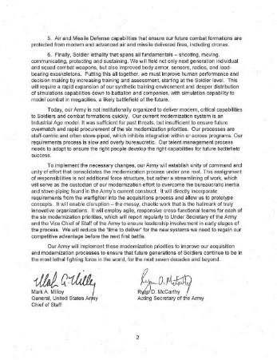
Army Modernization Priorities
#1 Long Range Precision Fires
LC-Term
Extended Range Cannon Artillery
Precision and Cooperative Weapons (GPS Denied)
UTAH
LBASM
Energetics
#2 Next Gen Combat Vehicles
Autonomous Ground Resupply
Advanced Power Demonstration
MAPs
Combat Vehicle Robotics
Advanced Lethality and Accuracy System
#3 Future Vertical Lift
Joint Multi-role Demonstrator
Aviation Manned-Unmanned Teaming
Next Generation Tactical UAS
Alternative Engine
Concepts
#4 Network/C3I
Resilient Communications
Intelligent Network
Assured PNT
Mission Command
Sensors for SA
CEMA/EW
#5 Air & Missile
Defense
Low Cost Extended Range
Air-Defense (LowerAD)
Ballistic Low Altitude
Drone Engagement
Accurate Rapid Controlled
Hybrid Effects Round
Next Generation Fires
Radar Technologies
Maneuver Air Defense Technologies
Position Navigation Timing
#6 Soldier Lethality
Next Generation Squad Weapon & Ammunition
Power and Energy
Advanced Soldier Survivability
Synthetic Training Environment
Exoskeleton
Soldier Performance

