Slide 1
NGAUS Industry Day
Major General Jon Mott
Assistant to the Director, Air National Guard
10 December 2019
This Briefing is UNCLASSIFIED

Slide 2
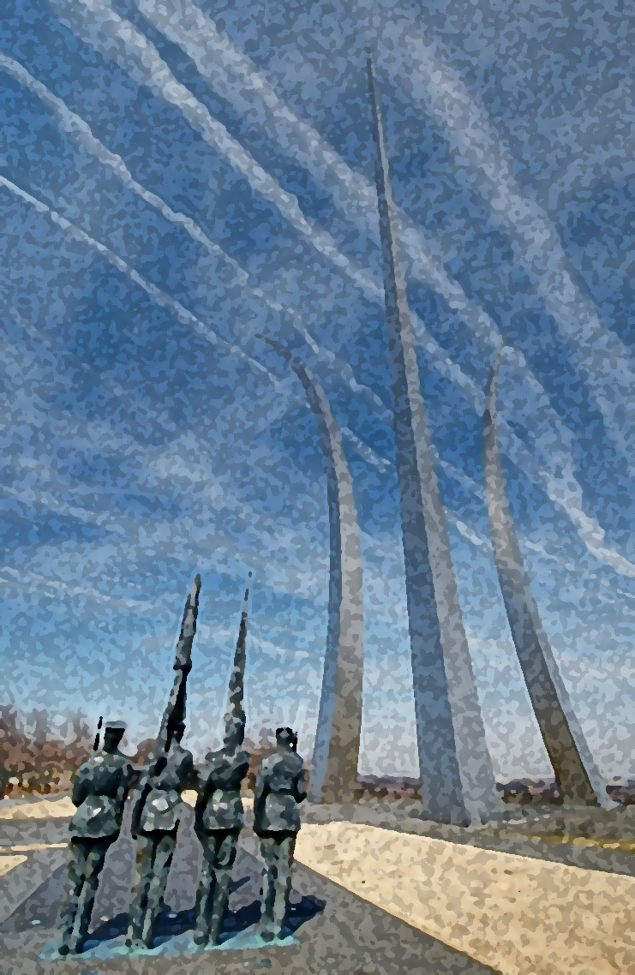
OVERVIEW
Strategic Environment
Strategic Priorities
ANG Recapitalization & Modernization Efforts
ANG and Industry

Slide 3
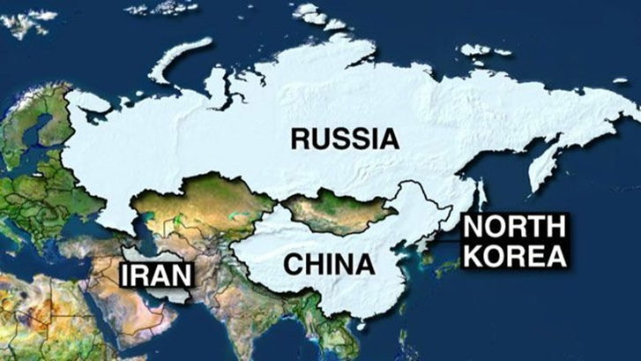
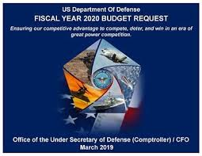
Strategic Environment
2+3 Threat Assessment
China & Russia
Iran
North Korea
VEOs
Budget

Slide 4
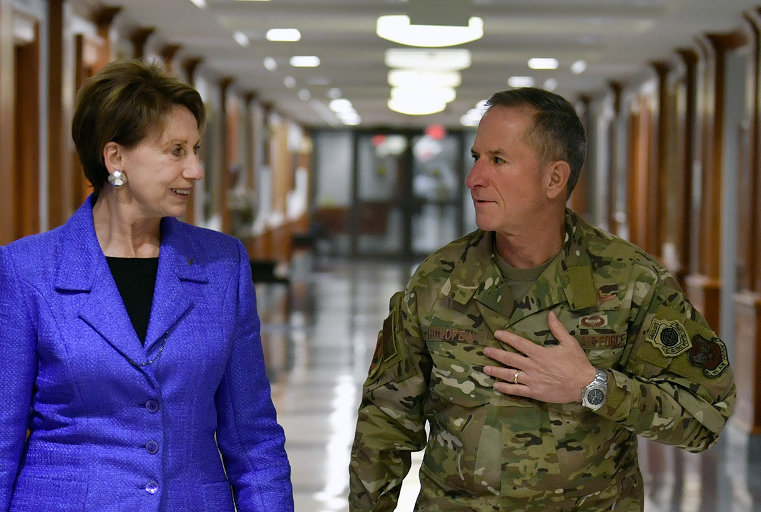
Strategic Priorities
Lethal Force
Alliances/Partnerships
Reform
The Air Force We Need
A More Lethal and Ready Force
Tomorrow's Air Force
Faster and Smarter
Ready Forces
People/Families/Employers
Innovation
Readiness
21st Century Guard Airmen
Tomorrow’s Fight

Slide 5
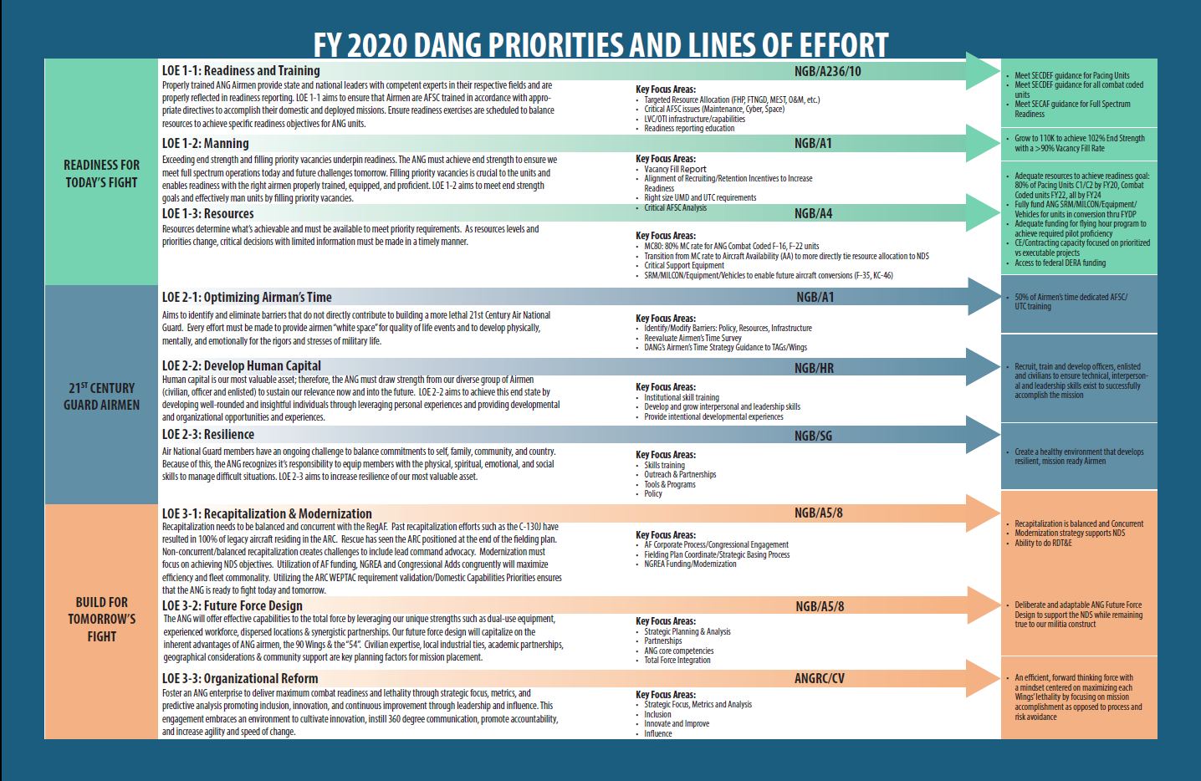
ANG Priorities

Slide 6
Tomorrow’s Fight: Recapitalization & Modernization
END STATE: Recap is balanced / concurrent; Mod strategy supports the NDS.
FOCUS AREAS: Involvement/Participation in AF Corporate Process/Congressional Engagement WSC involvement Future Missions & ANG Capstone Principles Fielding plan coordination Strategic Basing Process WEPTAC/DCP prioritized NGREA funding for modernization FY18 NGREA $429,000,000, FY19 NGREA $421,000,000, FY20 NGREA $TBD
Sub-metrics
2020
- Burlington achieves IOC
- OLR/HC 100% fielded
- 2 C-130J Basing Decisions
- Pease KC-46 IOC
- F-16 AESA ACA mod 50% Comp
2021
- +1 Sq C-130J Cong Add
- +2 Sqs F-15EX Cong Funding
- F-16 ACA ASEA 100% Comp
- $720M Cong Add for C-130 Upgrades
2022
- +1 C-130J Sq Cong Add
- Burlington achieves FOC
- +2 Sq F-15EX Cong Funding
- +720M Cong Add for C-130 Upgrades
- +$39M JWICS for 14 terminals
FY20 Plan of Action & Milestones | FY20 Initiatives | FY21 Initiatives
Recapitalization Milestones Requirements Development & Validation Strategic Basing Milestones | RECAPITALIZATION: F-35 Recap/beddown (Ops 2/5/6) Rescue Recap Fielding (OLR/CRH/HC) C-130J Basing (+2FY17, +6 FY18, +8 FY19) KC-46 MOB 2 beddown CAF Roadmap MODERNIZATION: C-130H Modernization (AMP, Engine, Props) F-16 ACA AESA ANG C-130H Test Det’s stand-up in progress KC-135 LAIRCM Block 30 test & fielding/RTIC Software Capability Space EW | RECAPITALIZATION: C-130J Recapitalization (+8 Cong Add) Develop SCIF Roadmap MAF Roadmap F-15EX Cong Funding/Fielding Plan Light Attack Cong Funding/Fielding Plan MODERNIZATION: JWICS Roadmap to modernize & secure C2 ISR collection, analysis, dissemination F-16/F-15 AESA in-line with CAF Roadmap C-130H Modernization (AMP, Engine, Props) KC-135 LAIRCM Block 30 test & fielding MAF RTIC Dedicated HH-60/KC-135 Test ACFT

Slide 7
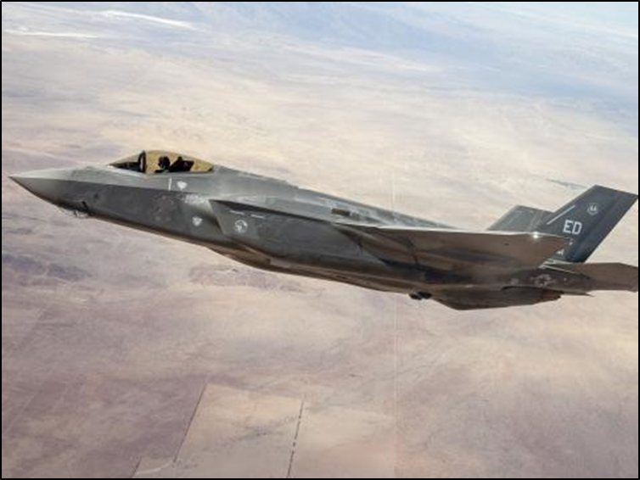
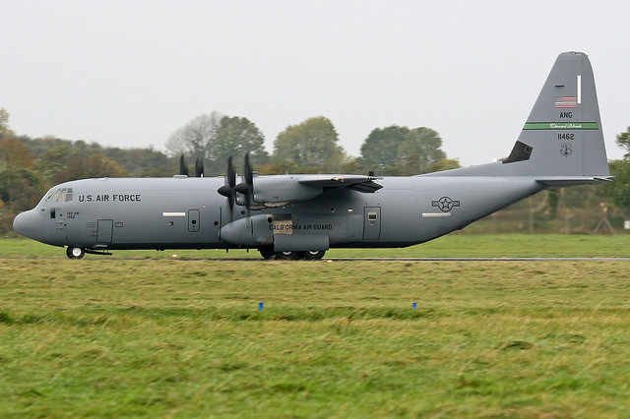
Recapitalization
Budget Uncertainty
Sole Owner Problem

Slide 8
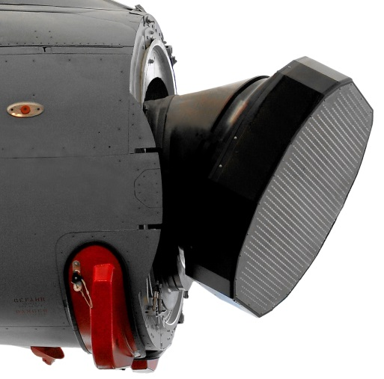
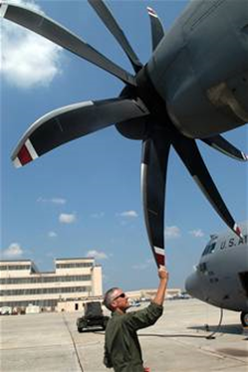
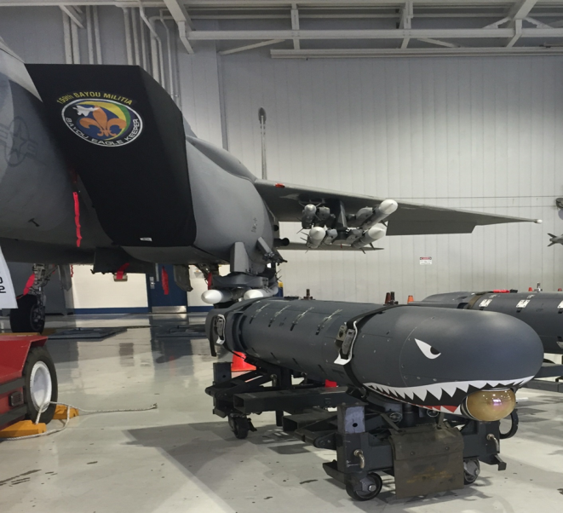
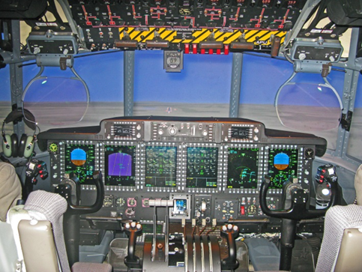
Modernization
Challenges
Opportunities

Slide 9
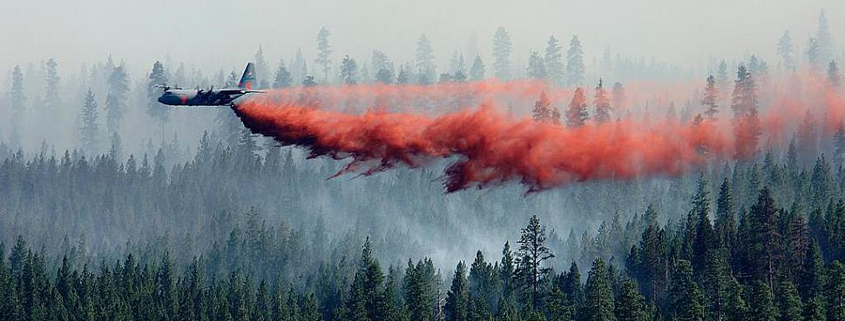
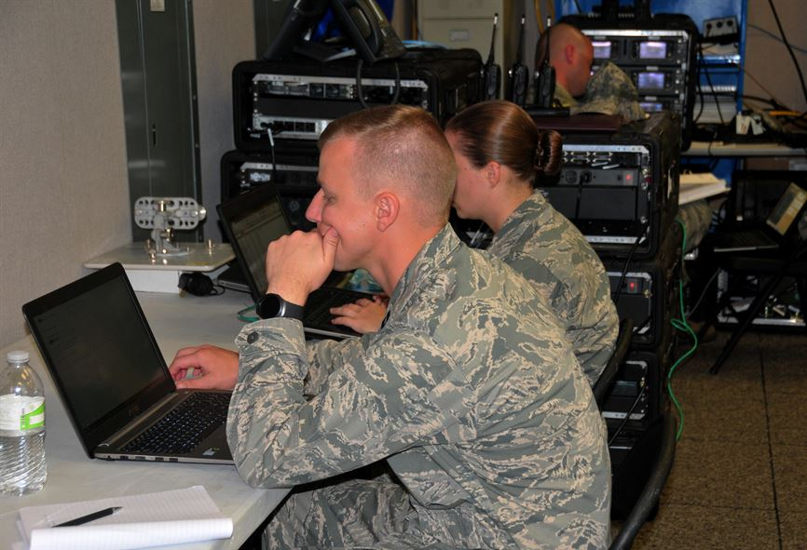
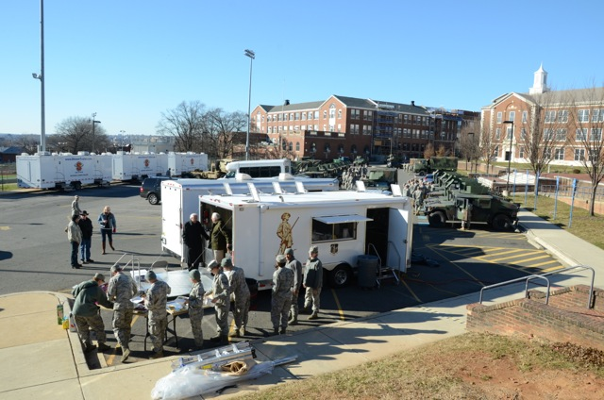
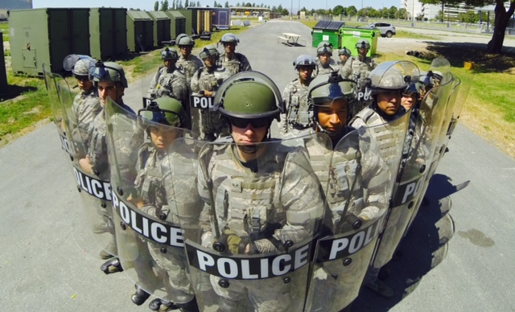
Dual Mission
Federal & State Missions

Slide 10
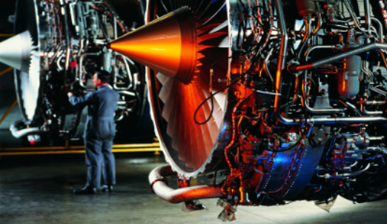
ANG and Industry
Cooperation
Alignment

Slide 11
QUESTIONS
Notes:
So with all of that as a framework for the future of the Air Guard, I want to know what is in your minds. What questions do you have for me? Q & A (15 minutes)

