Slide 1
NGAUS Industry Day
NGB/A5 Brief
Col Daniel J. Begin
Deputy Director, NGB/A5/8
10 Dec 2019

Slide 2
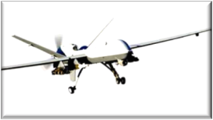
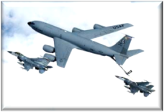
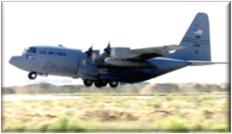
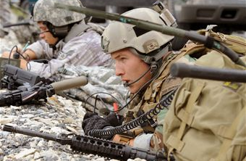
A5 Objective
Right capability in the hands of the warfighter…NOW!
Notes:
ANG seeks to put effective capability in the hands of the warfighter on a shorter cycle than AF is capable of
“80% of the capability at 20% of the cost”

Slide 3

The Problem
Notes:
ANG seeks to put effective capability in the hands of the warfighter on a shorter cycle than AF is capable of
“80% of the capability at 20% of the cost”

Slide 4

NGB/A5 Mission
Represent the ANG in DoD Requirements Development Processes
Identify, Verify, Validate and Field Material Solutions for ANG Airman Operating at Home and Abroad
Develop, Coordinate and Execute ANG Modernization Plans in Support of NGB and AF Leadership
4
Notes:
We are at the table as a voting member in the AFRRG and AFROC, and advise MAJCOMs, COCOMs and AF in the development of requirements relevant to ANG missions and platforms. This participation in, and understanding of, the Joint and AF Requirements Development process is fundamental to our daily business in A5.
NGB/A5 works with J-staff, AF and OSD to coordinate modernization plans. We work closely with MAJCOMs, COCOMs, and within NGB to formulate plans for modernization of the ANG fleet. Our System Modernization Plans (SMPs) address critical modernization requirements, anticipate future requirements, and include a long-term “vision” (10-15 years out) for every weapon system in the ANG.
Each year, Congress appropriates procurements funds (NGREA) directly to the ARC; NGB/A5 is responsible for ANG’s portion of that money, and must obligate it to address validated combat and domestic modernization requirements. Once a capability gap is identified, we work with industry, test organizations and the SPDs to field required material solutions.

Slide 5
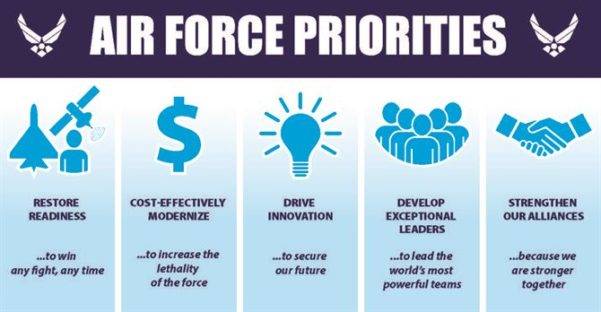
Air Force Priorities

Slide 6
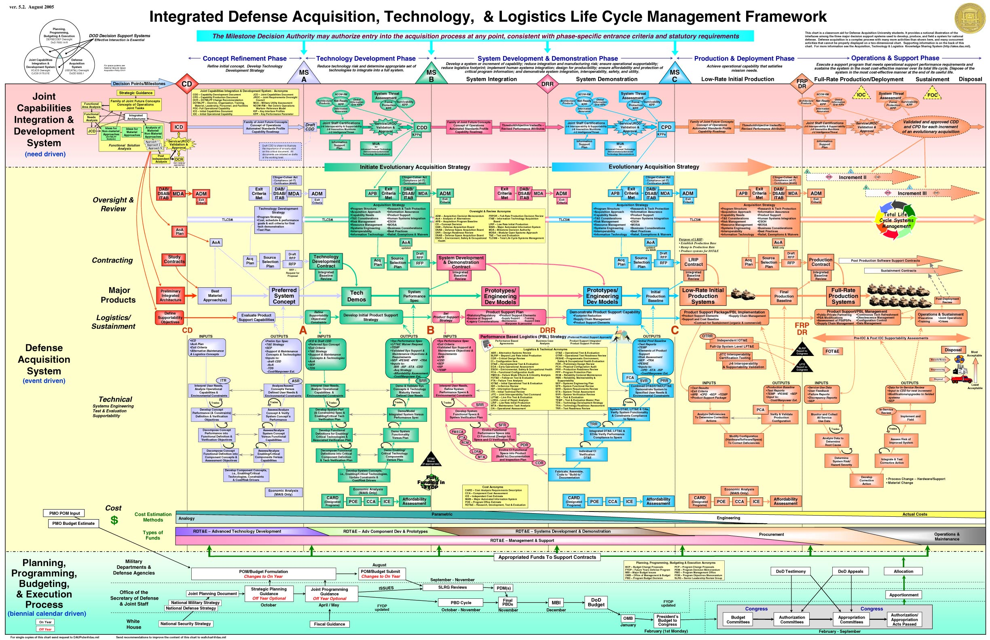
The System We Have

Slide 7
The System We Want
Seven Steps for Incorporating Rapid Prototyping into Acquisition – 10 April 2018 Memo, SAF/AQ (Dr Roper)
  Step 1: Have an aggressive goal
  Step 2: Bound your risks
  Step 3: Be aggressive but not greedy
  Step 4: Constrain time and budget, not the final performance
  Step 5: It takes a team to go fast
  Step 6: Get a signature from me
  Step 7: GO FAST
Notes:
7

Slide 8
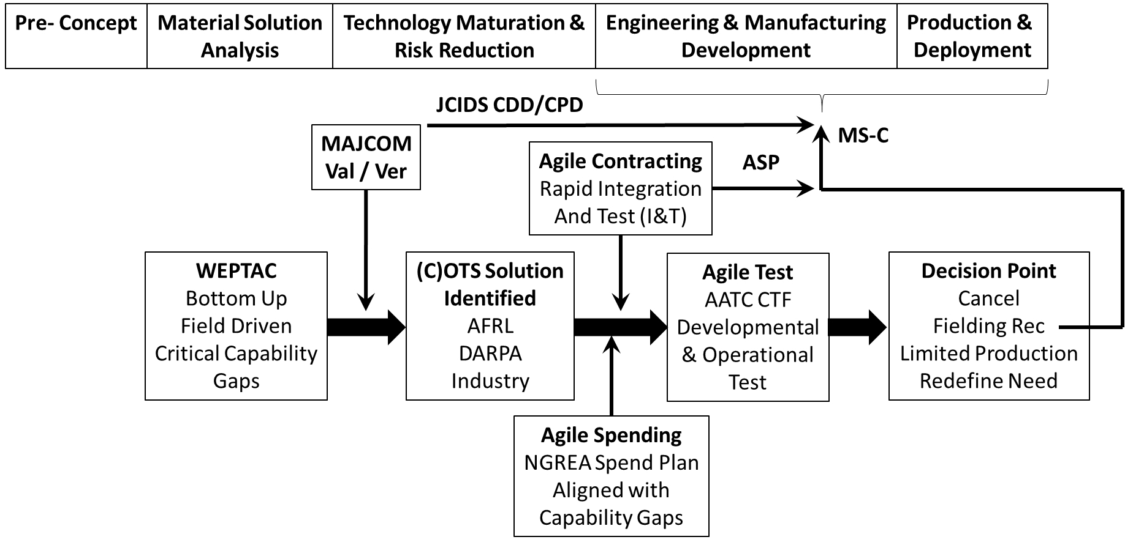
Reserve Component Model
*
*Alternate acquisition path is built on the principles of provisions in section 804, FY16 NDAA and 847, FY17 NDAA - referred to as "middle tier acquisition.”

Slide 9
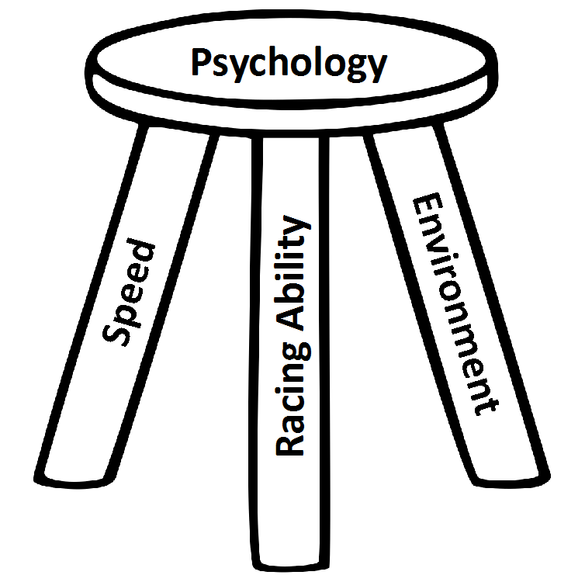
A5 Modernization Principles
“80% Capability at 20% Cost”
Partner with Industry
Maximize Previous Investments
  Legacy Aircraft
  Pods / Sensors
Cross-Platform Utilization
  Targeting Pods
  Datalink / Communications Packages
Cross-Platform Communication
Integrated/Interoperable/Joint Architecture
Modular / Adaptable Architecture
Non-Proprietary OFPs
Spiral Development
  Field Interim Capability ASAP
Work with Research Labs- AFRL/DARPA/DIU
Rapid Contracting Options- DMEA/NSPA
Fielded Material Solutions
Warfighter Input
Defense Industrial Base
USAF Corporate Process
Notes:
9

Slide 10
ANG Modernization Challenges
USAF Recapitalization Pressures
Budget Control Act / Sequestration / Fiscal Constraints
Increased Transfer of Legacy Aircraft to the ARC
Increasing Age of Legacy Aircraft / DMS
Sustainment Pressures
Ongoing Contingency Operations
Fleet Management Issues
Expanding ANG roles into all USAF Core Functions
Notes:
10

Slide 11

























NGB/A5
Col Dan Begin Deputy Director, Plans and
Requirements
Mr. Frank Ballinger, GS-15 Associate Director
SrA Carla Conley
NGB/A5E, Exec Support
Col Scott Gillion, NGB/A5R
Operational Requirements
Division
Col Brett Robinson
NGB/A5P
Programs Division
Mr. Mikey Graham, GS-14
NGB/A5X, Plans Division
Maj JT Thomas (Acting) NGB/A5RM MAF Branch
Maj Autumn Lorenz NGB/A5PS, C4ISR, Space
Branch
Ms Nikki Morris NGB/A5XS
Doctrine Branch
Lt Col Jason Halvorsen NGB/A5RC, CAF Branch
VACANT
NGB/A5PA, Agile Combat Support Branch
VACANT
NGB/A5XP, Strategy & Resources Branch
Maj Curtis WIlson NGB/A5RS, Special Mission Branch, CSAR

Slide 12
A5R Operational Requirements
Combat Air Forces
  A-10
  F-15C
  F-16CM
  F-16C+
  F-22*
  F-35*
ISR
  E-8
  MQ-9
  RC-26
  MC-12
Advanced Sensor Pods
Mobility Air Forces
  C-130H
  C-130J
  LC-130
  KC-135
  C-17
  C-40
Rescue / SOF
  HH-60
  HC-130J
  EC-130J
  C-32
* No ANG modernization (yet)
Notes:
12

Slide 13
A5P Programs Division
Cyber Operations
Space Operations
Intelligence
Command and Control (C2)
Logistics
Communications – Domestic and Tactical Response
Domestic Operations / Homeland Defense
Notes:
13

Slide 14
A5X Strategy Division
Simulation, Distributed Mission Operations, and Range Instrumentation
Battlefield Airmen / Special Operation Forces
Medical
COCOM Coordination
Contracting
Funding Management
Notes:
14

Slide 15
Funding Sources
USAF Budget - Program Objective Memorandum (POM)
  Primary method of funding
Other Congressional Adds (procurement, RDT&E, etc.)
ANG O&M Fallout funds meet limited mod/equip reqmts
National Guard and Reserve Equipment Account (NGREA) –
  Procurement only; not tied to specific programs
  Amount is unpredictable
  Spend plan based on WEPTAC/DCP critical capability priorities, DANG and Congressional guidance
  Obligation rate objectives drive spend plan (80/90/100%)
  Spend plan due to Congress 30 days after appropriation
  Continuing Resolution
Annual ANG
NGREA Amounts
(Millions)
FY13 $460
FY14 $323
FY15 $415
FY16 $330
FY17 $247
FY18 $429
FY19 $421
FY20 $???
Nature of NGREA drives pursuit of low risk, off-the-shelf solutions

Slide 16
NGREA Distribution
$2.16B Total (FY14-19)

Slide 17
ANG Requirements Overview
Field-led working groups (weapons officers or equivalent) determine critical (1-3 years) / essential (3-5 years) / desired (5-10 years) capabilities shortfalls
Weapons & Tactics Conference (WEPTAC)
  Combat capability gaps and tactics/training
  Organized by Major Weapon System
  19-23 Oct 2020 at Air National Guard / Air Force Reserve Command Test Center (AATC), Tucson, AZ
Domestic Capability Priorities (DCP) Conference
  State level focus for DOMOPS capability
  Organized by Emergency Support Function (ESF)
  4-8 May 2020 in Denver, CO
Critical capability gaps directly influence annual NGREA Allocations
Gaps must be paired with a valid Air Force / OSD requirement
  Off-The-Shelf Solutions – available today
  Staffed through lead MAJCOMS and SPOs for approval
  Agility in Operational Test – “fly before we buy”
Bottom-Up Construct Ensures Relevance to Immediate Needs

Slide 18











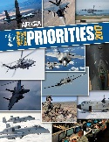




WEPTAC/DCP & NGREA
WEPTAC / DCP Working Groups
Congress
Critical
- Essential
- Desired
Out Brief
DoD Budget
(NGREA)
Approval
Submission Process
Validation
Verification
NGREA Spend Plan
Sr. Leadership
Congress
Industry
Air Force
Test & Field Capability

Slide 19
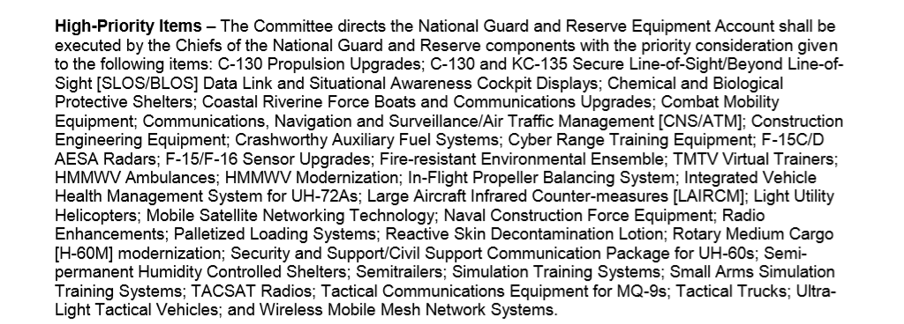
Additional Guidance
DANG Direction
Congressional Input
Notes:
19

Slide 20
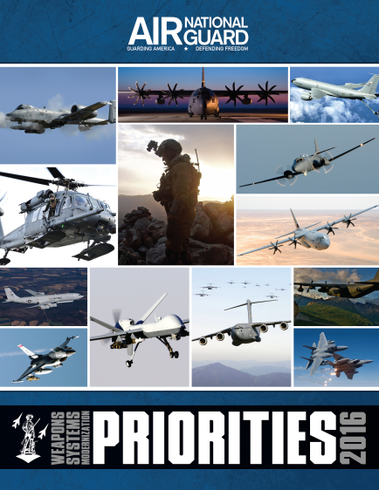

Modernization Book Process
  ANG’s sources for modernization priorities
    Priorities from the field working groups
    Produced for both WEPTAC and DCP councils
    Prepared by NGB/A5; approved by the ANG Director
  Mod Book arranged by major weapon system (MWS)
    All ANG MWSs represented
    Aligns with AF Service Core Functions
  DCP Book arranged by Emergency Support Function (ESF)
    Aligns ANG’s response capabilities with DHS/FEMA
  Mod & DCP books to industry, Air Force, OSD, Congress

Slide 21
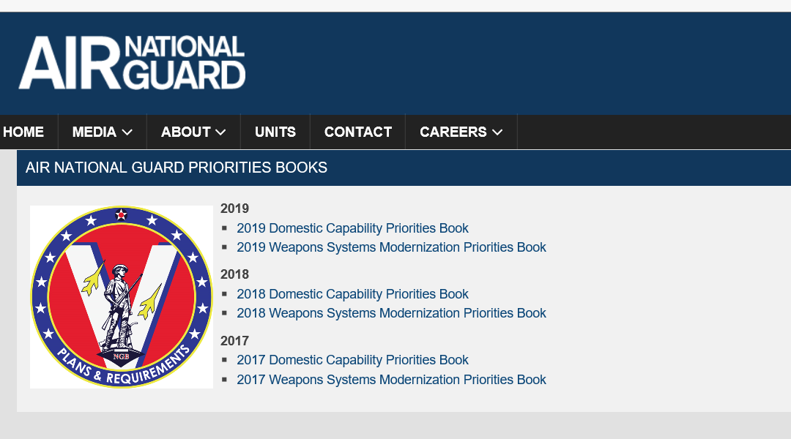
Modernization Books
http://www.ang.af.mil/Home/ANG-Priorities-Books/

Slide 22


AATC - Integrated Test
Operational Test & Evaluation (OT&E) assesses utility and maturity
  Mix of weapons experts and test pilots
Integrated approach
  AATC project managers work closely with NGB/A5
  Constant operator input maintains focus and speeds decisions
ANG PMs are in place longer; lead projects from creation to fielding
  Continuity builds relationships with SPOs, enhances efficiency, and speeds progress

Slide 23
Modernization Snapshot - 1 Meter Targets
Combat Air Forces
  F-16 - AESA Radar for all ANG aircraft (not just 372 POR); ALR-69A test/fielding
  F-15 - ALQ-128, IRST fielding, Pod-to-Pod communications
  A-10 - Field necessary High Resolution Display and Increased Helmet Mounted Cueing Accuracy
  MQ-9 - Ghost Reaper concept / First operational Ground Based Detect & Avoid Radar system, Agile / LITENING Pod integration
Mobility Air Forces
  C-130H - Successful fleet-wide NP-2000/T-56 3.5 fielding and on-time Avionics Modernization Program Increment 2 POR
  KC-135 - On-time Real Time Information in the Cockpit fielding and High Value Airborne Asset material solution development (i.e. DRWR, Active Expendables)
Special Operations Forces / Personal Recovery
  HC-130J/EC-130J - Accelerate fielding Link 16 capability (vice waiting for Block 8.1 upgrade in 10+ years); Improved/Second EO/IR Sensor
  HH-60 - Field Degraded Visual Environment Solution with Helmet Mounted Display, and snych OLR/CRH
Space / Cyber
  Continue to field more sophisticated/integrated training capabilities (i.e. Virtual Interconnected Training Environment, Space Control Satellite Emulation Suite)
  First major Cyber & Space NGB/A5 & AATC test efforts to take place in FY20

Slide 24
What’s Next?
1.5 Meter Targets
  Expanded common podded solutions - AMC/ACC/AFSOC platforms
  Data Link gateways / sensor nods across platforms
  Artificial Intelligence / Machine Learning
  5th to 4th generation secure Tactical Data Link communications
  Anti-jam GPS / P-N-T material solutions across platforms
  Fused sensor applications / mature Pod-to-Pod communications
  Cyber applications / synergies across multiple MDSs
3-10 Meter Targets
  cUAS material solutions / Air Base Defense
  Expanded Space capabilities
  Hypersonics material solutions

Slide 25
Key A5 Takeaways
NGB/A5 follows a field-driven modernization process
NGREA = direct appropriation to the ANG (with significant limits)
  Competition with multiple MDS and ANG domestic missions
  Year to year fluctuations drive immediately available, off-the-shelf solutions, preclude programming
NGB/A5 and AATC seek to partner with SPOs and Industry
  Seek right solution and right price within customer’s timeframe
  AATC brings a depth of test and PM expertise to the table
  IRAD is an extension of NGREA capability
A5 Objective: Right capability in the hands of the warfighter—now!

Slide 26
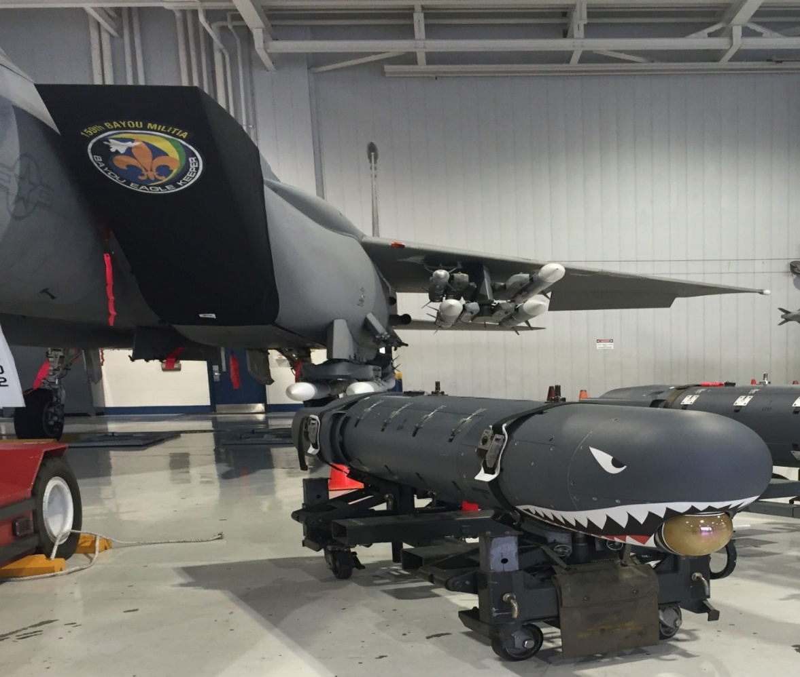
Questions/Discussion
Yes, We Procure “Sharks with Laser Beams”

